Slide 1
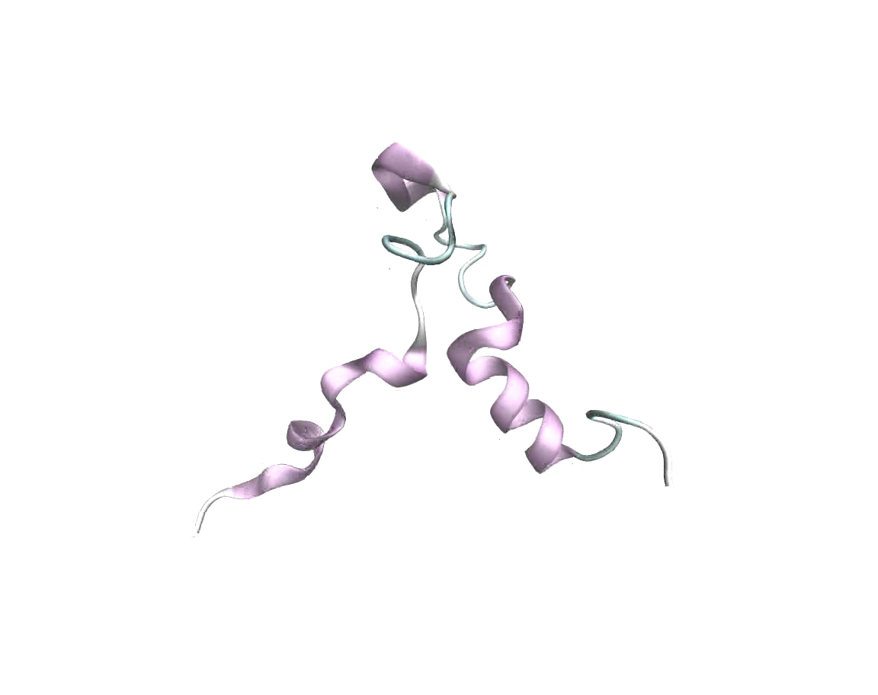
“Auto-Regulatory mechanism of enzyme activity by the nuclear localization signal of lysine specific demethylase 1”
Dulmi Senanayaka¹*, Danyun Zeng¹*%, Sahar Alishiri¹, Benjamin P. Brown², William J. Martin ^{2,3}, Khadijah I. Moore¹, Roshni Patel¹, Zigmund Luka³, Alexander Hirschi^{2,3}, and Nicholas J Reiter¹ &
Supplemental Movie (SM1): Trajectories from a 2 μs AMBER MD simulation from a low energy model derived from ab initio Rosetta. De novo model of human LSD1 (aa 100-151)

