Slide 1
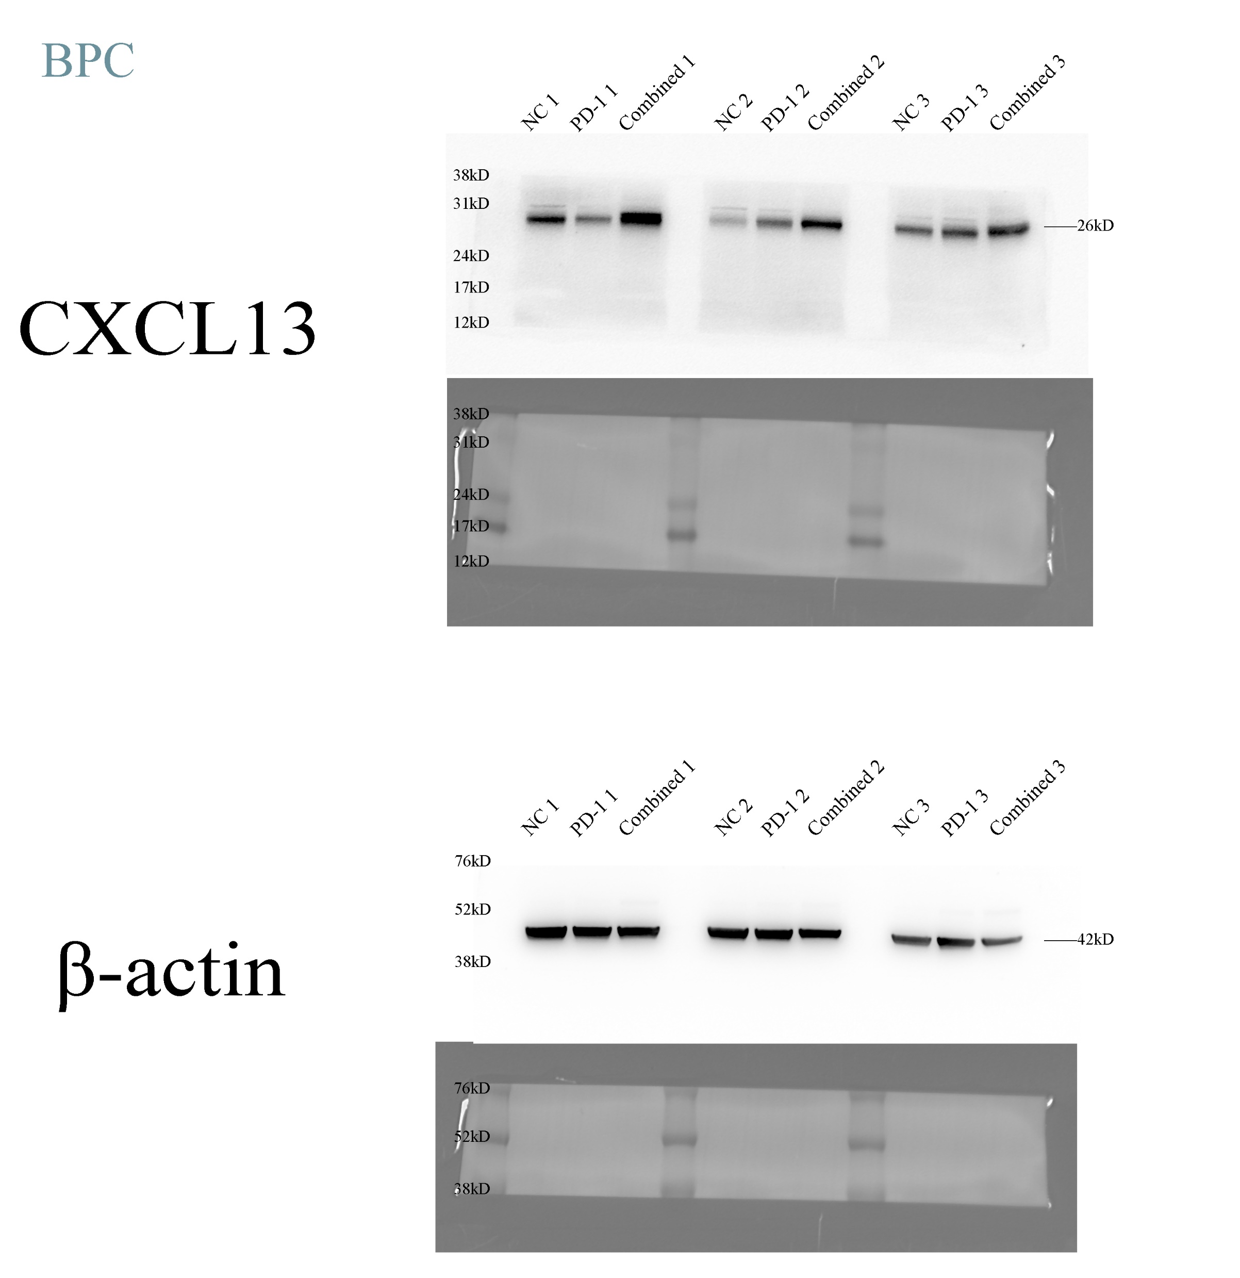
Full unedited blot/gel for Figure 7F

Slide 2
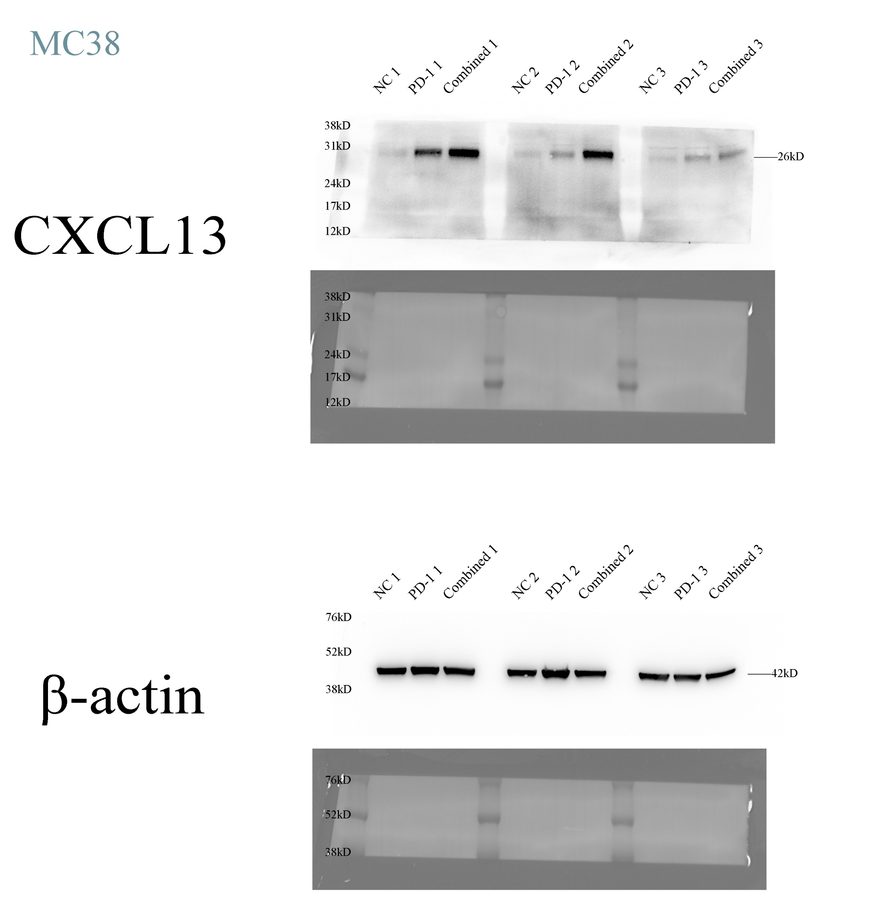
Full unedited blot/gel for Figure S13E

Slide 3
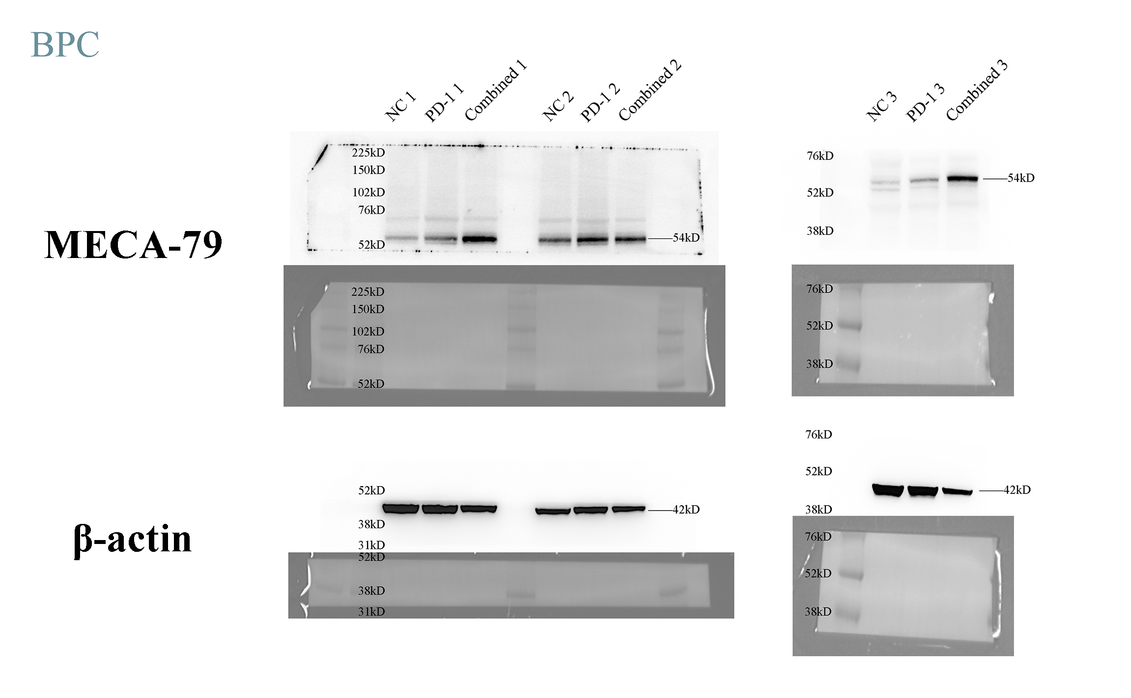
Full unedited blot/gel for Figure 7F

Slide 4
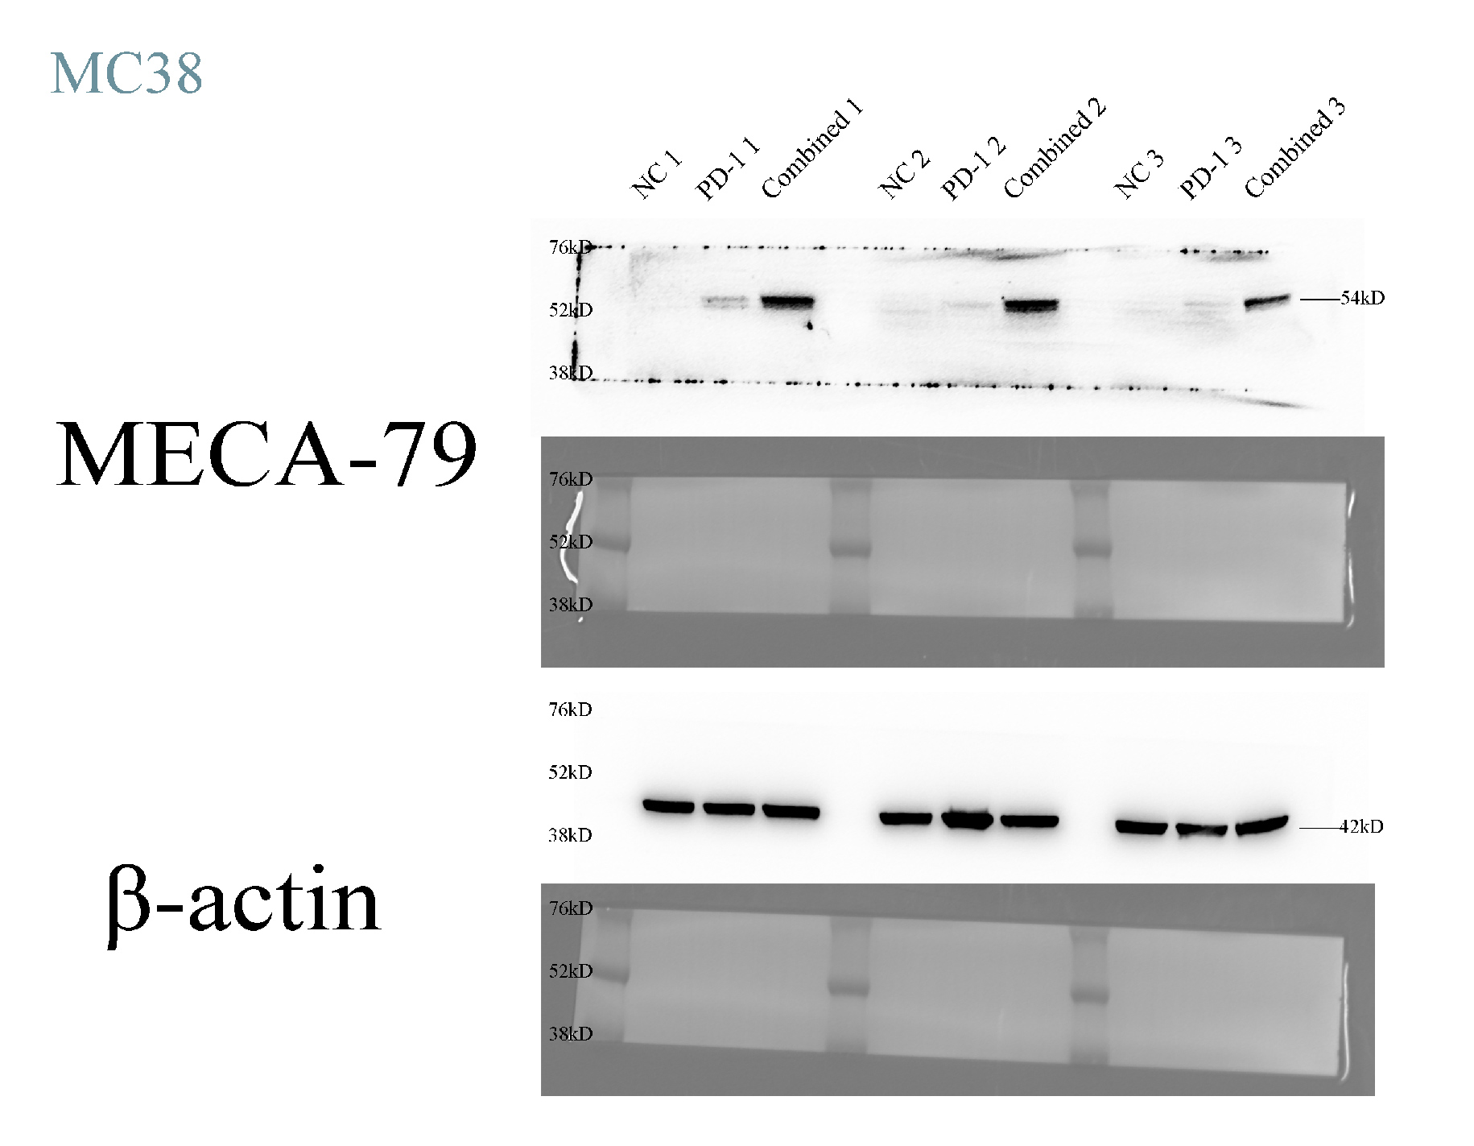
Full unedited blot/gel for Figure S13E

