Slide 1
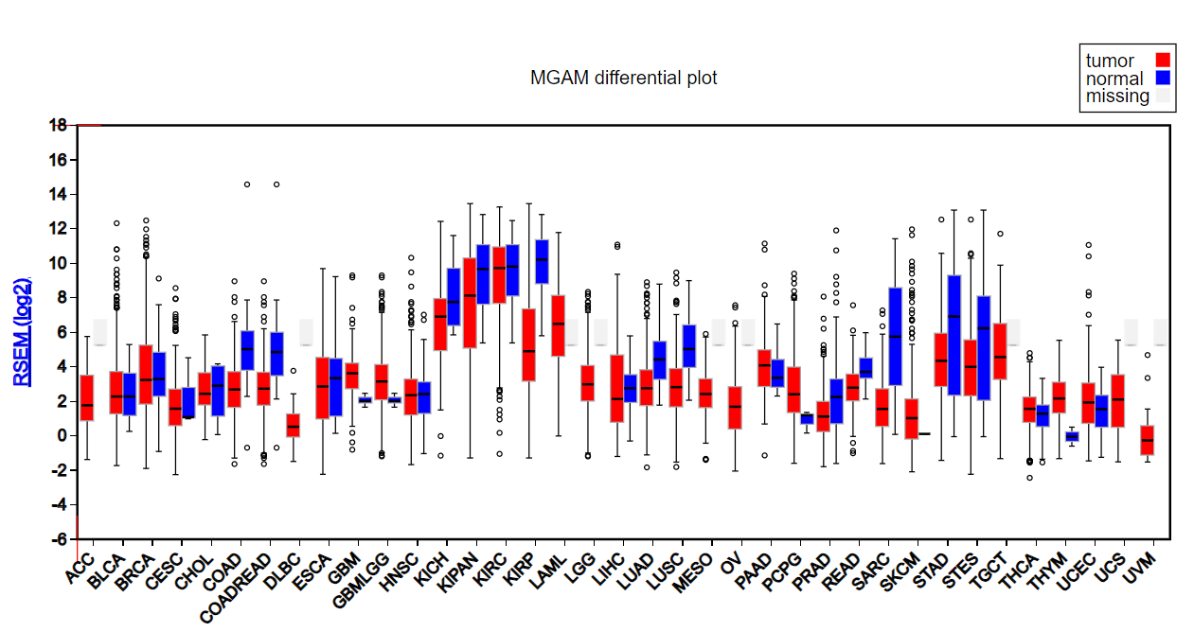
Notes:
Supplementary file 1. Pan cancer expression of MGAM based on Firebrowse database

Slide 2
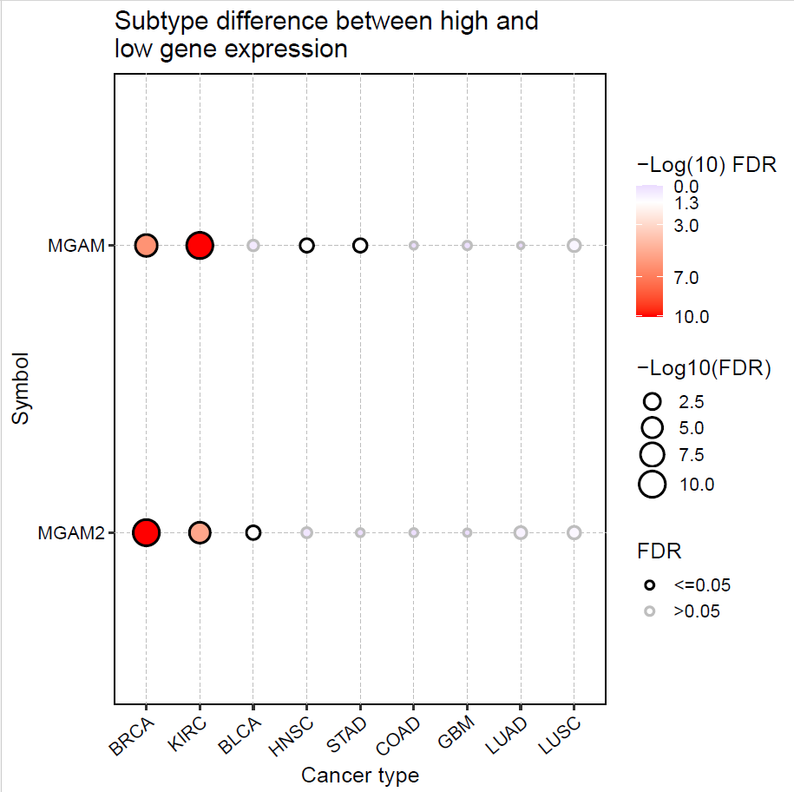
Notes:
Supplementary file 2. Correlation analysis between MGAM and MGAM2 gene expression and cancer’s subtypes

Slide 3
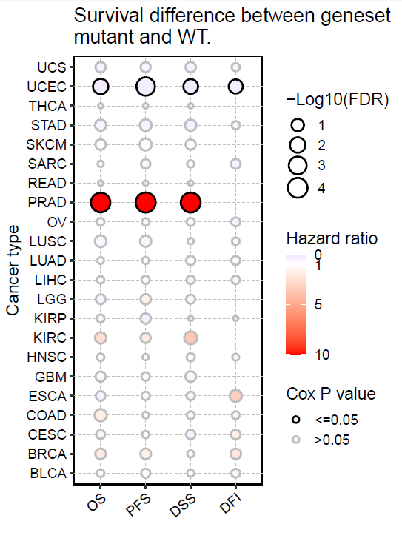
Notes:
Supplementary file 3. Correlation Analysis between MGAM SNVs, disease-specific survival (DSS) and overall survival (OS) and progression free survival (PFS)

Slide 4
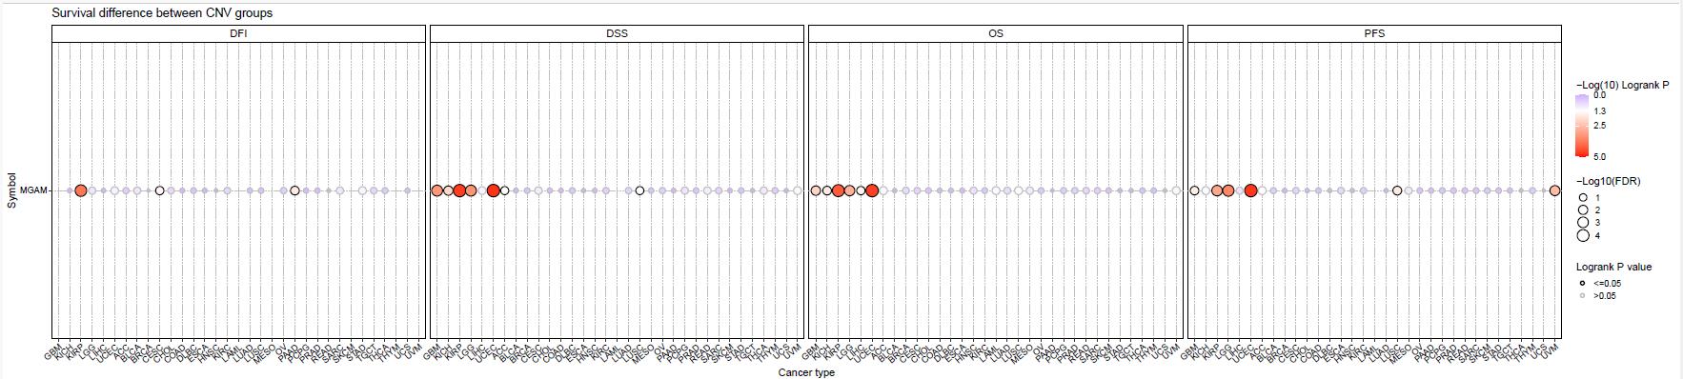
Notes:
supplementary file 4. Correlation Analysis between MGAM CNVs and overall survival (OS), disease-specific survival (DSS) and progression free survival (PFS)

Slide 5
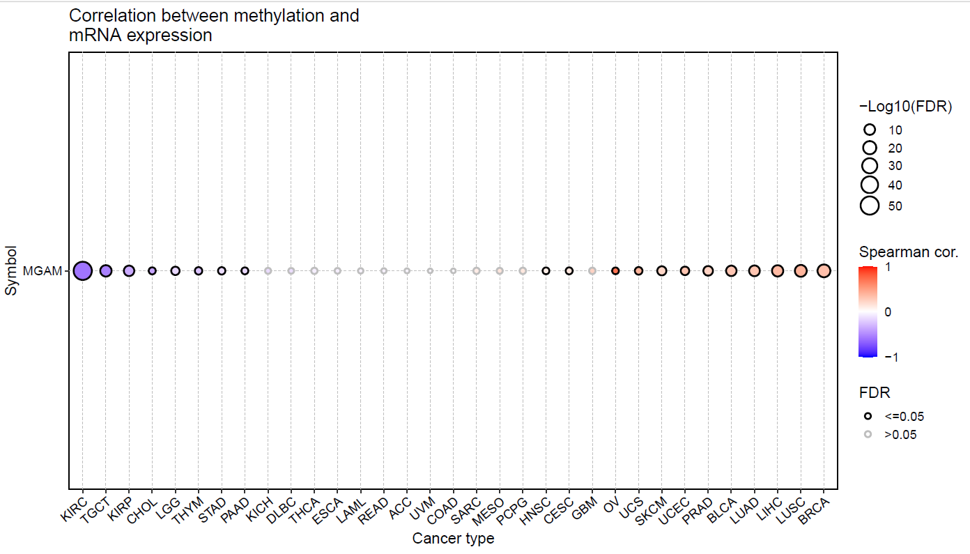
Notes:
supplementary file 5.Correlation Analysis between MGAM Expression and Methylation

Slide 6
Notes:
supplementary file 6. ROC curve analysis

