Slide 1
WB: β-actin (MDA-MB-231)
siRNA-SLMO2-1
siRNA-SLMO2-1
siRNA-SLMO2-2
siRNA-SLMO2-2
siRNA-scr
siRNA-scr
30s exposure
3s exposure
This image corresponds to figure 9A. This image is an unprocessed raw exposure.
Because the β-actin’s exposure signal is strong and the background is clean, the membrane edge is not clear.
Gel Imager System：Tanon 4600

Slide 2
WB: SLMO2 (MDA-MB-231)
siRNA-SLMO2-1
siRNA-SLMO2-2
siRNA-SLMO2-1
siRNA-SLMO2-2
siRNA-scr
siRNA-scr
15s exposure
30s exposure
1. siRNA-SLMO2-2 is not knocked down, so it is not shown in the text.
2. This image corresponds to figure 9A. This image is an unprocessed raw exposure.

Slide 3
WB: β-actin (A549)
siRNA-SLMO2
siRNA-scr
1s exposure
This image corresponds to figure 9A. This image is an unprocessed raw exposure.
Gel Imager System：Tanon 4600

Slide 4
WB: SLMO2 (A549)
siRNA-SLMO2
siRNA-scr
3s exposure
This image corresponds to figure 9A. This image is an unprocessed raw exposure.

Slide 5
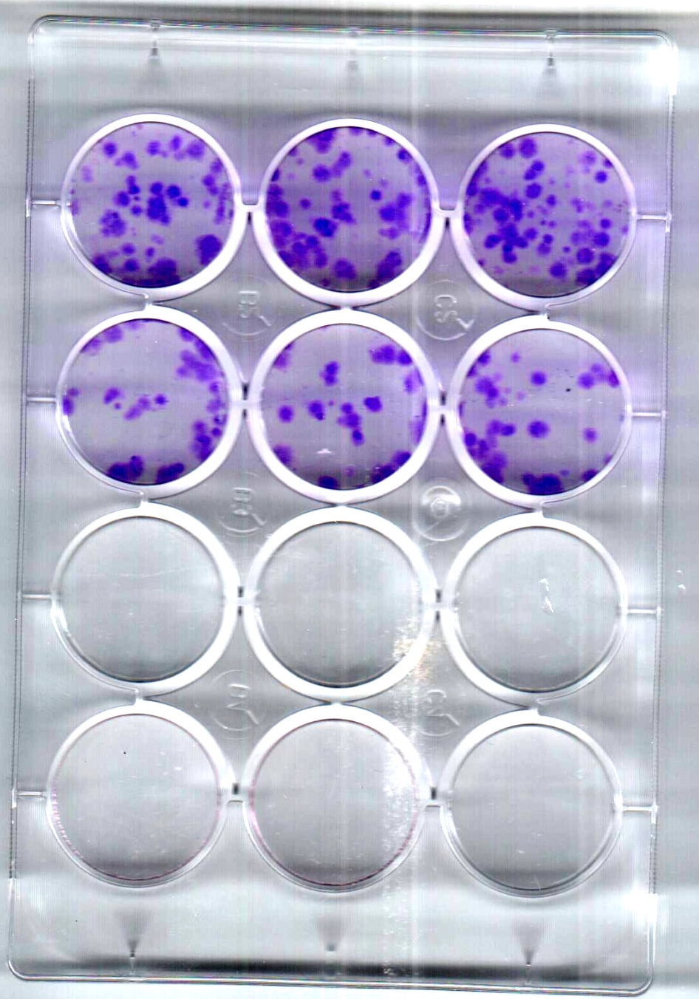
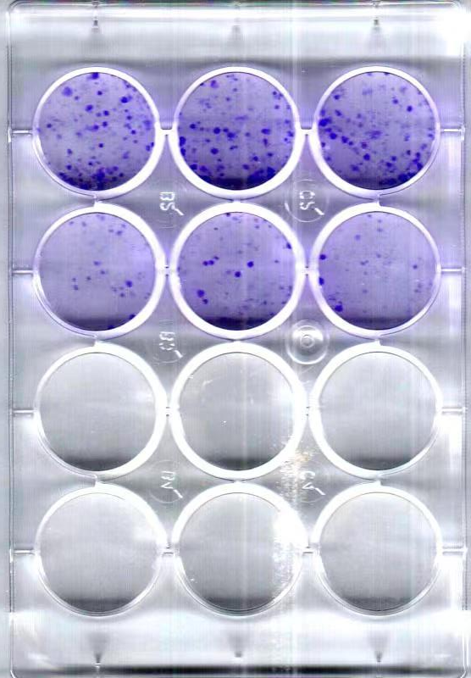
Clone formation assay
MDA-MB-23
A549
siRNA-scr
siRNA-scr
siRNA-SLMO2
siRNA-SLMO2

Slide 6
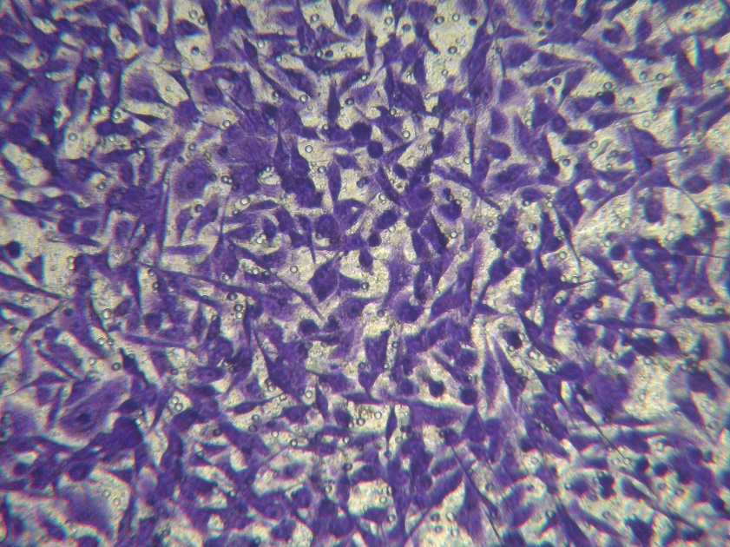
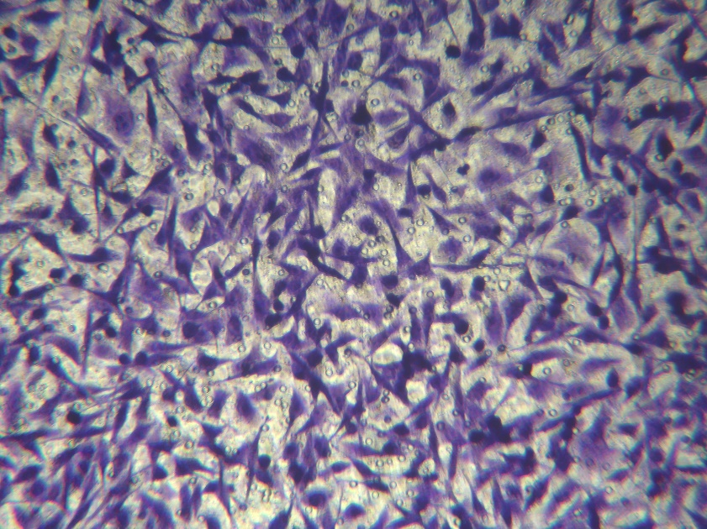
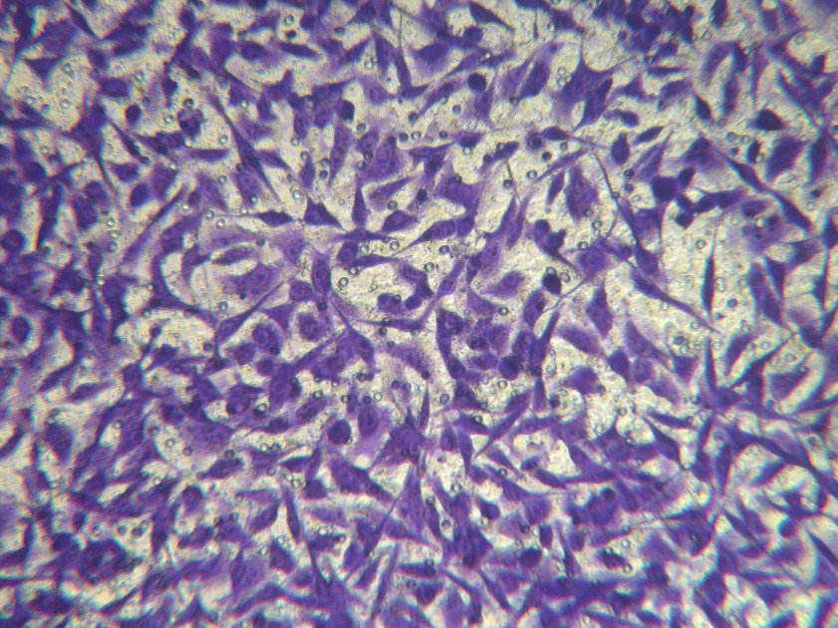
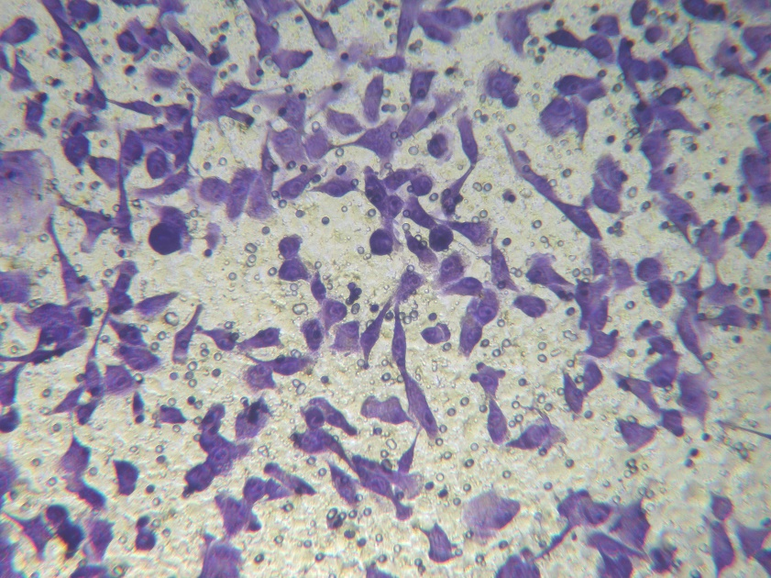
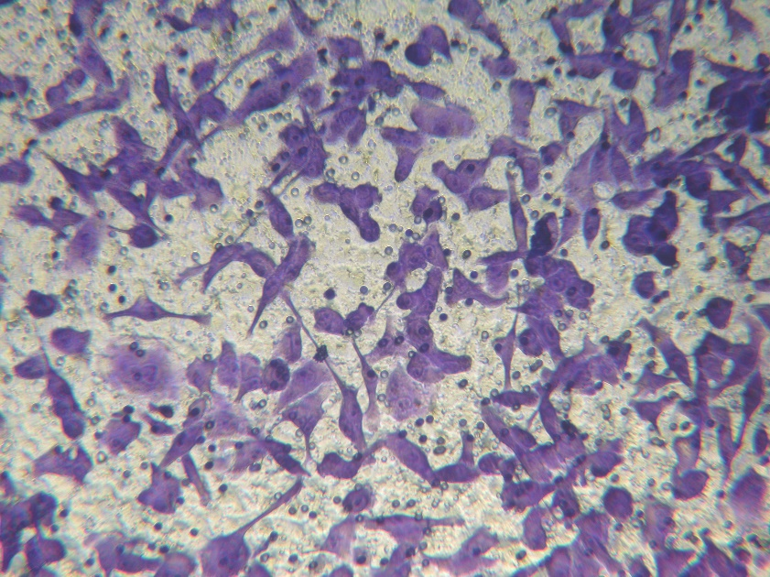
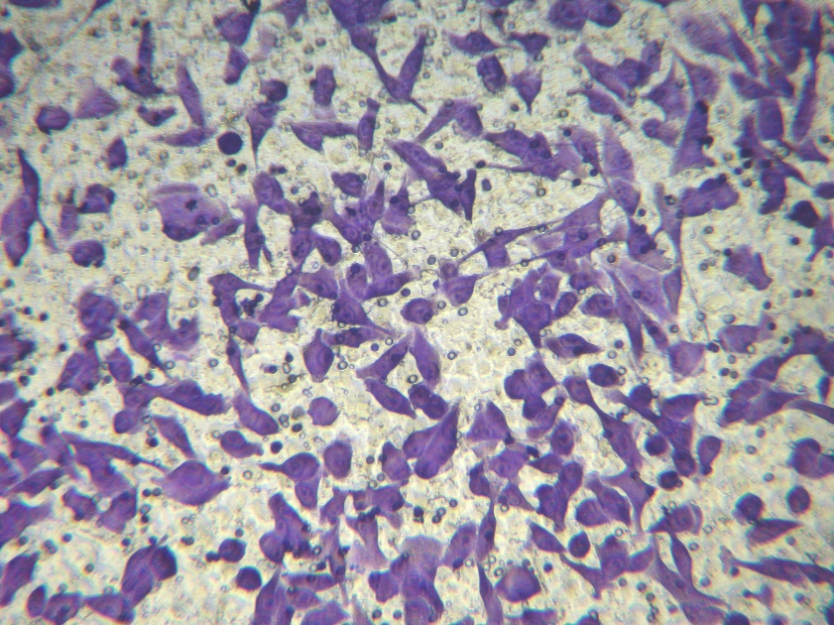
Transwell for cell migration
MDA-MB-23
siRNA-scr
siRNA-
SLMO2

Slide 7
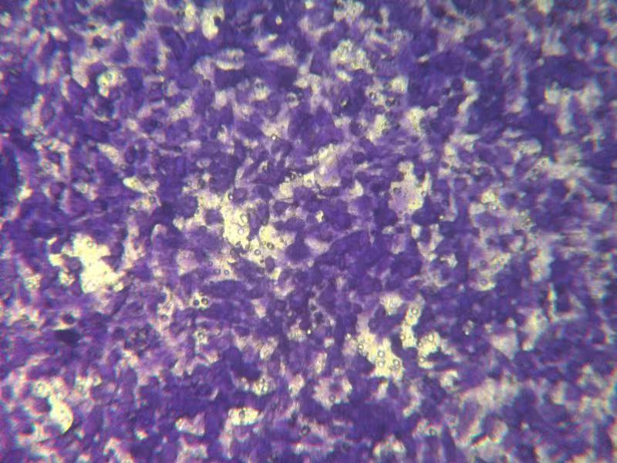
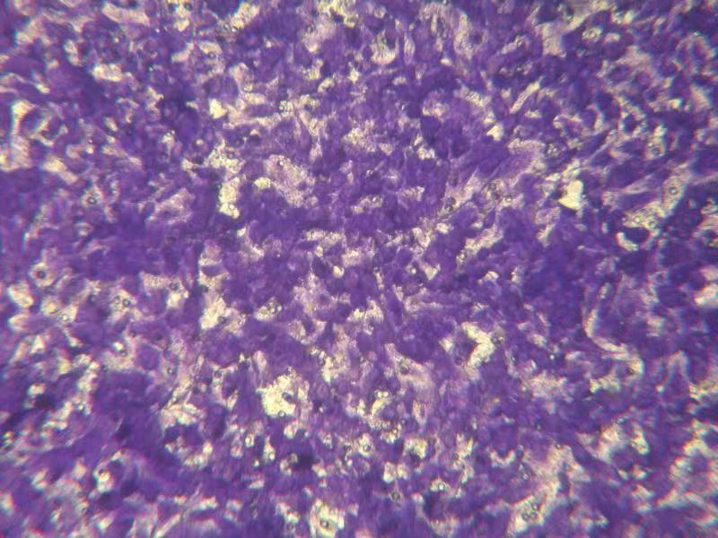
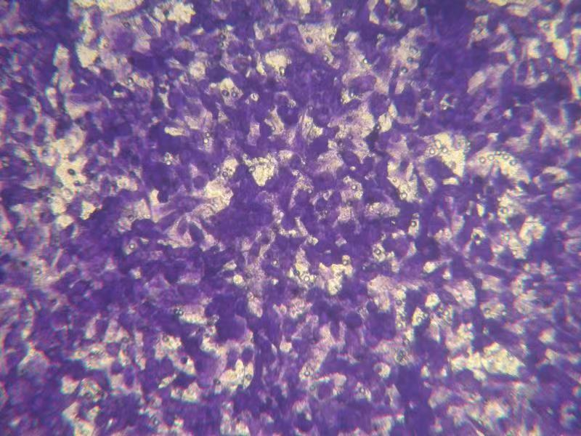
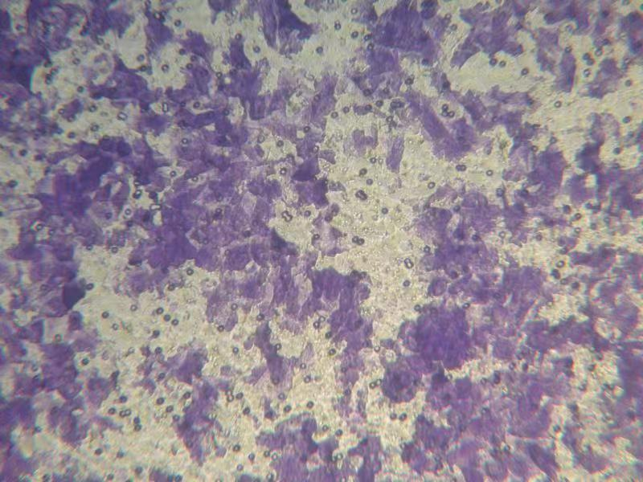
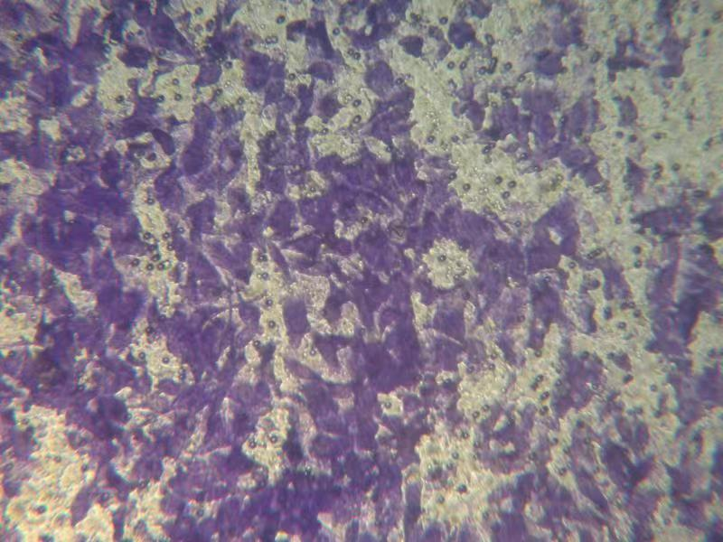
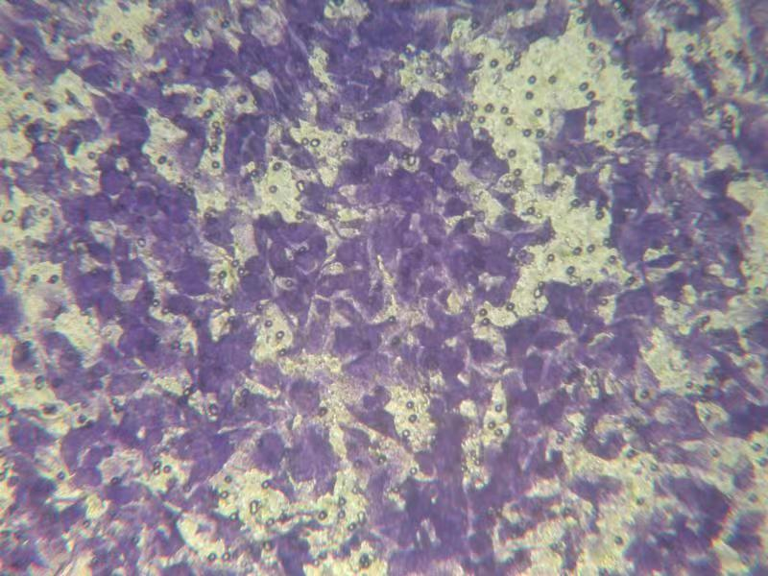
Transwell for cell migration
A549
siRNA-scr
siRNA-
SLMO2

