Slide 1
Supplementary Figure 1. Vectors used for DLR or GUS assays. I. Control vector contains Renilla LUC driven by the CaMV 35S pro. II. Reporter vector contains CsPT1 pro or CsPT4 pro driven firefly LUC or GUS.
I. Control
CaMV 35S Pro
Renilla LUC
II. Reporter
CsPT1/CsPT4 Pro
Firefly LUC or GUS

Slide 2
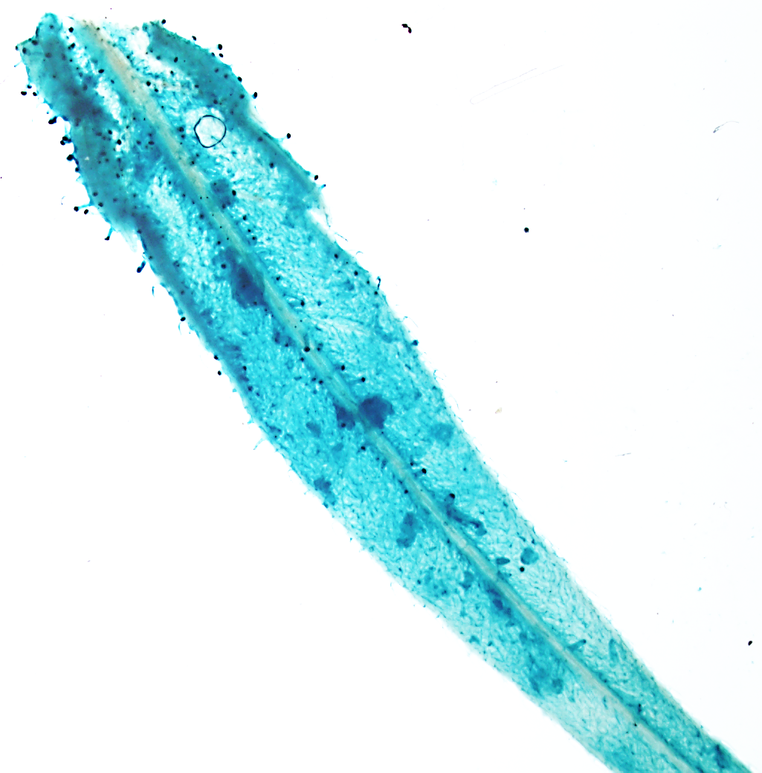
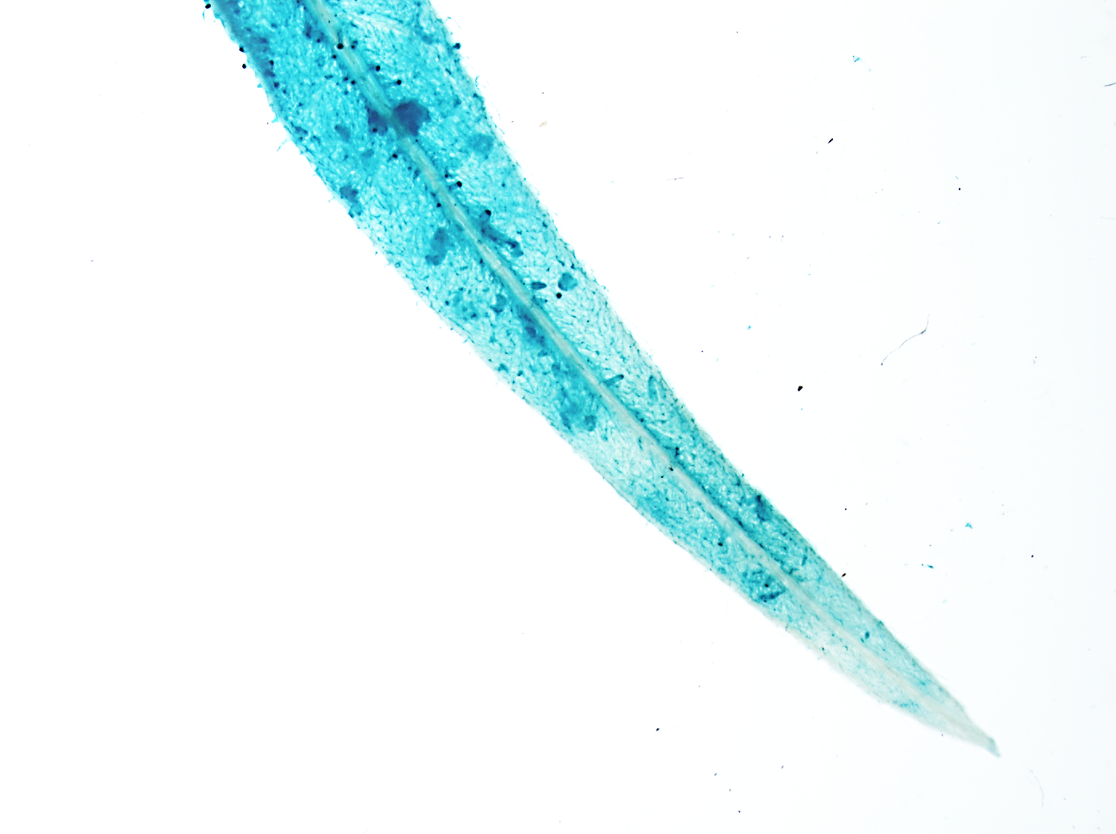
Supplementary Figure 2. A leaflet from a sugar leaf after GUS staining showing CsPT4 promoter activity. Higher promoter activity was visualized where the glandular trichomes are clustered toward the base of the leaflet.

Slide 3
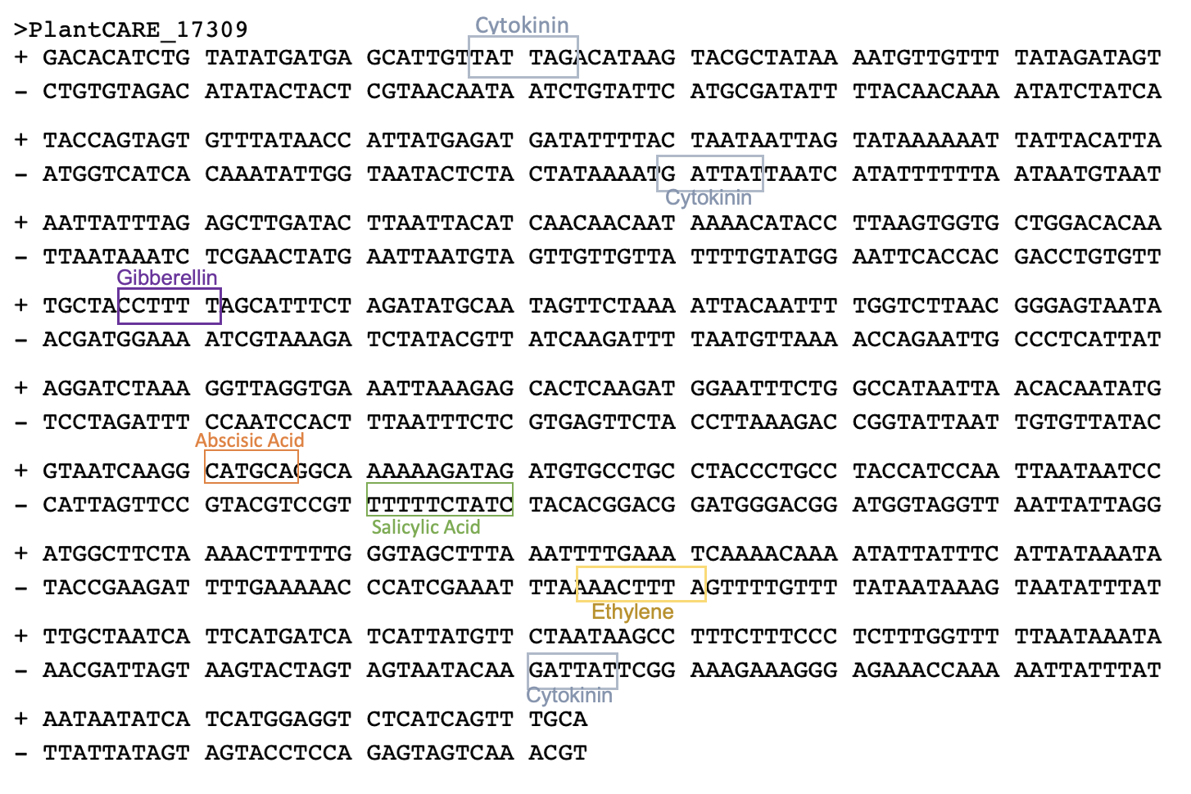
Supplementary Figure 3. Hormone responsive elements within the 600 bp region of CsPT4 pro from an in silico analysis using PLACE and PlantCARE.
Notes:
Supplementary information
See what Dr. Wang does about promoter databases
May have more elements we haven’t cloned – we aren’t sure exactly why we couldn’t clone the full region
Anticipate that we will have questions about why we only cloned the 600 base pairs
Why did we use Arabidopsis protoplasts? In the other organisms
We should ask somebody if different plant species have different elements
DOF1 – reasons good to cannabis does have a putative

Slide 4
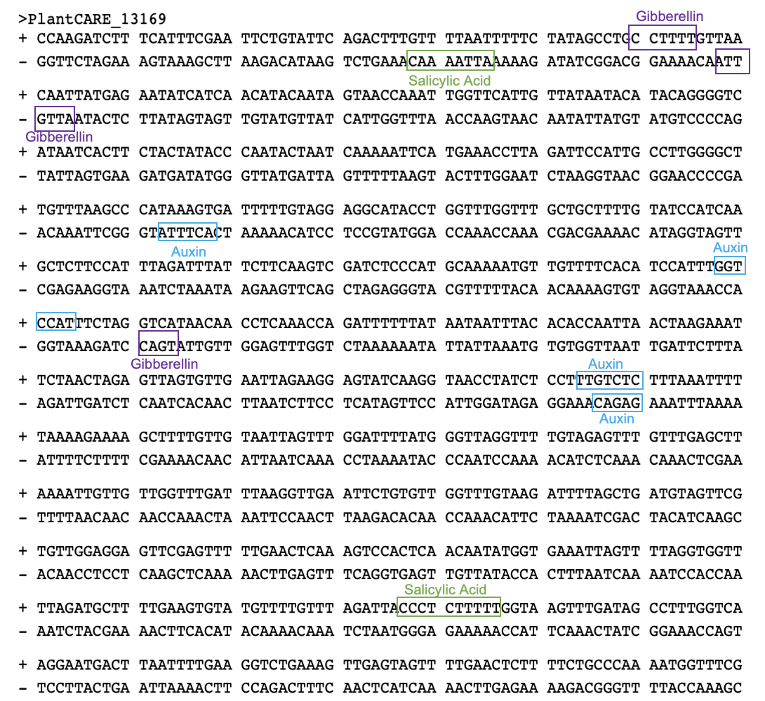
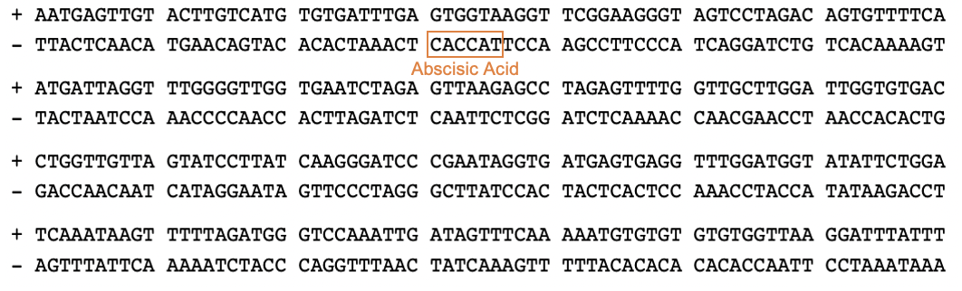
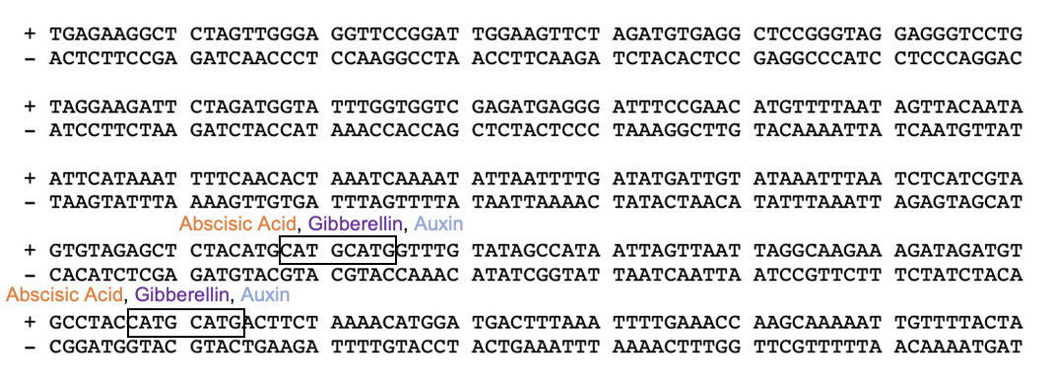
Supplementary Figure 4. Hormone responsive elements within the 1500 bp region of CsPT1 pro from an in silico analysis from PLACE and PlantCARE.
Notes:
Full promoter of PT1

Slide 5
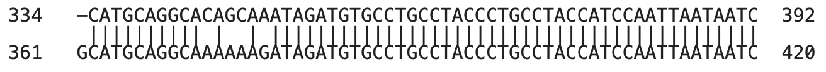
Supplementary Figure 5. Alignment of the original and site directed mutagenized SARE in CsPT4 pro. Four nucleotides are changed in the SARE, shown in red box and in Supplementary Table 3 in red font, to prevent binding from SA related transcription factors.
SDM
NON-SDM

Slide 6
Supplementary Figure 6. CBDA measurement following MeSA treatment. Slight CBDA increase was observed in treated plants compared to DMSO control plants (n = 3).

Slide 7
Supplementary Table 1. qPCR primers of Arabidopsis hormone responsive genes used in initial hormone experiment.
Hormone Group | Gene | Forward Primer | Reverse Primer
Cytokinin | AtARR2 | TCAGAGAACATCTTGCCTCGT | CGCGTTTTAGCTGCGAGTAG
Auxin | AtSAUR41 | CCACCCGATCTTCGTTGGTT | GACCCTTCAAACCCTCCCAA
Gibberellic Acid3 | AtGA3OX | GGGGTGCCTTCCAAATCTCA | ACAGGTAGCCCGAAGAGACT
Salicylic Acid | AtNPR1 | TCATTGCCGGAAGAGCTTGT | ACAGGTAGCCCGAAGAGACT
Abscisic Acid | AtCOR78 | CGGGATTTGACGGAGAACCA | GGTCTCTTCCCAGCTCAGTC
Ethylene | AtERF1 | CTAATCGAGCAGTCCACGCA | GTCCCGAGCCAAACCCTAAT
Methyl Jasmonate | AtJAZ10 | TCCCATCGCAAGGAGAAAGT | AGGCCGATGTCGGATAGTAAG
Housekeeping Gene | AtGAPDH | CTCCCATGTTTGTTGTTGGTGTCA | CTTCCACCTCTCCAGTCCTTCATT

Slide 8
Supplementary Table 2. Primers used for cloning, SDM and qPCR of cannabinoid biosynthetic genes.
Gene | FWD Primer | REV Primer
CsPT1 | TTGCTGGGATTATCTGGCCC | CTGCTTCCGGGTCGTAATTTG
CsPT4 | CCATATCGAGTCATGTGGGCT | CCATATCGAGTCATGTGGGCT
CBDAS | CAGCAATTCCATTCCCTCAT | ATCCAGTTTAGATGCTTTTCGT
GPPS ssu | AGTTCACGAGGCCATGTACA | AAGGGAGGTGGTCATGAGTG
CsOAC | TCACAGAAGCCCAAAAGGAAGA | TACCCCTGCAATGGCAAACA
CsTKS | TCTTCACTAGCGCATCAACC | GAACGGTTCCACCACCATAA
CsUbiquitin | TACTGCGCCAGCTAACAAACC | GCACCCGTCTGACCTGAATC
CsPP2A | AGCAACGTTCAGCCCGTTAA | GACACTTCCCTCCAATTCGAAA
CsPT4 promoter | GGACACATCTGTATATGATGAGC | GGACTCTCATTAGTTTGTACCTTTTC
CsPT1 promoter | TCCAAGATCTTTCATTTCGAATTC | ATAGTAAAACAATTTTTGCTTGGTTTC
Attb1/2 sites | GGGGACCACTTTGTACAAGAAAGCTGGGTC | GGGGACCACTTTGTACAAGAAAGCTGGGTC
CsPT4 promoter SDM Primers | CATGCAGGCACAGCAAATAGATGTGCCTGC | CTTGATTACCATATTGTGTTAATTATGGCCAGAAATTCCATCTTG

Slide 9
Supplementary Table 3. qPCR of hormone responsive genes in response to various concentrations of their corresponding hormones
Hormone | Responsive Gene | Concentration (uM) | Fold Change (relative to control)
NAA | Small Auxin Upergulated 41 (SAUR41) | 5 | 0.79
 |  | 10 | 1.52
 |  | 50 | 0.82
ABA | Cold Regulated 78 (COR78) | 5 | 0.88
 |  | 10 | 2.72
 |  | 50 | 2.42
SA | Non-Expressor of Pathogenesis Related Genes 1 (NPR1) | 5 | 1.26
 |  | 10 | 1.49
 |  | 50 | 1.83
GA₃ | Gibberellin 3-Oxidase 1 (GA3OX) | 5 | 0.19
 |  | 10 | 2.25
 |  | 50 | 3.5
ZR | Arabidopsis Response Regulator 2 (ARR2) | 5 | 0.41
 |  | 10 | 1.08
 |  | 50 | 0.91
MeJA | Jasmonate-Zim-Domain Protein 10 (JAZ10) | 5 | 1.85
 |  | 10 | 2.13
 |  | 50 | 1.94
ACC | Ethylene Response Factor 1 (ERF1) | 5 | 0.75
 |  | 10 | 1.09
 |  | 50 | 0.73
Note: Initial hormone experiment conducted in transfected Arabidopsis protoplasts. Multiple hormone concentrations were administered to the protoplasts. Highlighted in yellow is the gene expression level for the concentration to be used in DLR assays.

