Slide 1
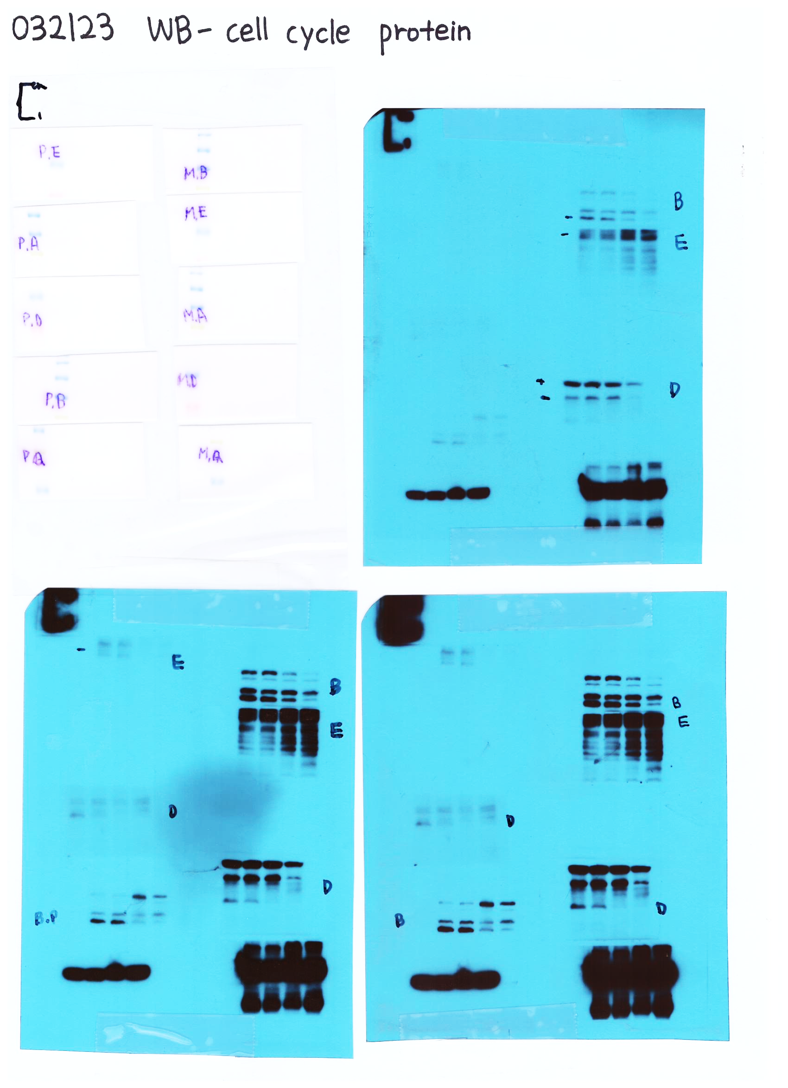
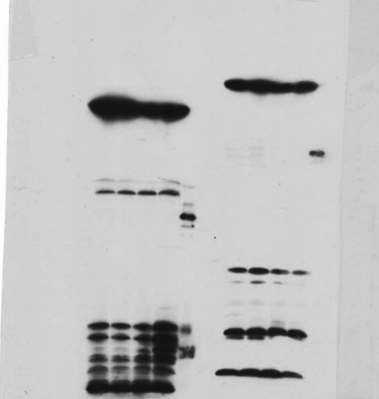
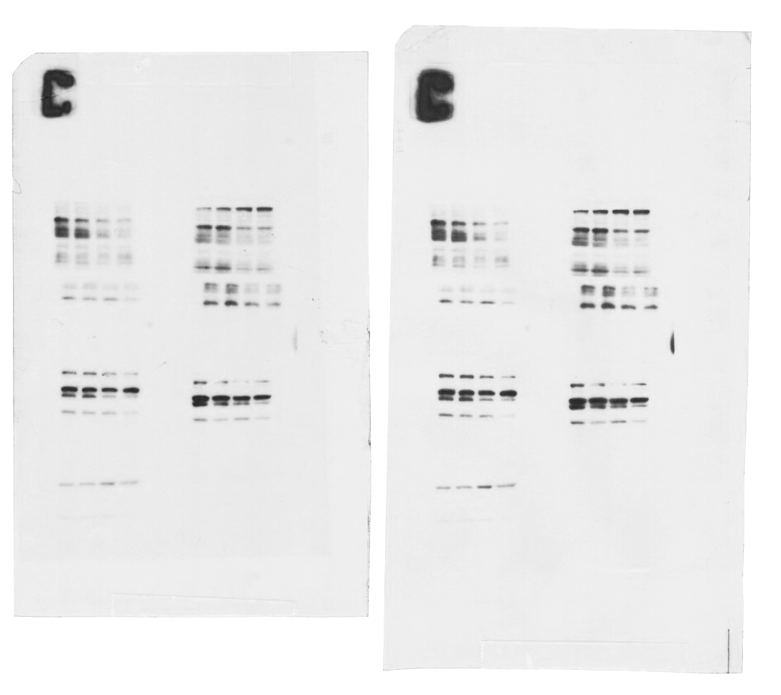
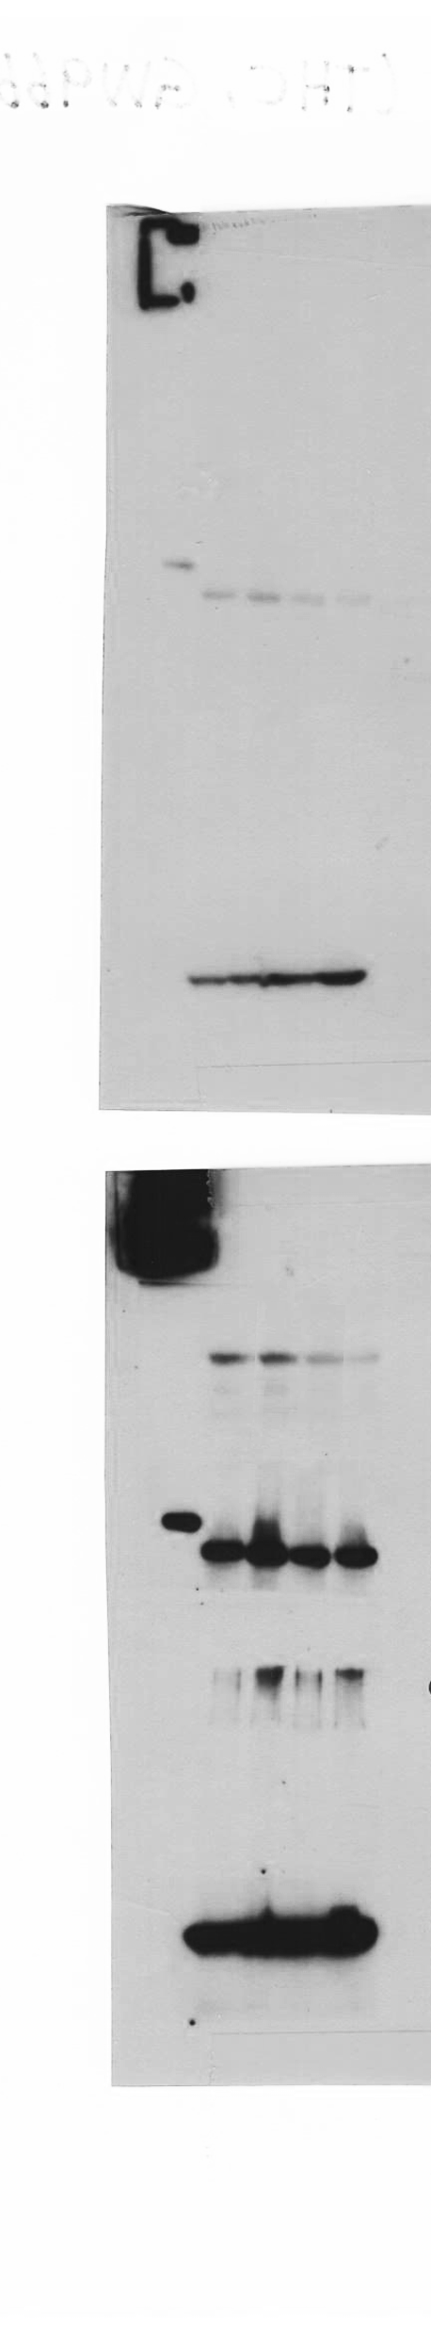
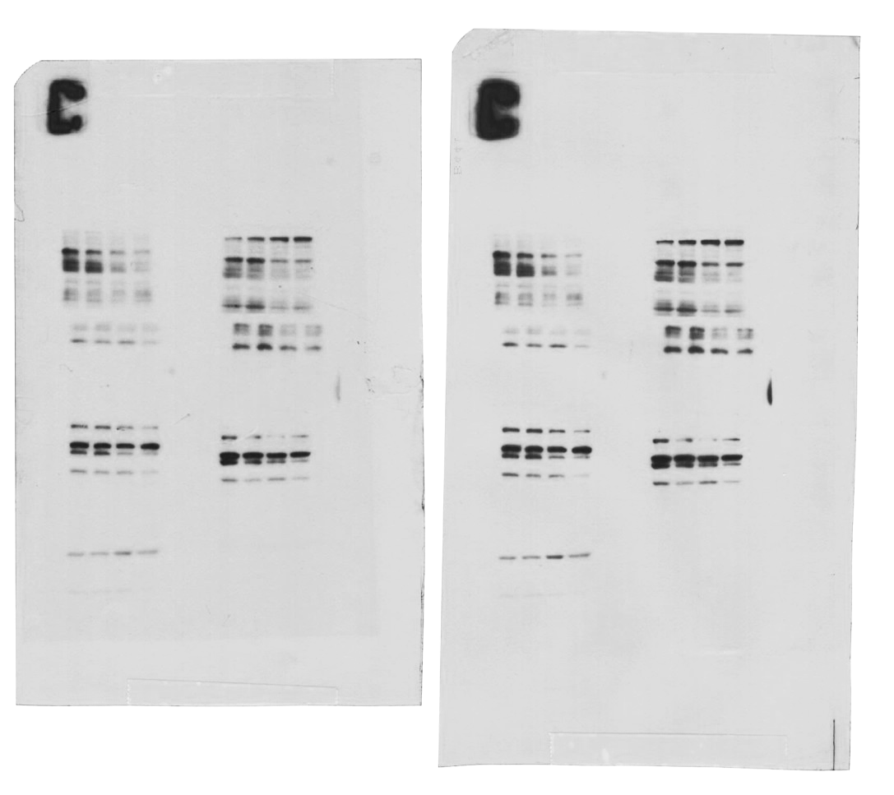
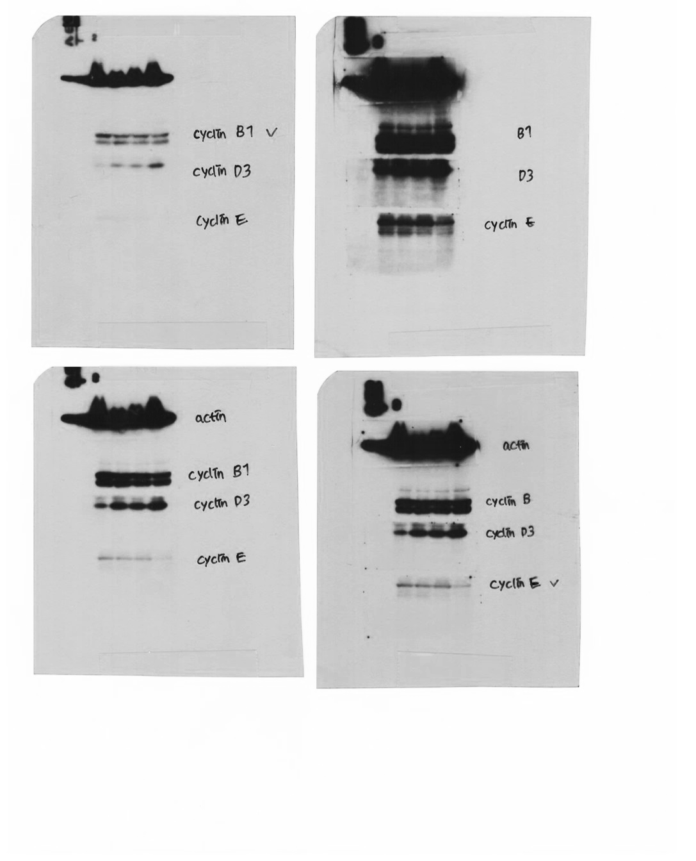
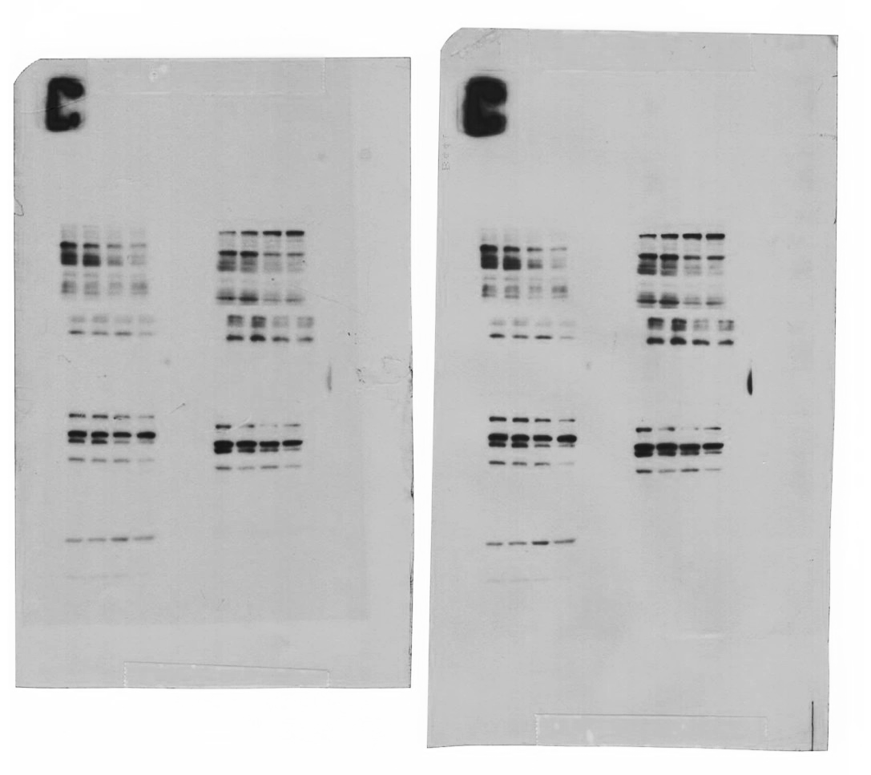
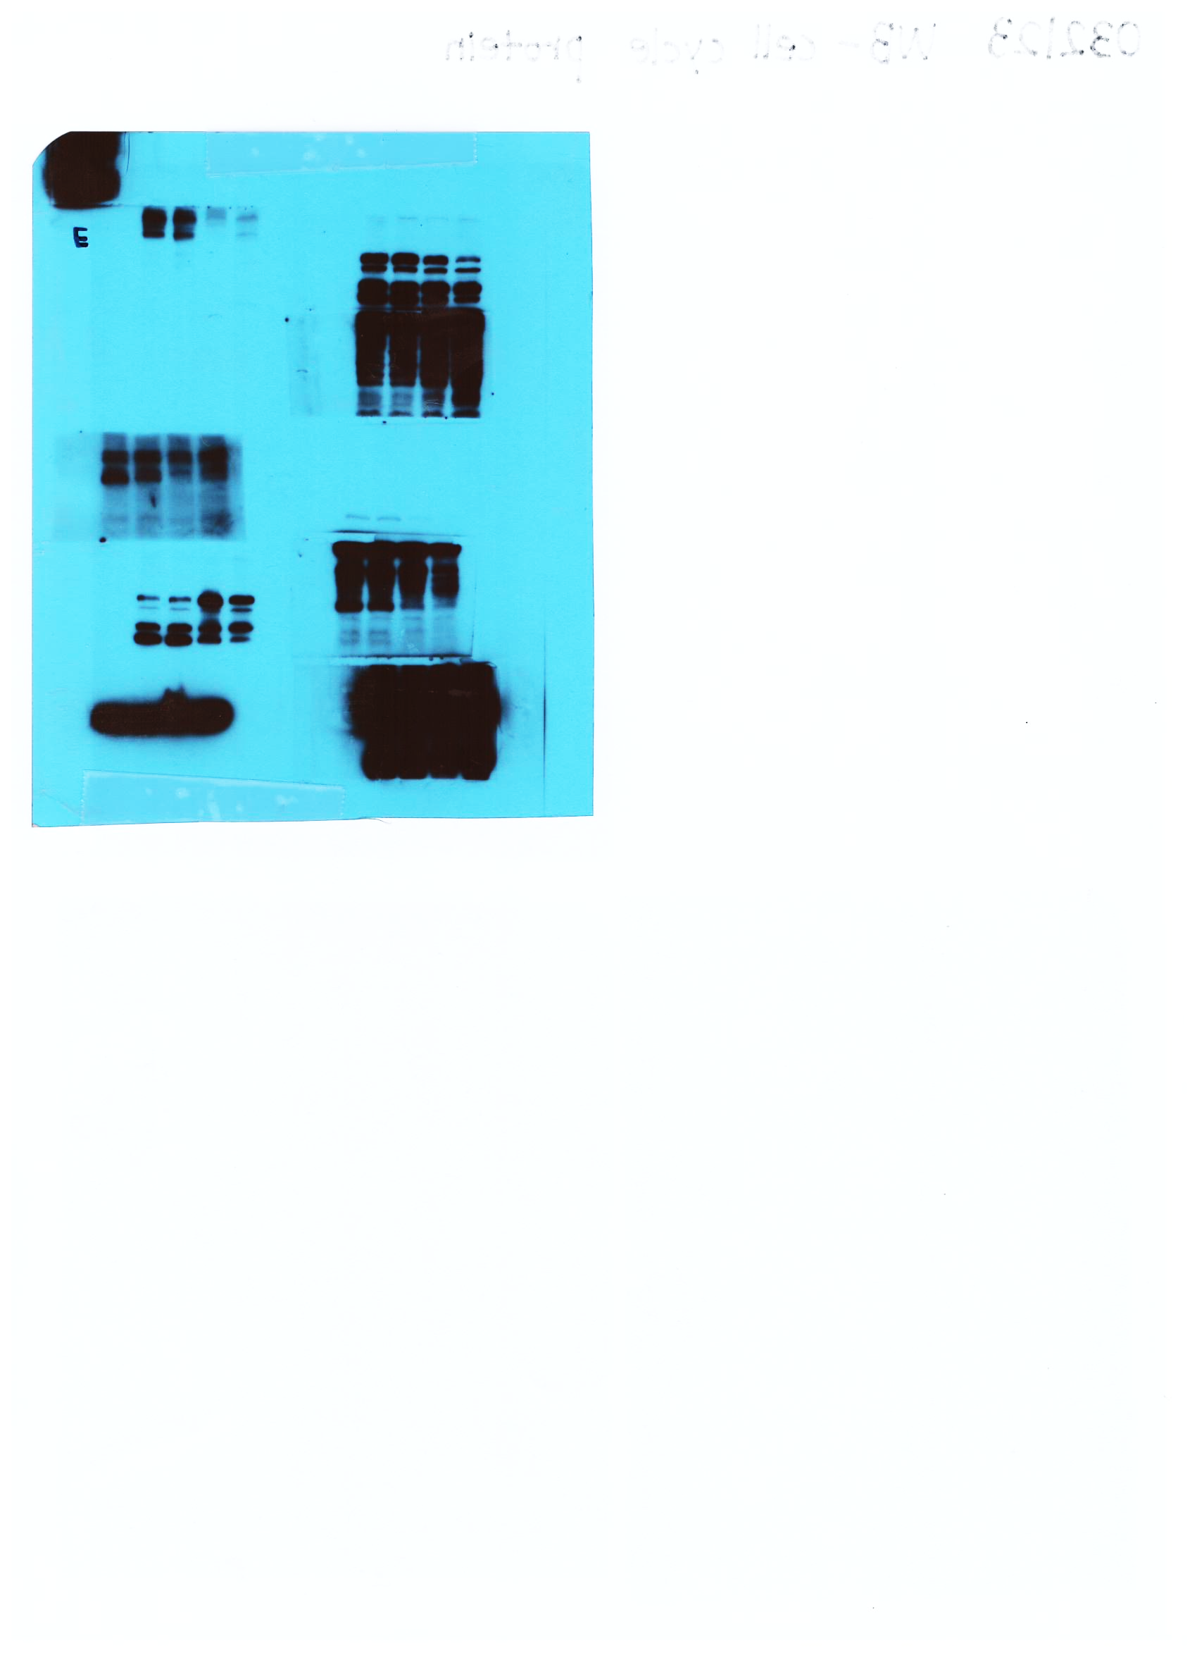
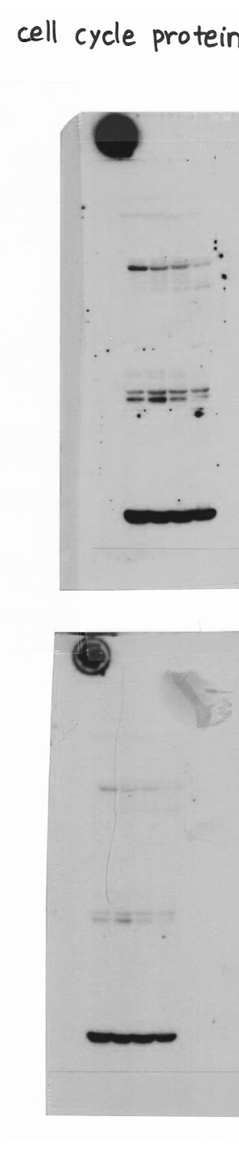
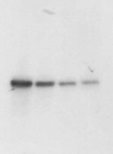
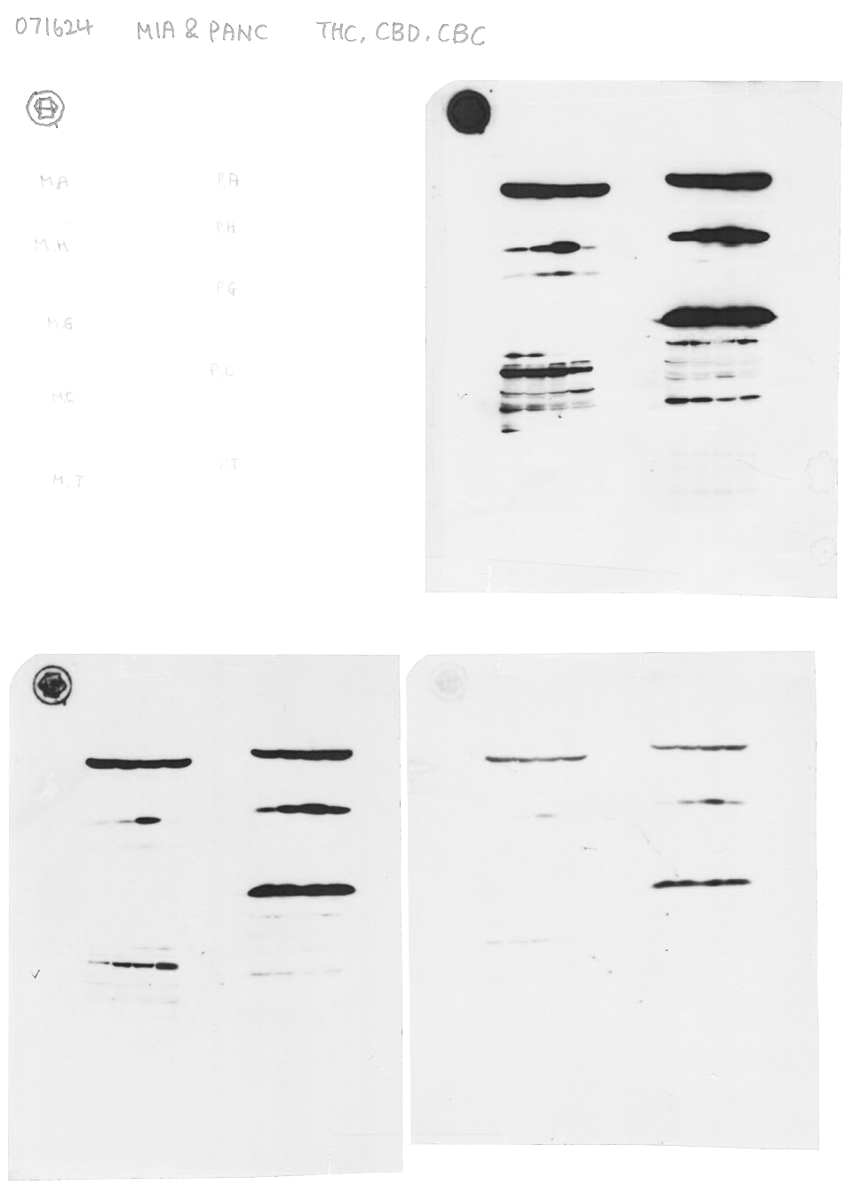
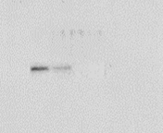

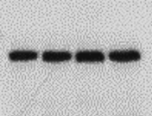

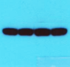
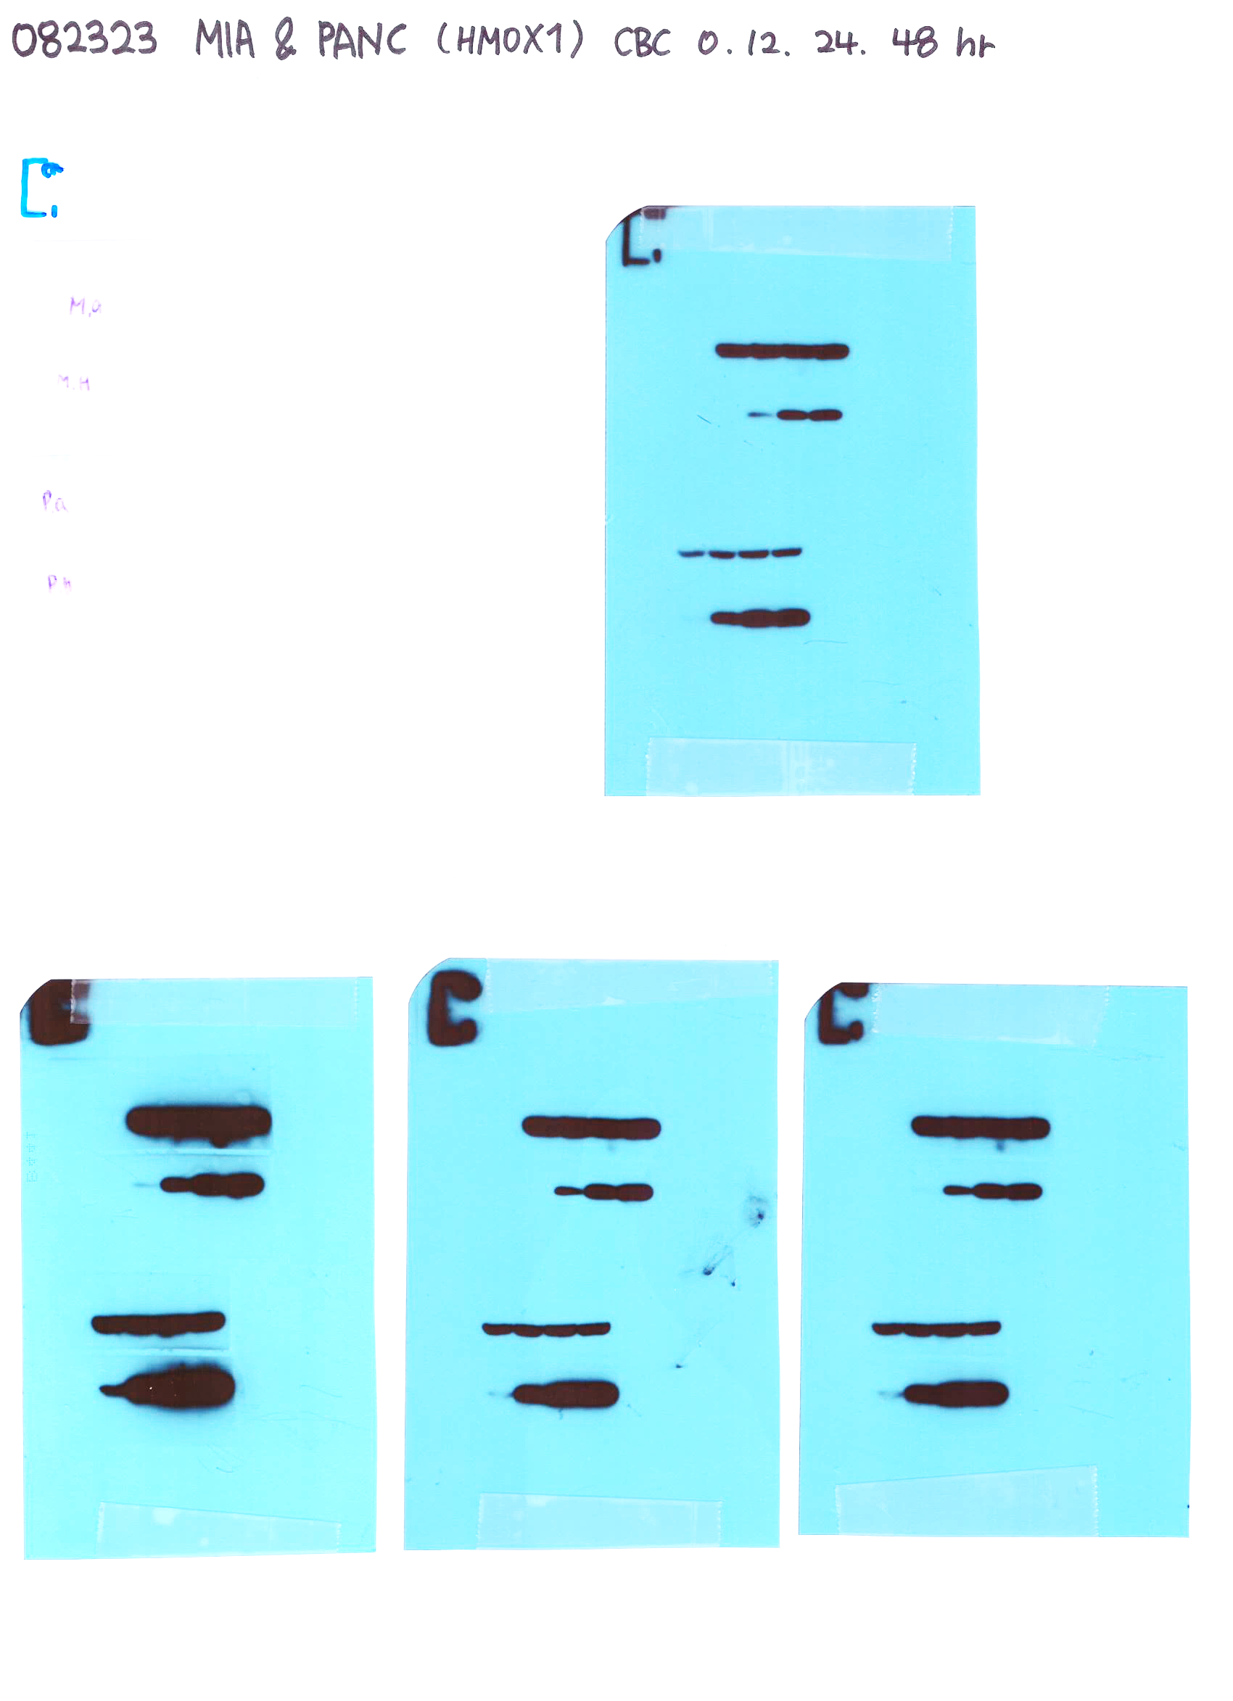
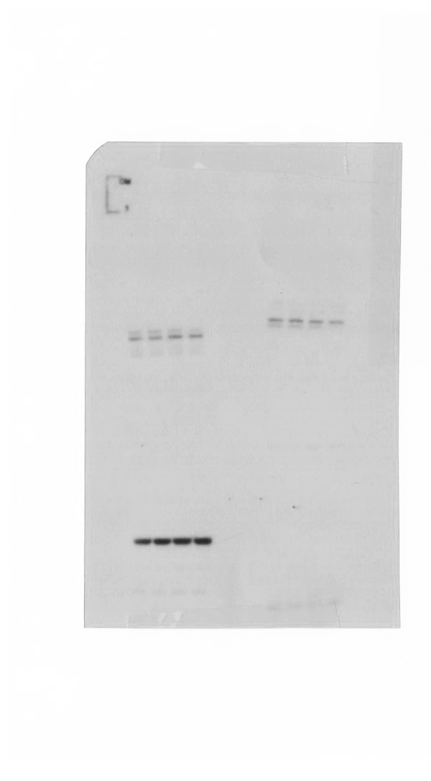
Figure 1
F
MIA PaCa-2
PANC-1
1st
2nd
3rd
1st
2nd
3rd
35
Cyclin D3
35
Cyclin D3
35
Cyclin D3
35
35
Cyclin D3
25
25
35
Cyclin D3
Cyclin D3
20
20
25
25
25
25
48
48
48
48
Cyclin E
48
Cyclin E
Cyclin E
Cyclin E
35
48
35
Cyclin E
35
35
Cyclin E
35
25
35
25
25
25
25
25
63
Cyclin B1
63
Cyclin B1
63
63
Cyclin B1
63
Cyclin B1
48
Cyclin B1
48
63
Cyclin B1
48
48
48
48
63
48
β-actin
48
48
β-actin
48
48
β-actin
β-actin
β-actin
48
35
35
35
35
35
35
β-actin

Slide 2
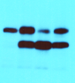
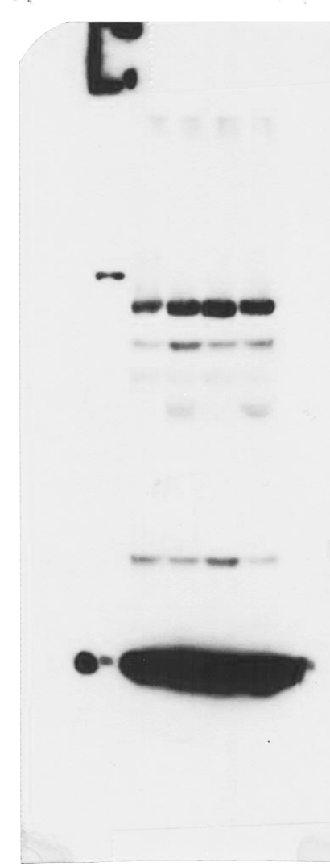

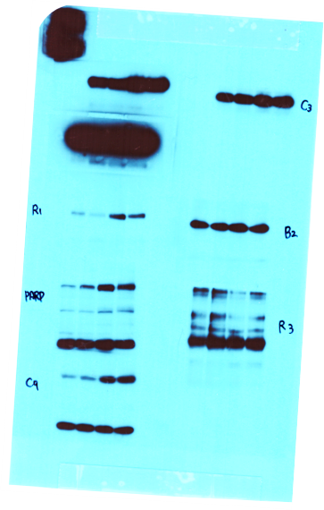
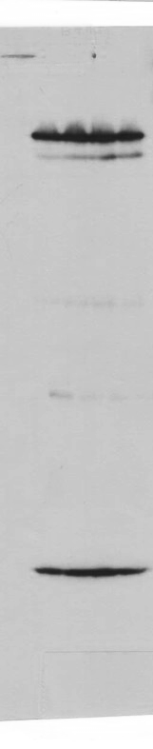
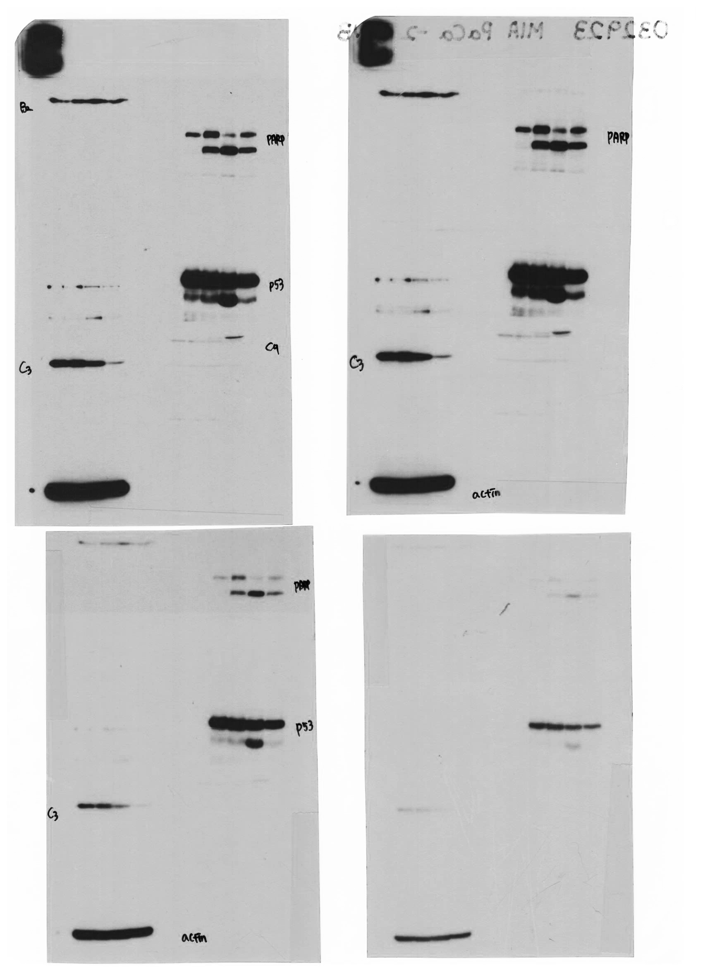
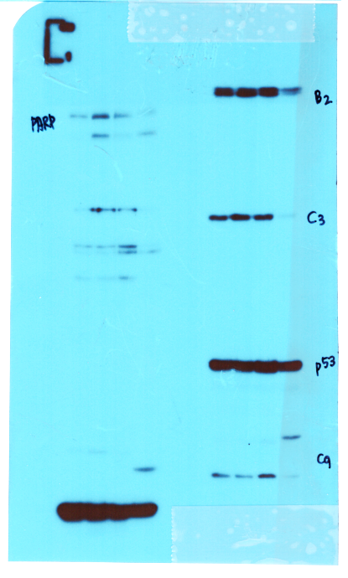
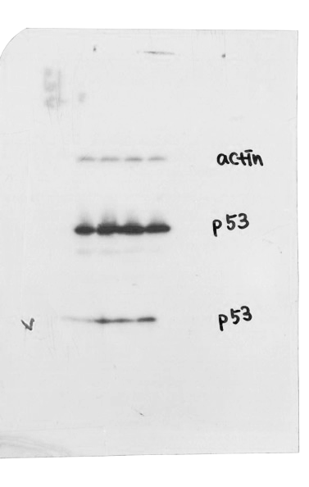
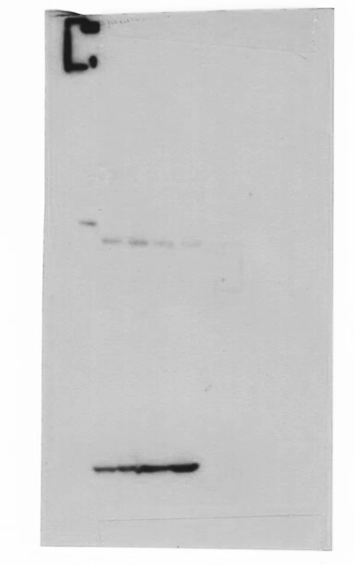
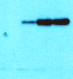
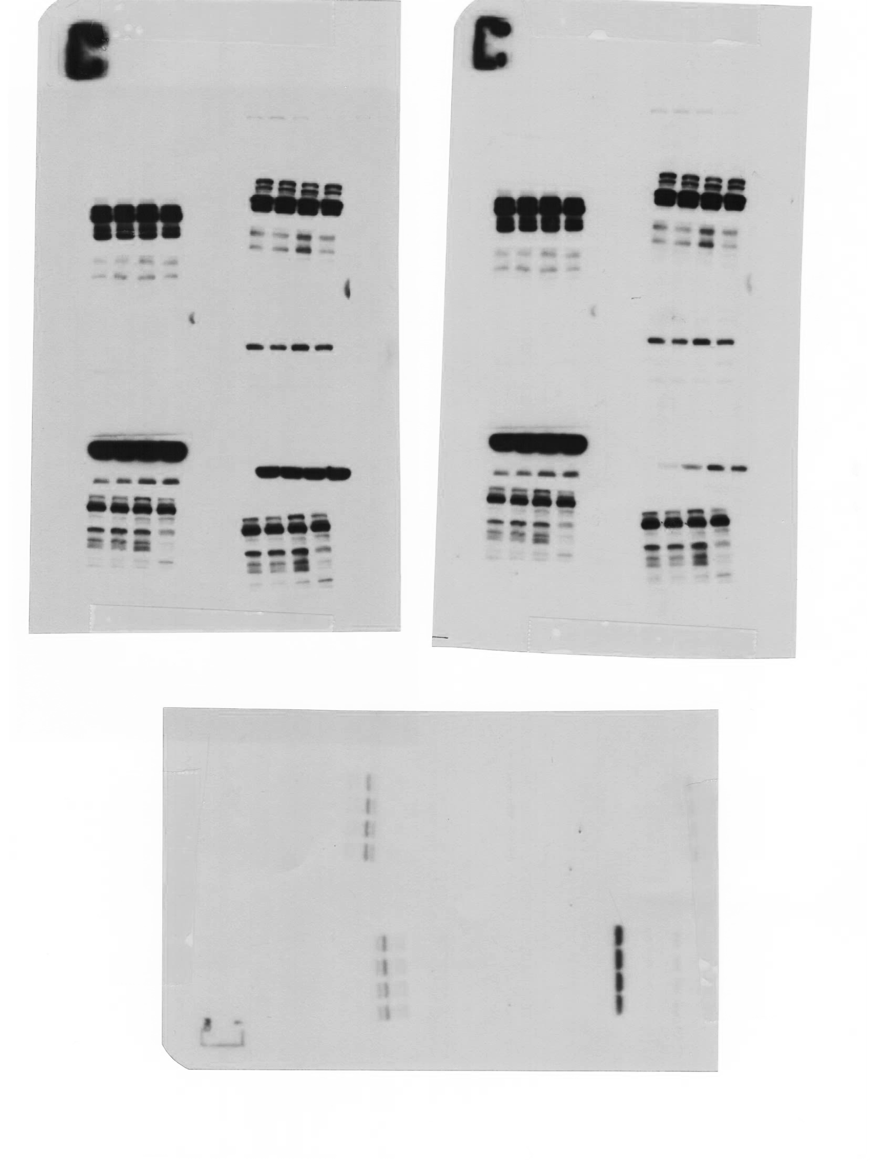
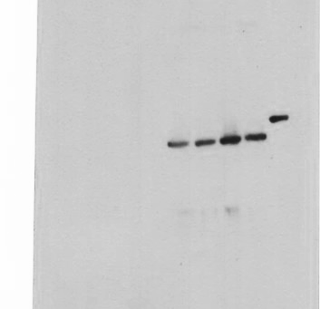
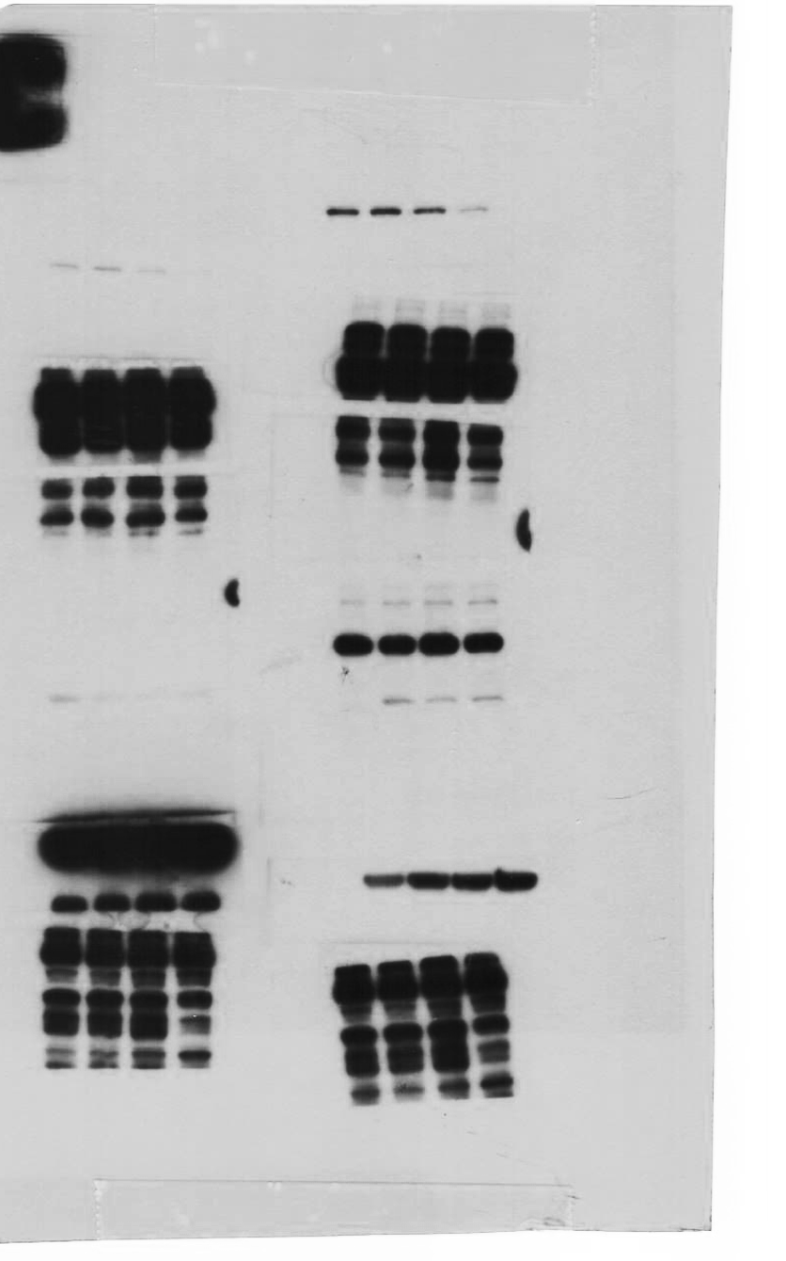
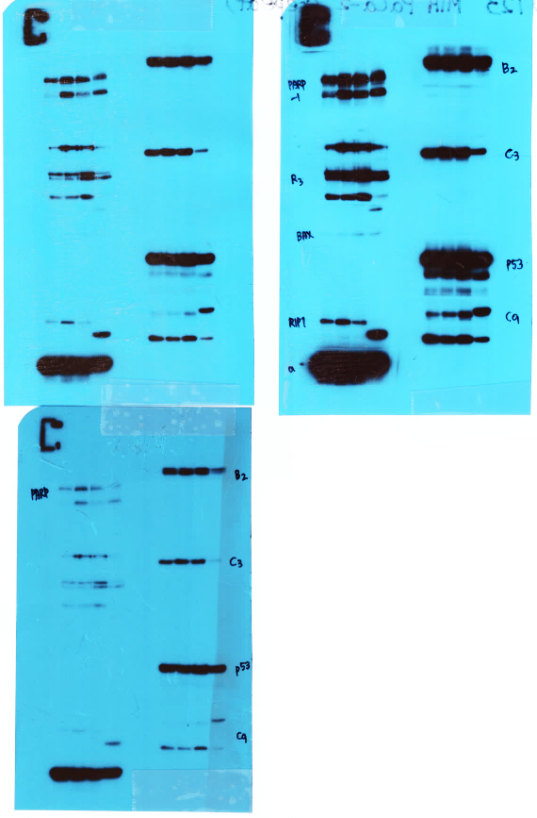
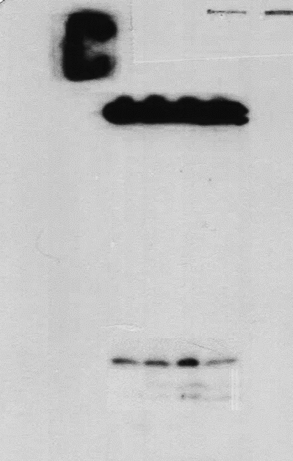
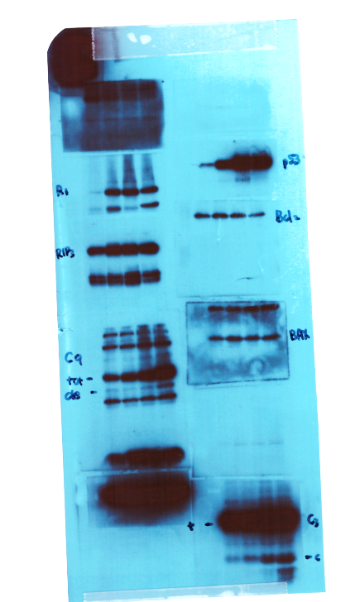
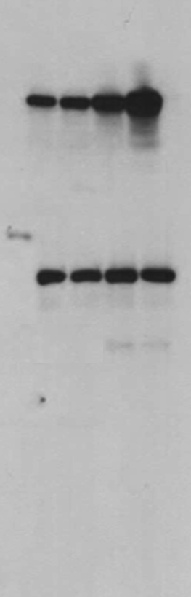
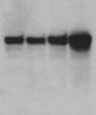
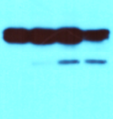
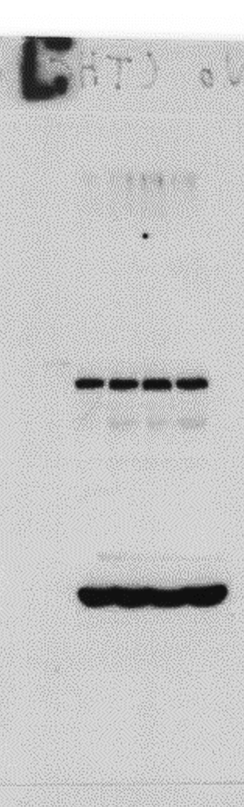
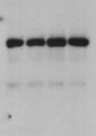
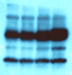
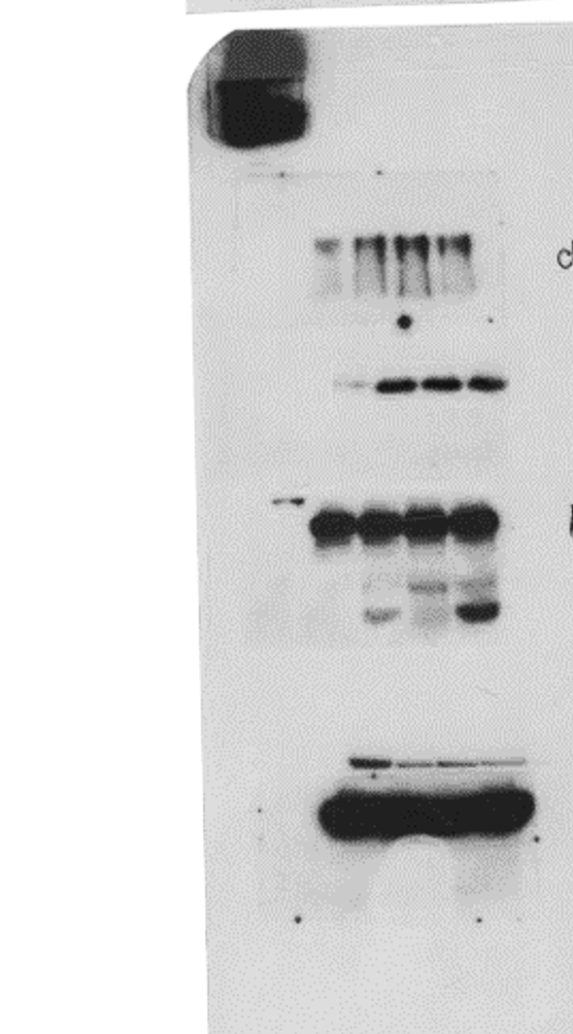
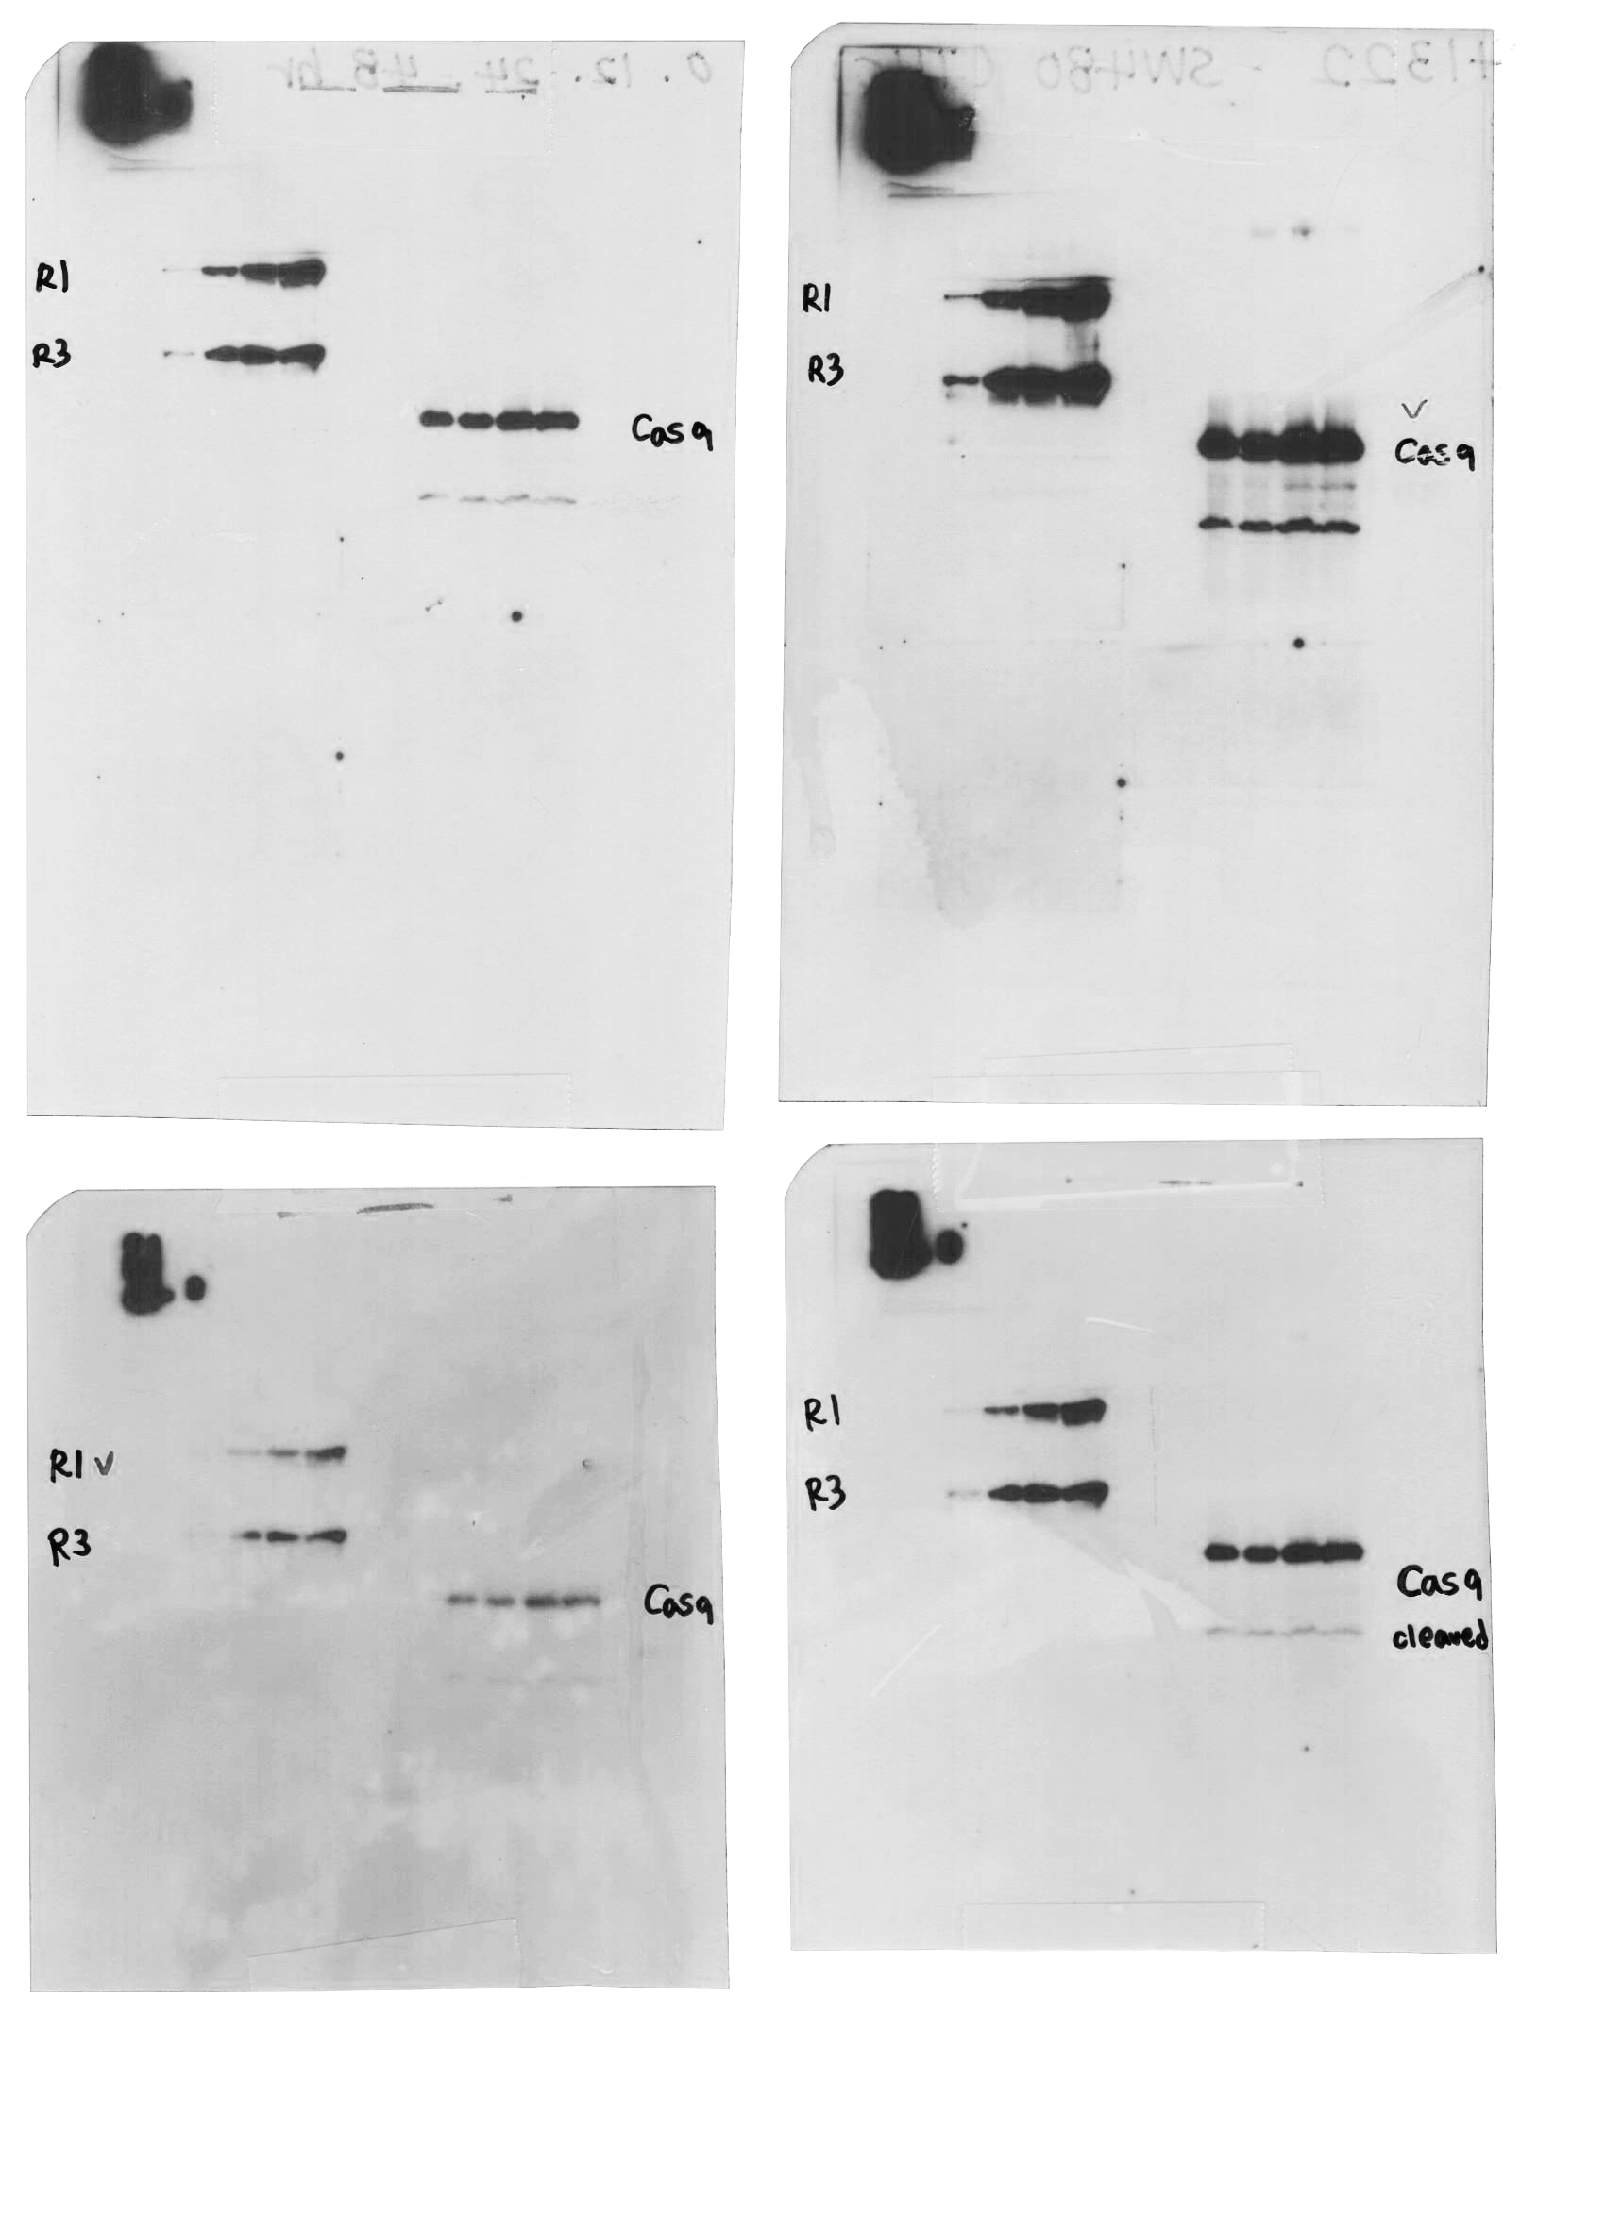
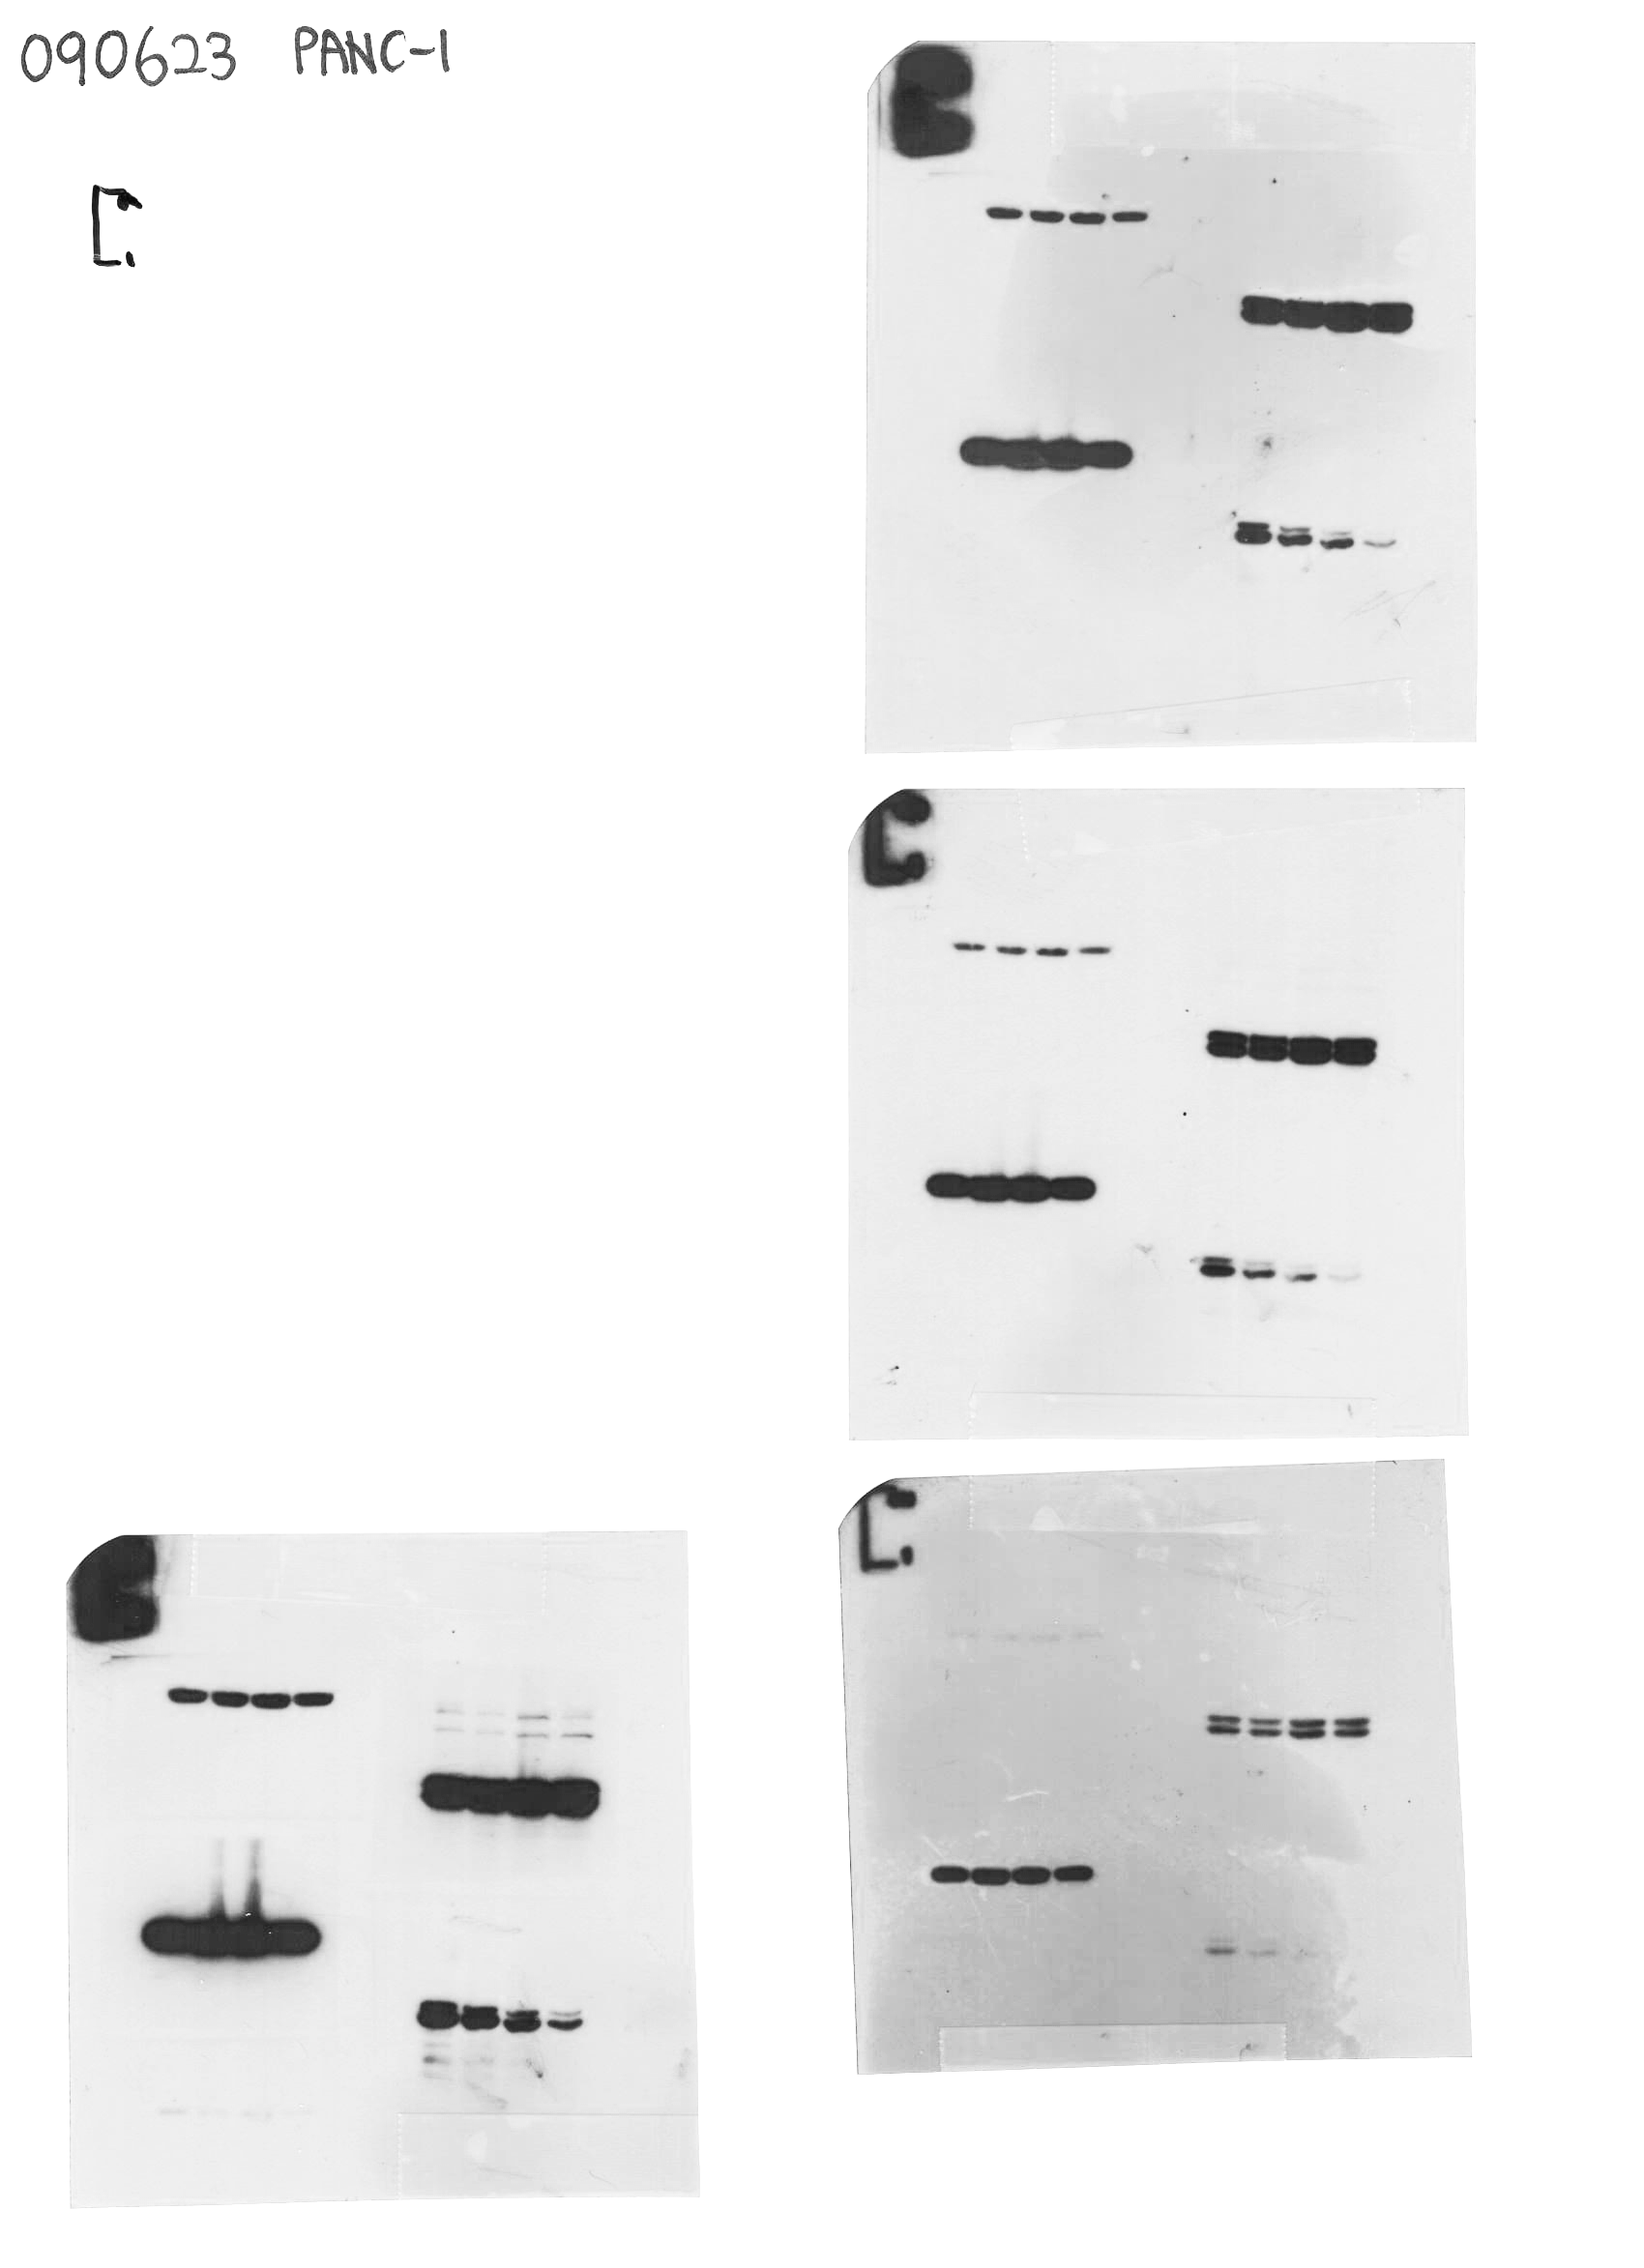
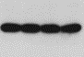

Figure 1
G
MIA PaCa-2
PANC-1
1st
2nd
3rd
1st
2nd
3rd
135
135
135
135
135
135
100
Cleaved
PARP-1
100
100
Cleaved
PARP-1
100
100
100
Cleaved
PARP-1
Cleaved
PARP-1
75
Cleaved
PARP-1
Cleaved
PARP-1
75
75
75
63
75
75
63
63
63
63
63
63
63
p53
63
63
p53
p53
48
63
63
p53
48
48
35
p53
p53
48
35
48
48
35
35
35
35
35
35
35
25
cleaved
caspase 3
25
cleaved
caspase 3
35
35
35
25
cleaved
caspase 3
20
20
25
25
20
17
17
25
20
20
17
20
cleaved
caspase 3
17
cleaved
caspase 3
17
cleaved
caspase 3
48
48
17
48
cleaved
caspase 9
cleaved
caspase 9
35
35
cleaved
caspase 9
48
48
48
35
25
cleaved
caspase 9
cleaved
caspase 9
25
25
35
cleaved
caspase 9
35
35
48
48
25
25
25
48
β-actin
β-actin
β-actin
48
35
35
35
48
β-actin
β-actin
48
β-actin
35
35
35

Slide 3

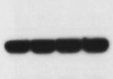

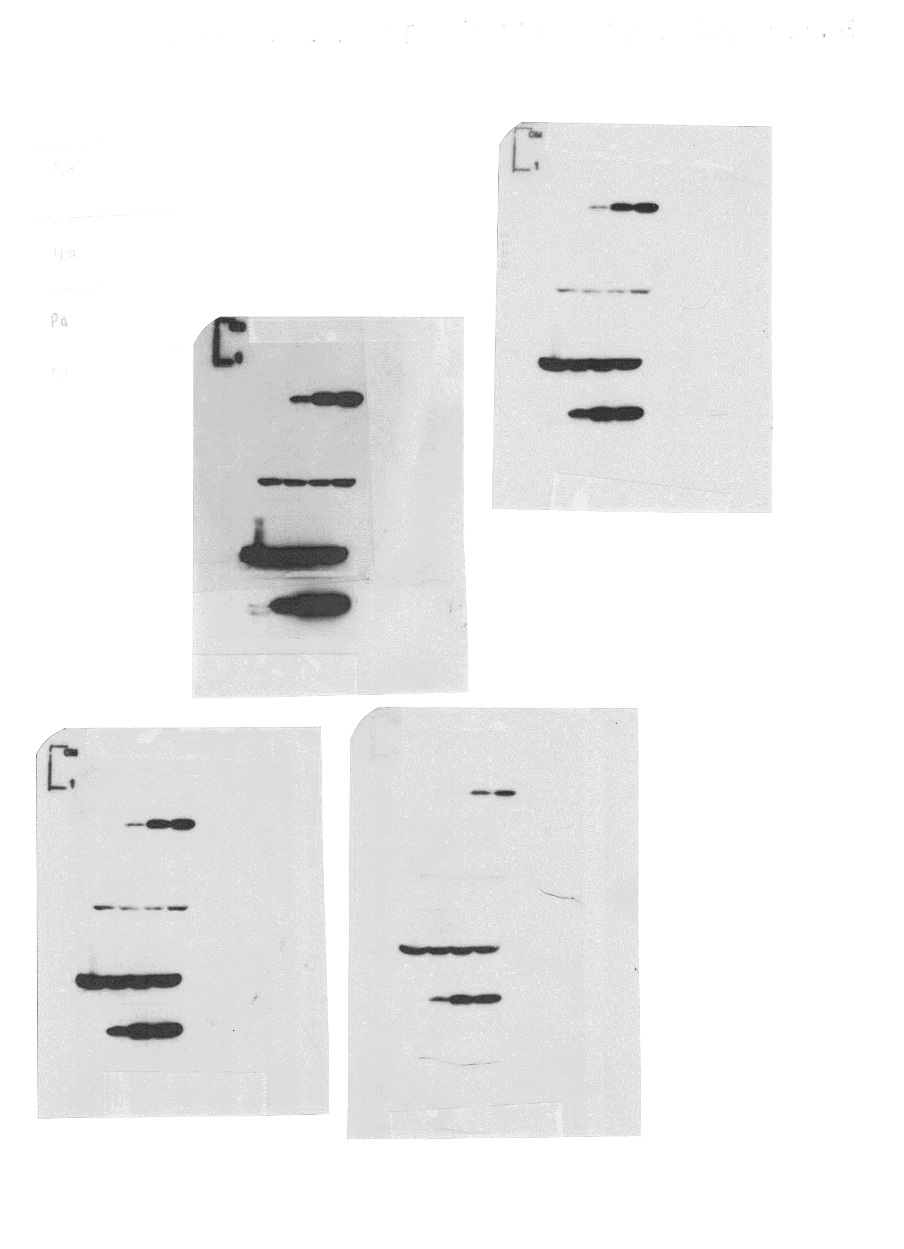


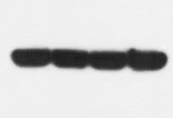

Figure 2
MIA PaCa-2
C
1st
2nd
3rd
35
HMOX1
35
HMOX1
35
HMOX1
25
25
20
20
25
63
63
63
48
48
48
β-actin
β-actin
β-actin
35
35
35
PANC-1
1st
2nd
3rd
35
35
HMOX1
HMOX1
35
HMOX1
25
25
20
20
25
63
63
63
48
48
48
β-actin
β-actin
β-actin
35
35
35

Slide 4
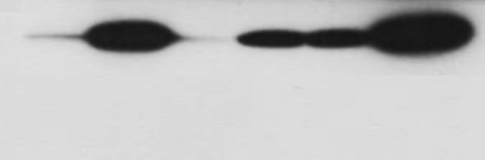
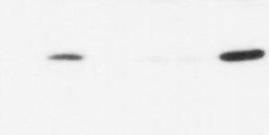
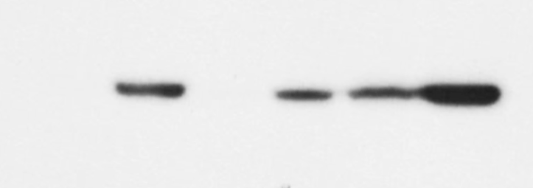
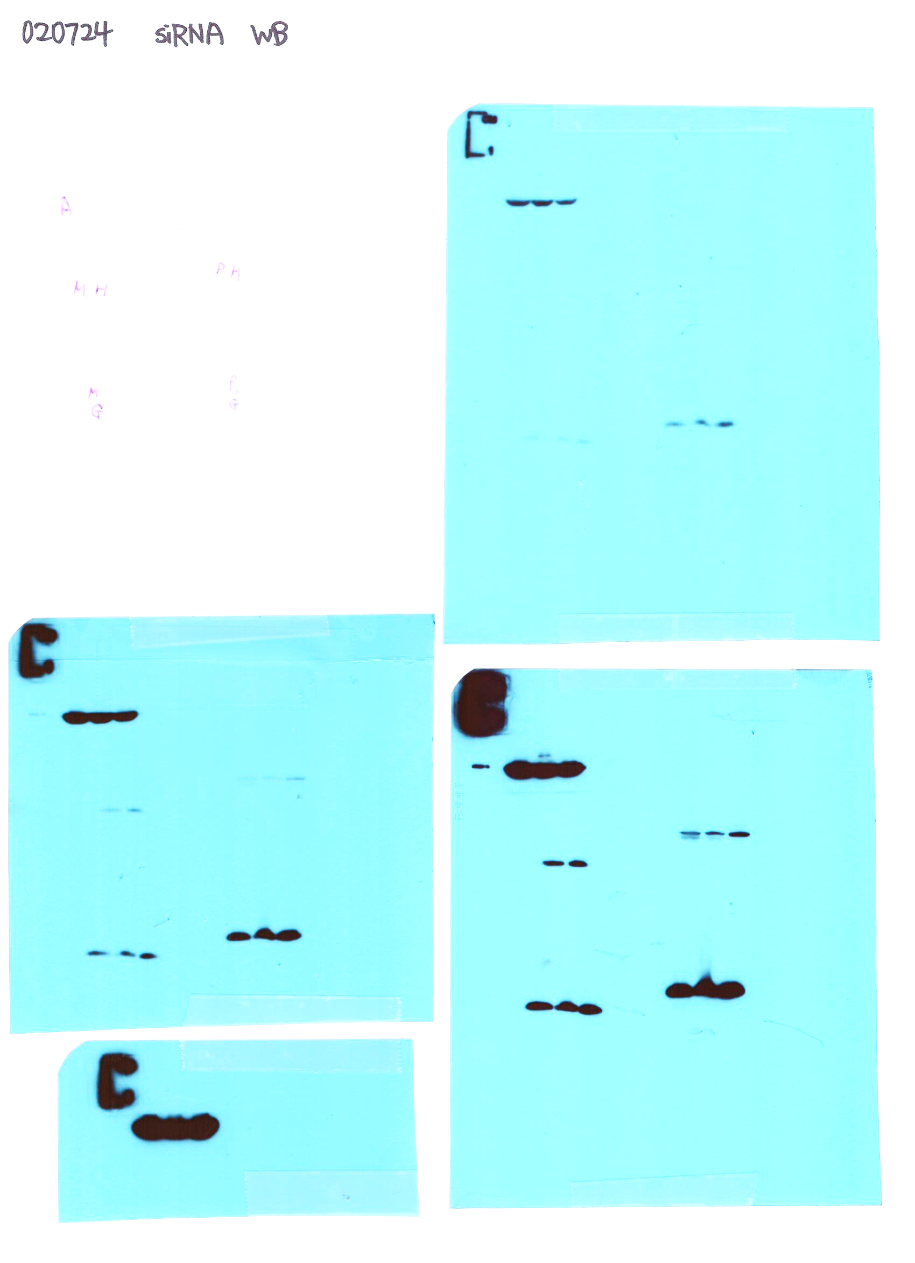
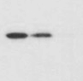
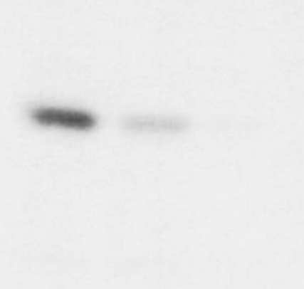














Figure 3
B
C
MIA PaCa-2
MIA PaCa-2
1st
2nd
3rd
1st
2nd
3rd
35
48
35
35
HMOX1
35
35
35
HMOX1
25
20
25
25
25
25
25
20
48
20
20
20
48
48
β-actin
35
35
48
48
48
β-actin
35
35
35
35
PANC-1
PANC-1
1st
2nd
3rd
1st
2nd
3rd
35
48
35
48
35
35
HMOX1
35
HMOX1
25
25
25
35
20
25
20
25
25
20
48
48
48
48
48
48
β-actin
35
35
35
β-actin
35
35
35

Slide 5























Figure 4
C
MIA PaCa-2
PANC-1
1st
2nd
3rd
1st
2nd
3rd
63
63
63
48
p53
63
63
63
35
48
48
p53
48
35
48
48
35
35
35
35
35
35
35
25
35
35
25
35
20
cleaved caspase 3
20
cleaved caspase 3
25
17
25
25
17
25
20
20
20
20
17
17
17
17
35
HMOX1
35
HMOX1
25
25
35
20
35
20
35
35
25
25
25
25
35
20
20
25
20
20
25
GPX4
20
GPX4
20
25
17
25
17
20
25
20
25
17
20
17
20
48
β-actin
17
63
17
63
48
35
48
63
β-actin
48
48
35
48
35
35
35
35

Slide 6
































Figure 5
MIA PaCa-2
MIA PaCa-2
1st
2nd
3rd
1st
2nd
3rd
B
135
135
135
D
135
135
135
100
100
100
TRPV1 receptor
100
100
100
TRPV1
receptor
75
75
75
75
75
75
63
63
63
63
63
63
48
48
48
48
48
CB₂ receptor
35
35
CB₂
receptor
35
35
35
48
25
25
25
35
25
25
25
63
63
63
63
48
63
48
48
48
48
β-actin
48
β-actin
35
35
35
35
35
35
PANC-1
PANC-1
135
135
135
100
TRPV1 receptor
100
TRPV1
receptor
100
75
100
100
75
75
100
75
63
75
75
63
63
63
48
63
48
CB₂
receptor
48
48
CB₂ receptor
48
35
35
35
48
35
25
25
25
35
25
25
35
25
63
63
48
β-actin
63
63
48
63
48
48
48
48
35
35
β-actin
35
35
35
35

Slide 7




































Figure 6
MIA PaCa-2
1st
2nd
3rd
MIA PaCa-2
A
100
TRPV1
receptor
F
100
100
1st
2nd
3rd
75
75
75
135
63
63
135
135
48
100
100
cleaved PARP-1
48
48
β-actin
100
75
35
75
35
35
75
35
48
48
48
35
35
20
35
35
35
CB₂
receptor
20
20
cleaved caspase 3
17
17
25
25
25
17
48
11
48
48
48
48
β-actin
35
48
β-actin
35
35
35
35
35
PANC-1
PANC-1
1st
2nd
3rd
1st
2nd
3rd
100
100
TRPV1
receptor
100
100
100
cleaved PARP-1
100
75
75
75
75
75
75
63
63
48
48
63
63
35
48
β-actin
cleaved caspase 3
35
35
35
20
35
35
20
17
48
48
17
48
35
35
CB₂
receptor
25
48
β-actin
20
48
35
35
25
25
17
63
β-actin
48
35
48
48
48
35
35
35
35

