Slide 1
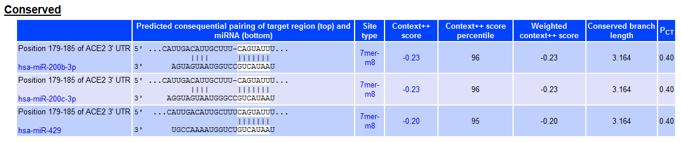
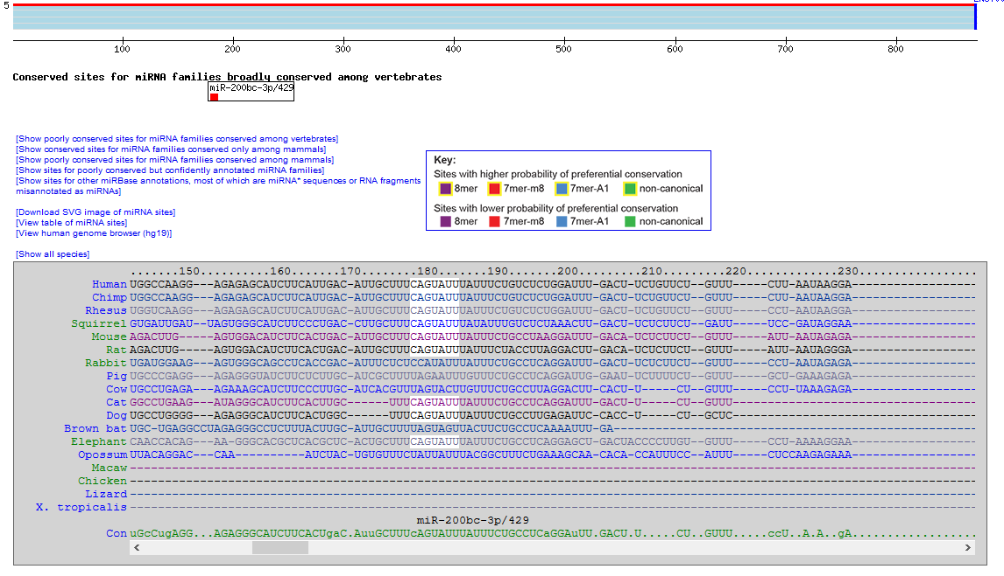
A
B
Figure S1

Slide 2
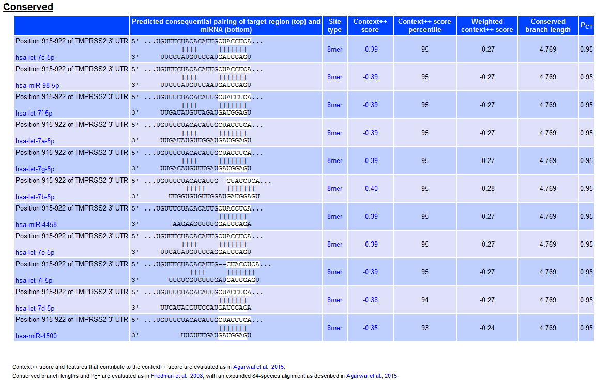
A
Figure S2

Slide 3
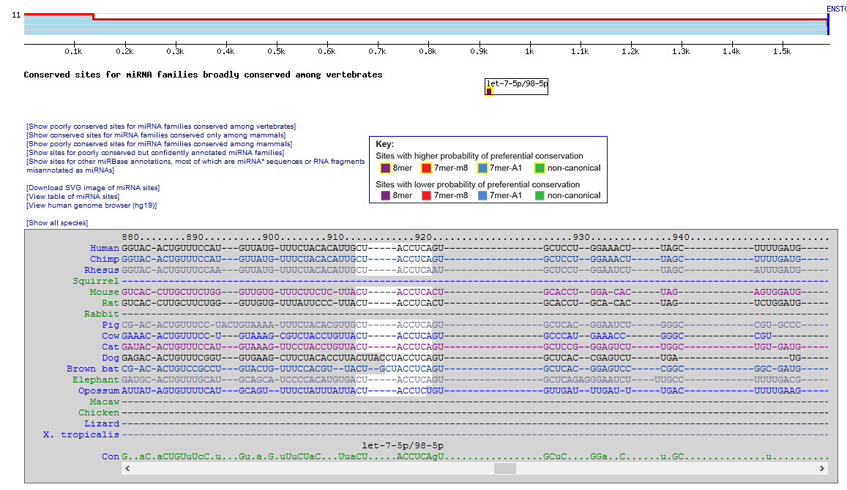
B
Figure S2

Slide 4
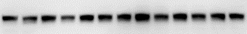
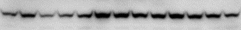
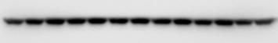
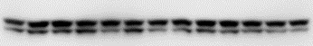
Untransfected/DMSO
Negative control A/DMSO
miR-200c-3p inhibitor/DMSO
Negative control A/CBD
miR-200c-3p inhibitor/CBD
Negative control A/#1
miR-200c-3p inhibitor/#1
Negative control A/#5
miR-200c-3p inhibitor/#5
Negative control A/#7
miR-200c-3p inhibitor/#7
Negative control A/#129
miR-200c-3p inhibitor/#129
Untransfected/DMSO
Negative control A/DMSO
Let-7a-5p inhibitor/DMSO
Negative control A/CBD
Let-7a-5p inhibitor/CBD
Negative control A/#1
Let-7a-5p inhibitor/#1
Negative control A/#5
Let-7a-5p inhibitor/#5
Negative control A/#7
Let-7a-5p inhibitor/#7
Negative control A/#129
Let-7a-5p inhibitor/#129
A
B
ACE2
TMPRSS2
GAPDH
GAPDH
NS
**
*
**
**
Figure S3

Slide 5
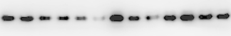

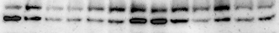
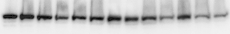
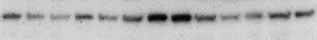
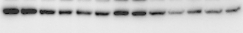
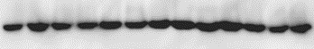
DMSO
10 μM CBD
#1
#5
#7
#10
#45
#81
CD10
#129
#132
#169
#98
A
ACE2
(100 kDa)
TMRPSS2
NS
p-p65
(Ser536)
p65
pAkt1/2/3
Akt1
GAPDH
Figure S4

Slide 6
B
*
*
*
*
*
*
*
*
*
*
*
*
*
*
*
*
*
*
*
*
*
*
*
*
*
*
*
*
*
*
*
*
*
*
*
*
*
*
*
*
*
*
*
*
Figure S4

Slide 7
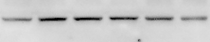
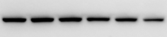
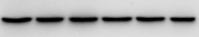
A
DMSO
10ng/ml TNF/IFN
1 μg control plasmid
3 μg control plasmid
1 μg Akt1 CRISPR KO
3 μg Akt1 CRISPR KO
B
TNF/IFN + #7
*
*
*
pAKT1
AKT1
GAPDH
TNF/IFN + #7
**
**
**
**
**
**
**
*
*
*
TNF/IFN + #7
Figure S5

Slide 8
Figure S6

Slide 9
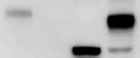
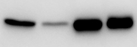
Hep G2_ACE2+/+
Hep G2_ACE2-/-
WI-38_#1
WI-38_#10
ACE2 (glycosylated)
ACE2 (non-glycosylated)
GAPDH
Figure S7

