Slide 1
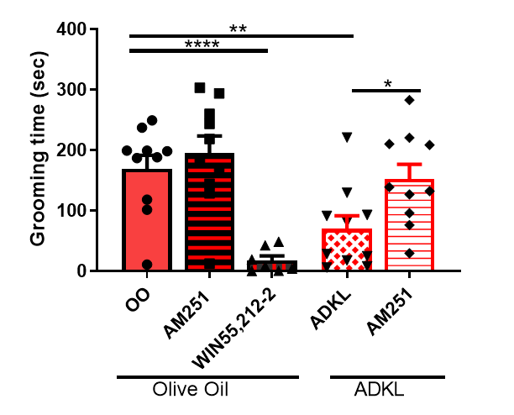
Figure S0 - Raw Data (Behavioral Tests)
A
B
C
D
Figure 2 Raw data (not normalized)
A
Figure 3 Raw data (not normalized)

Slide 2
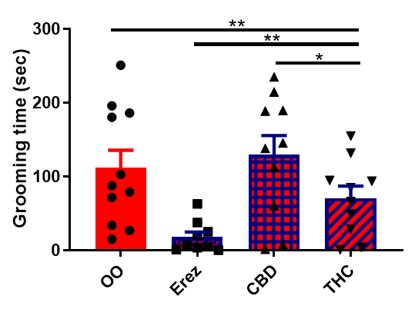
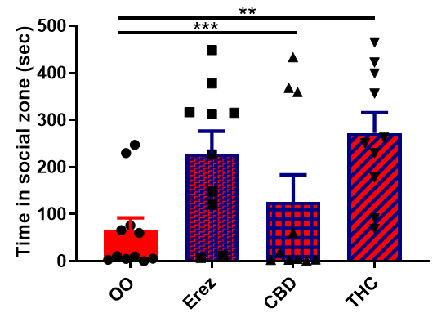
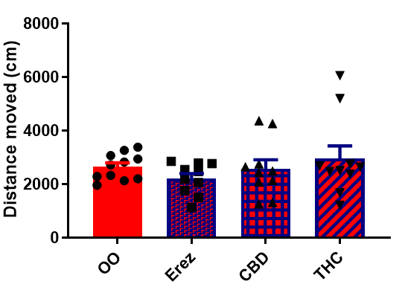
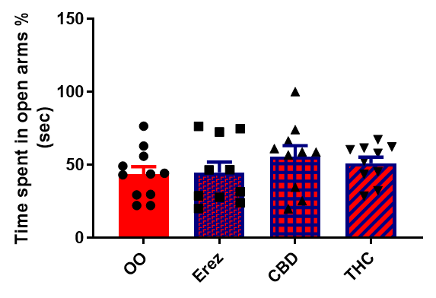
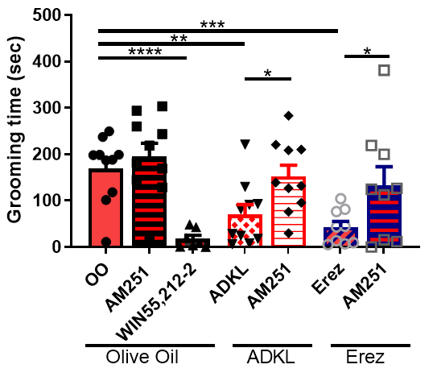
A
B
C
D
Figure 5 Raw data (not normalized)
Figure S2 Raw data (not normalized)

Slide 3
A
B
Figure S4 Raw data (not normalized)
Figure S6 Raw data (not normalized)

