Slide 1
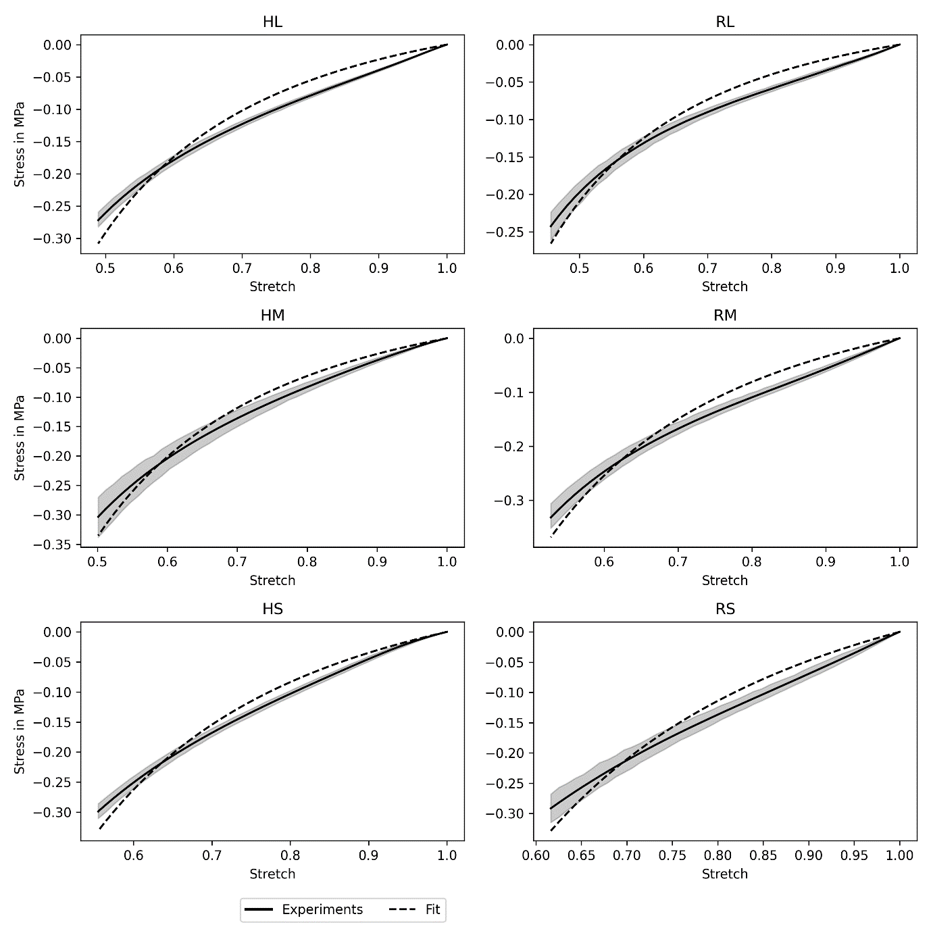
Additional File 6
Notes:
Additional File 6: Comparison of the Neo-Hookean model data with experimental data. Parameters used are from Figure 6 in Supplemental File 5.

