Slide 1
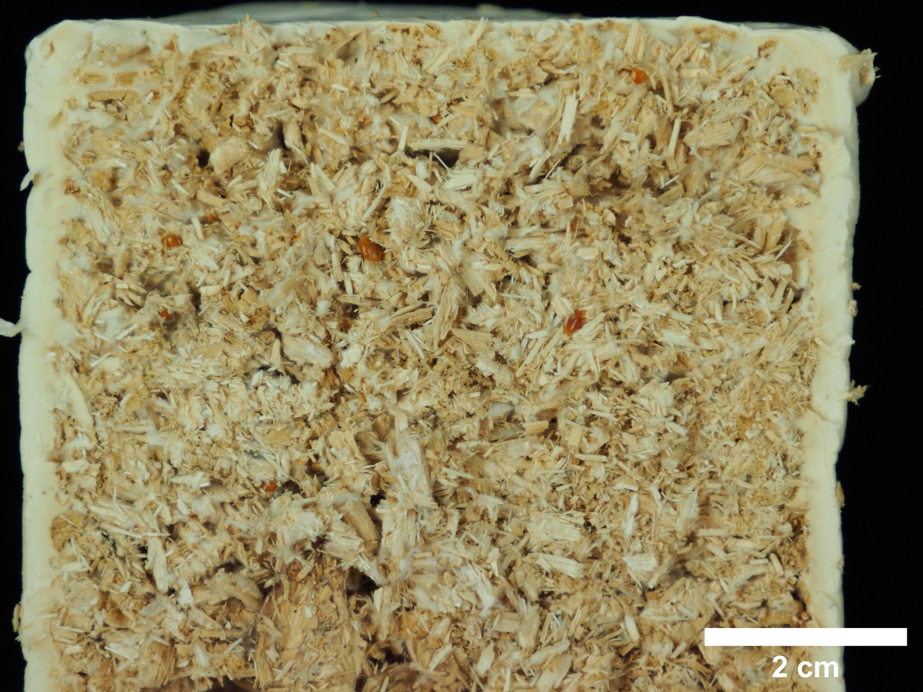
Additional File 3
A
B
Notes:
Additional File 3. Cut section of a typical sample as they were used for mechanical testing. The outer section (A) displays a much denser mycelium growth in a zone of 3-4 mm around the entire sample. The inner zone (B) is characterized by a sharp decline of mycelial content within 2-4 mm, followed by a more constant but lower mycelium-to-plant-material ratio. The core of the material is therefore expected to behave differently than the outer shell.

