Slide 1
In vitro metabolism of Benzyl-4CN-BUTINACA and MDMB-4CN-BUTINACA using human hepatocytes and LC-QToF-MS analysis
Supplementary Information B: Benzyl-4CN-BUTINACA
Caitlyn Norman¹, Kristin Webling¹ , Dārta Štālberga¹, Lisa Maas¹, Johannes Tveit², Huiling Liu², Shimpei Watanabe^{1,3,4}, Svante Vikingsson^{1,3,5}, Henrik Green^{1,3,*}.
¹Department of Biomedical and Clinical Science, Division of Clinical Chemistry and Pharmacology, Linköping University, Linköping, Sweden.
²Chiron AS, Trondheim, Norway
³Department of Forensic Genetics and Forensic Toxicology, National Board of Forensic Medicine, Linköping University, Linköping, Sweden
⁴Forensic Science Group, Photon Science Research Division, RIKEN SPring-8 Center, Hyogo, Japan
⁵Center for Forensic Science Advancement and Application, RTI International, Research Triangle Park, North Carolina, USA
*Corresponding author: Henrik.Green@liu.se

Slide 2
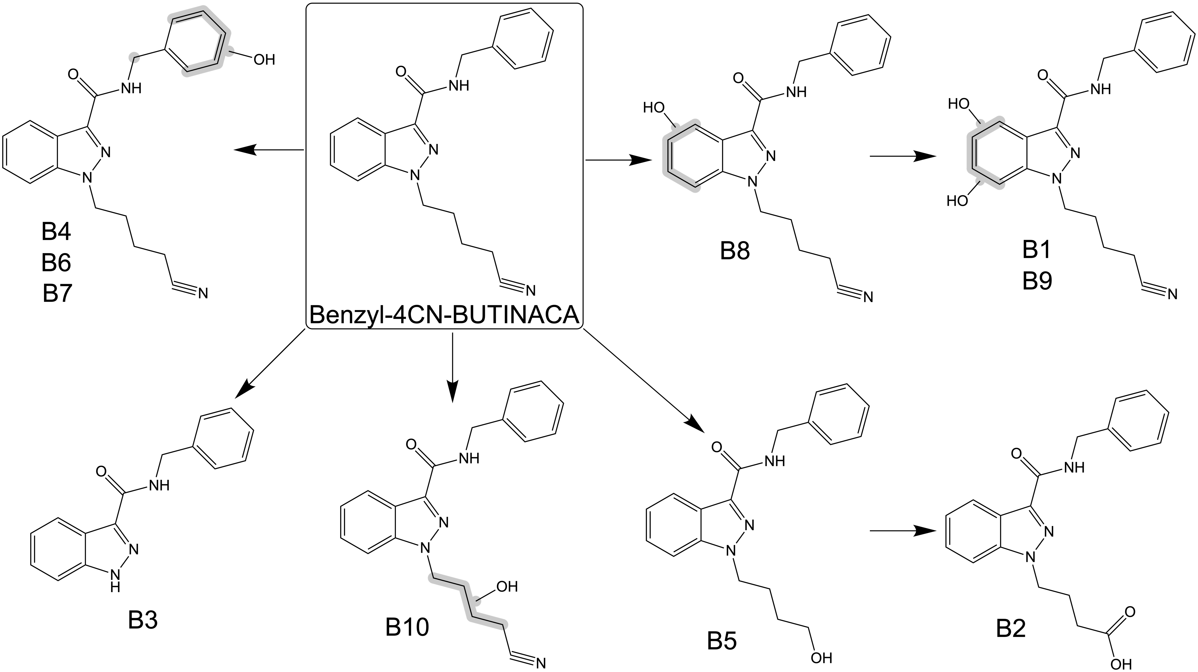
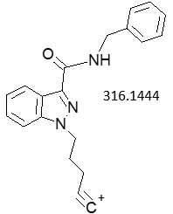
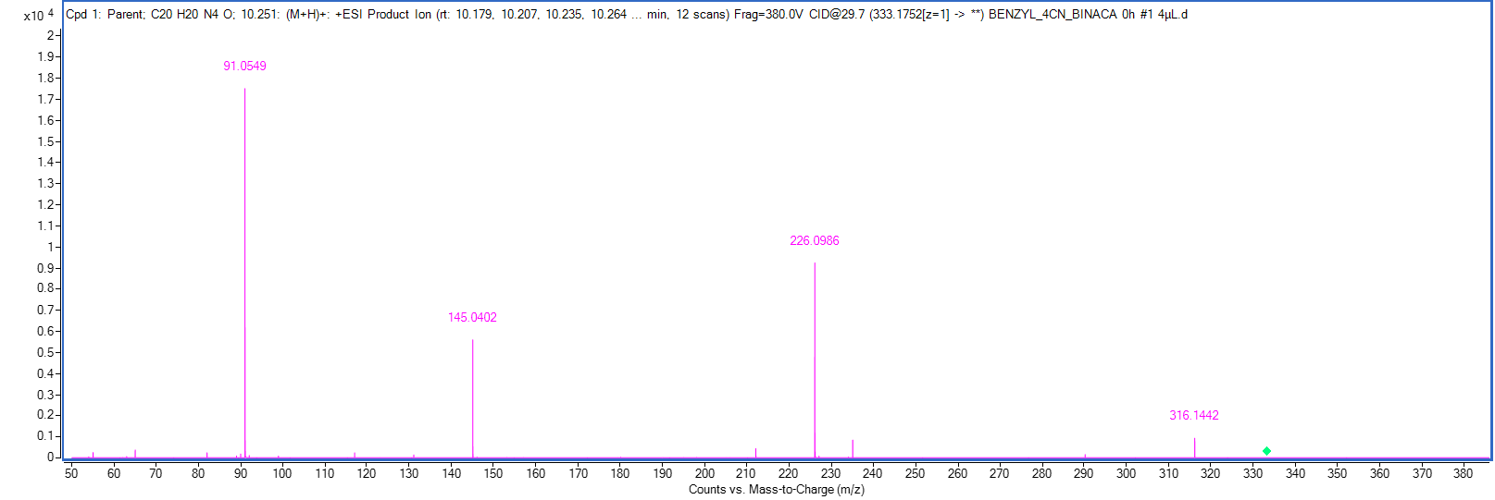
Benzyl-4CN-BUTINACA
RT 10.23
91.0548
226.0975
145.0396
333.1710

Slide 3
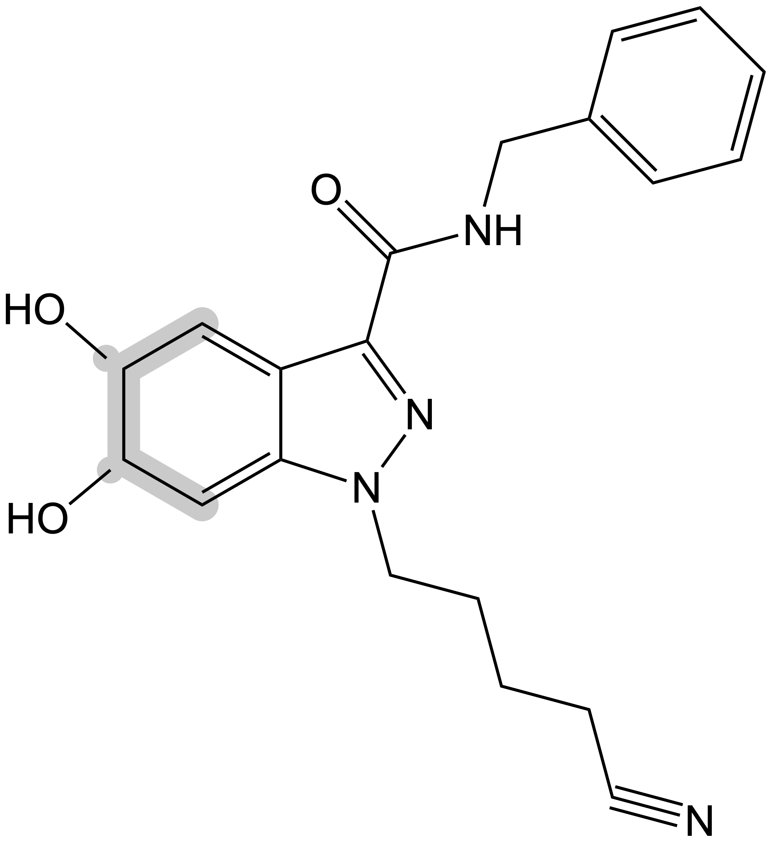
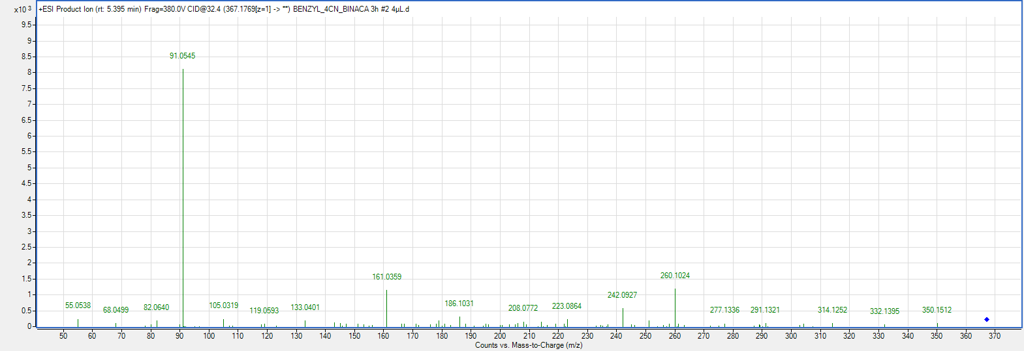
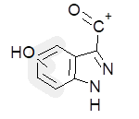
Dihydrodiol (B1)
RT 5.39
91.0548
– H2O
242.0930
260.1035
367.1765
161.0346

Slide 4
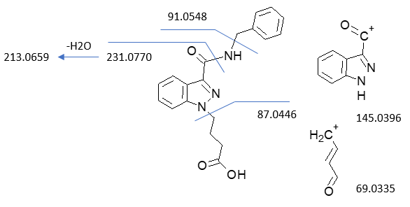
Decyanation to carboxylic acid (B2)
RT 8.20
91.0548
231.0770
– H2O
213.0659
87.0446
338.1499
145.0396
69.0335

Slide 5
N-dealkylation (B3)
RT 7.57
91.0548
145.0396
252.1131

Slide 6
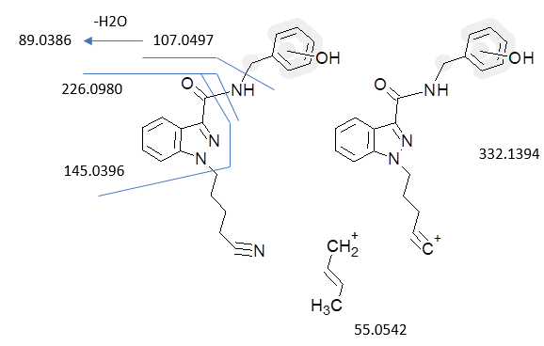
Monohydroxylation (B4)
RT 5.35
89.0386
107.0497
– H2O
226.0975
349.1659
145.0396
332.1394
55.0542

Slide 7
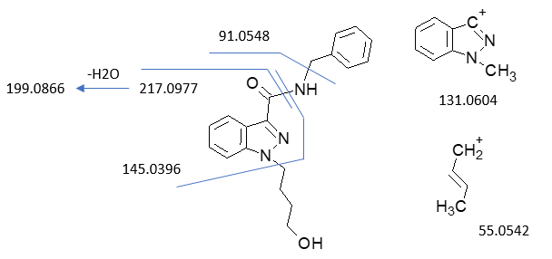
Decyanation to –OH (B5)
RT 8.34
91.0548
217.0977
– H2O
199.0866
145.0396
324.1707
131.0604
55.0542

Slide 8
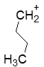
Monohydroxylation (B6)
RT 5.04
89.0386
107.0497
– H2O
226.0975
145.0396
349.1659
57.0669
55.0542

Slide 9
Monohydroxylation (B7)
RT 7.46
89.0386
107.0497
– H2O
226.0975
145.0396
349.1659

Slide 10
Monohydroxylation (B8)
RT 6.06
91.0548
242.0930
161.0346
349.1659

Slide 11
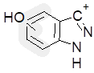
Dihydrodiol (B9)
RT 6.06
91.0548
– H2O
242.0930
260.1035
367.1765
161.0346
133.0396
55.0542

