Slide 1
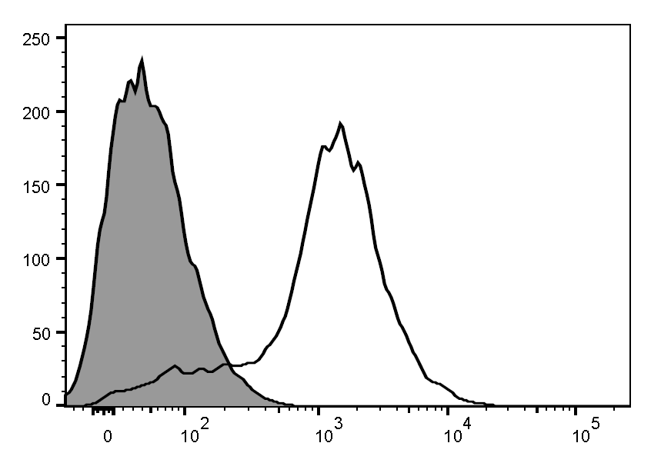
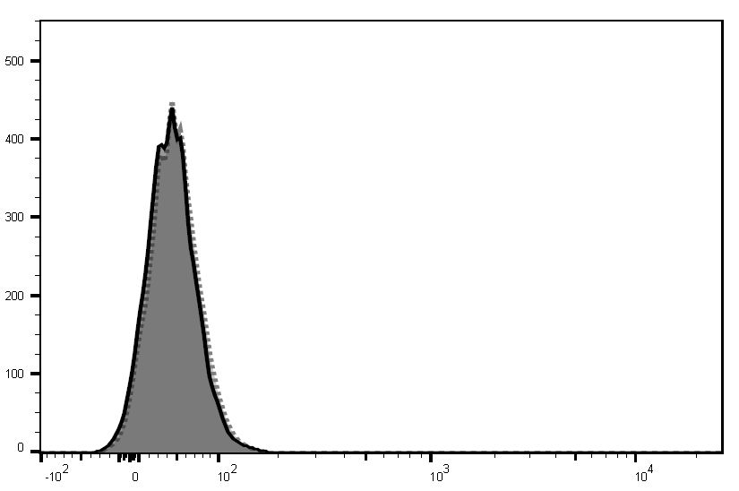
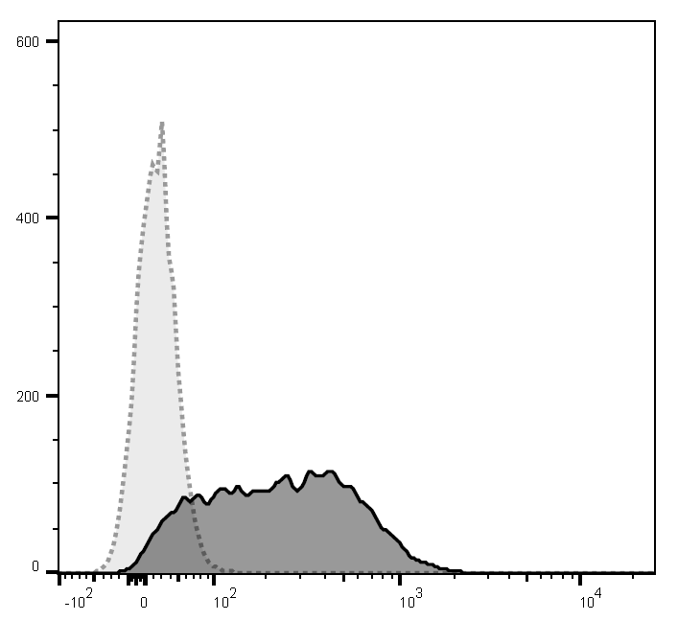
Figure S1.
a
No Staining
Cell Number
F4/80 PE
F4/80-PE
b
HL-60
dHL-60 (1.3% DMSO)
No Staining
CD11b PE
Cell Number
CD11b-PE

Slide 2
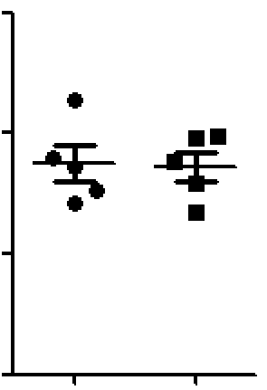
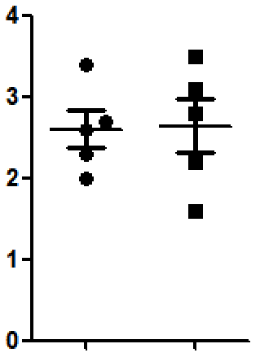
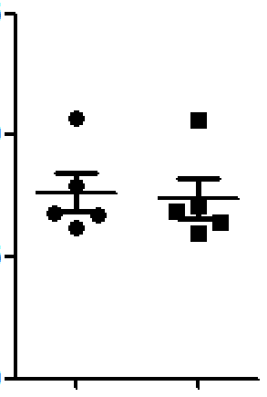
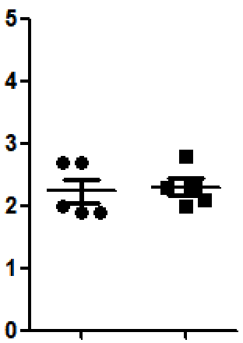
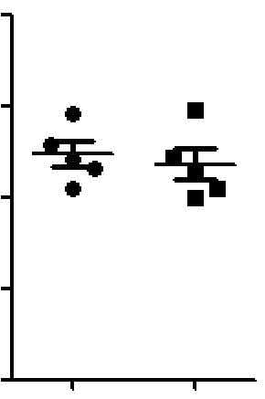
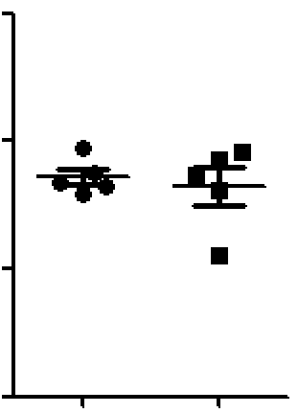
Figure S2.
a
c
Blood
Peritoneum
Blood
Peritoneum
1.5
4
ns
1.5
5
ns
ns
3
4
ns
1.0
1.0
3
Neutrophil count (10⁵)
Per mL lavage
Neutrophil count (10⁵)
Per mL lavage
Neutrophil count (10³/μL)
2
Neutrophil count (10³/μL)
2
0.5
0.5
1
1
0.0
0
0.0
0
NC
PLAG
NC
PLAG
NC
NAC
NC
NAC
b
Blood
Peritoneum
2.0
ns
150
ns
1.5
100
Neutrophil count (10⁵)
Per mL lavage
Neutrophil count (10³/μL)
1.0
50
0.5
0.0
0
NC
REP
NC
REP

Slide 3
Figure S3.
5-FU (A) or AC regimen (B)
CBC analysis (Blood)
-1 | 0 | 1 | 2 | 3 | 4 | 5
(d)
PLAG (250mg/kg)
P.O. administration
a
b
***
***
***
***
Blood neutrophil count
(10³ cells/μl)
Blood neutrophil count
(10³ cells/μl)
PLAG | - | - | +
PLAG | - | - | +
5-FU
AC regimen

Slide 4


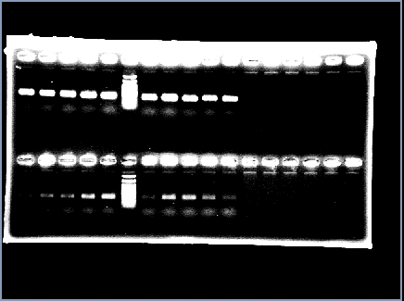

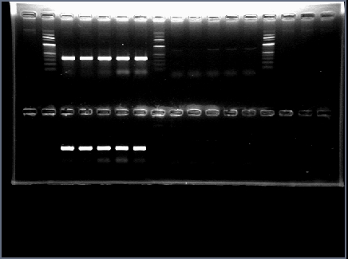
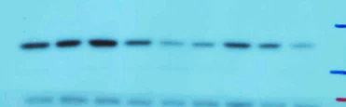

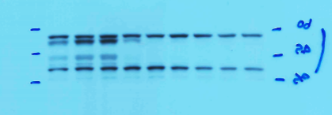
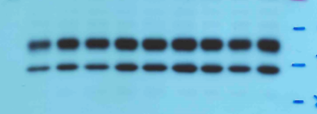

Figure S4.
a
b
e
THP-1
GEM(10μg/ml)
GEM (10μg/ml)
- | 1 | 5 | 10 | GEM (μg/ml)
0
0.5
1
2
4
Time (h)
0 | 5 | 15 | 30 | 60 | 90 | 120
Time (min)
CXCL2
CXCL8
p-Erk
CXCL8
GADPH
Erk
GAPDH
p-p38
p38
p-Jnk
Jnk
β-actin
c
d
f
g
***
***
***
***
***
***
***
***
***
**
**
0 | 1 | 5 | 10
0 | 6 | 12 | 24
GEM (μg/ml)
Time (h)

Slide 5
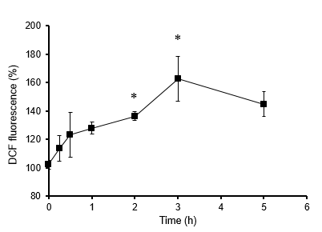
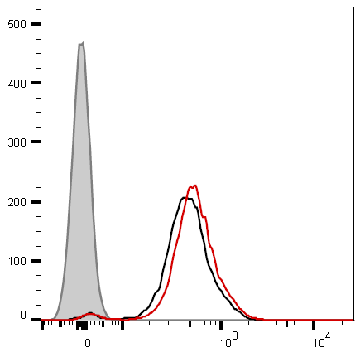
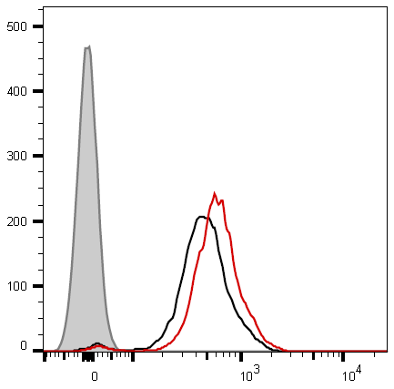
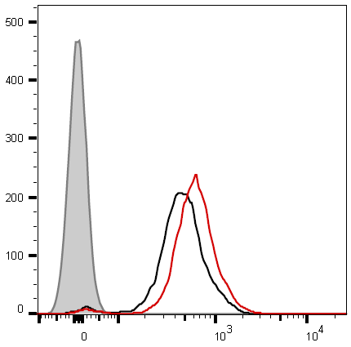


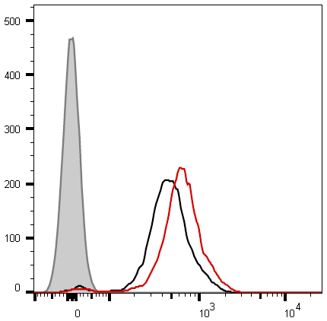
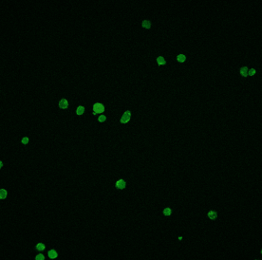
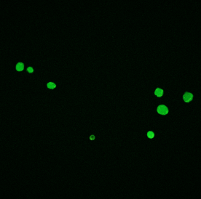
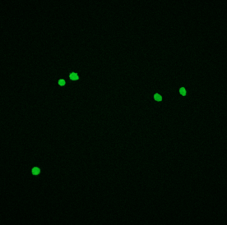
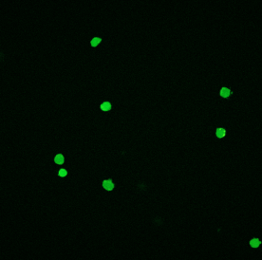
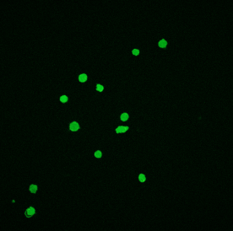
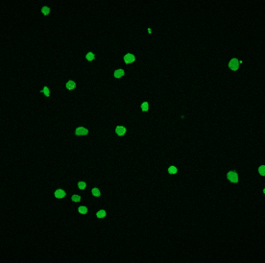
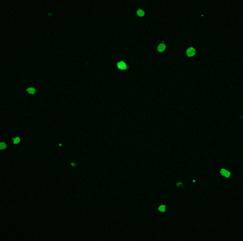
Figure S5.
a
b
No Staining
NC
GEM
15m
30m
60m
Cell counts
90m
120m
180m
c
0m
15m
30m
60m
CM-H2DCFDA (FITC-ROS)
(20x)
90m
120m
180m

Slide 6
Figure S6.
a
PLAG (or Olive oil)
p.o. administration daily
·····
0
12
40
(Day)
RPMI8226
Injection
Chemotherapy
(Gemcitabine)
Last measured
Tumor weights
b
Negative control (olive oil)
PLAG 500 mg/kg
Gemcitabine 80 mg/kg
PLAG/Gemcitabine 500/80 mg/kg
Gemcitabine 120 mg/kg
PLAG/Gemcitabine 500/120 mg/kg

