Slide 1
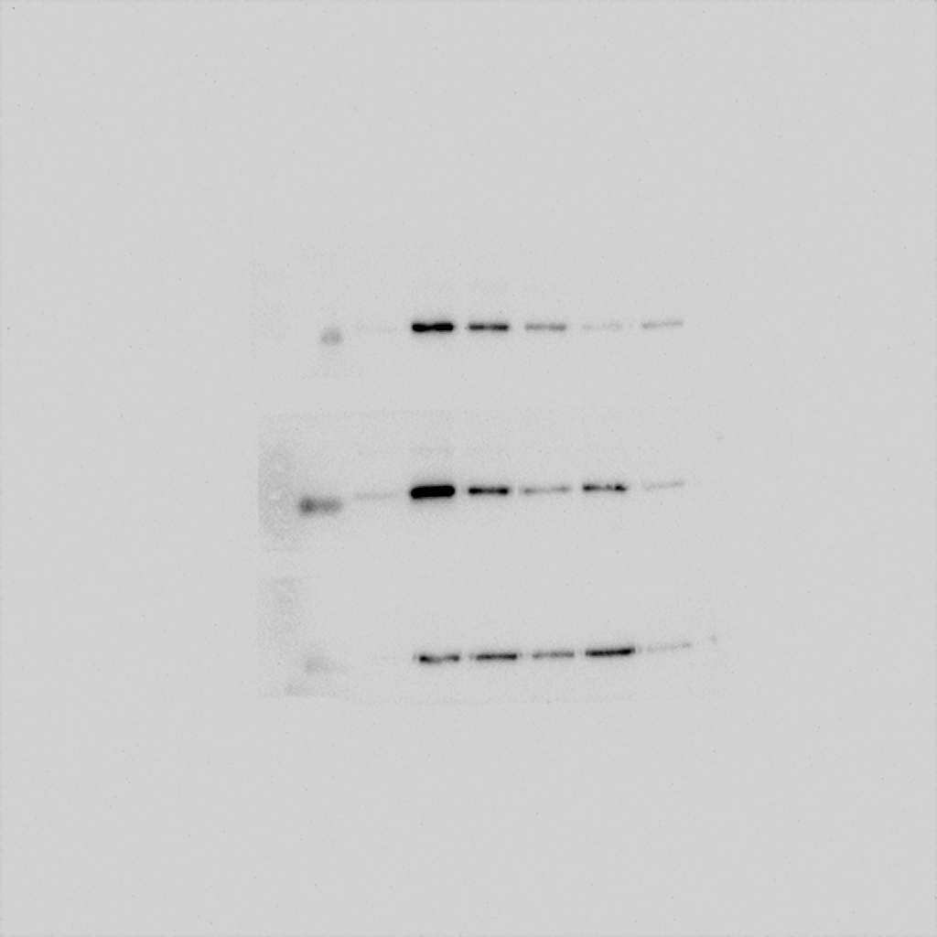

A
Rat primary microglia
*
**
**
***
***
LPS (10 ng/ml)
+
+
+
+
+
+
VCE-004.8(µM)
-
1
2.5
5
10
25
B
Rat primary microglia
LPS: - + + + + +
VCE-004.8 (μM): 0 0 1 5 10 25
α-COX-2
COX-2
α-Actin
Actin
Figure S1. VCE-004.8 inhibits COX-2 expression and PGE₂ release in LPS-stimulated rat primary microglia cells. (A) PGE₂ released was analyzed in the supernatants from primary microglia cells treated as in A. Data represent the mean ± SD (n=3). *p<0.05 **p<0.01, ***p<0.001 (one-way ANOVA followed Tukey´s test). (B) Primary microglia cells were pre-treated with increasing concentrations of VCE-004.8, then stimulated with LPS for 24 h and the expression of COX-2 analyzed by immunoblot (n=2).

