Slide 1
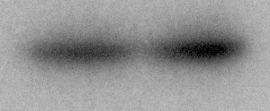
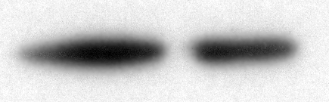
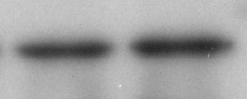
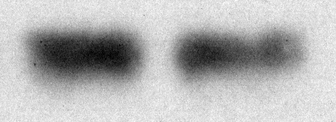
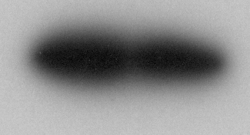
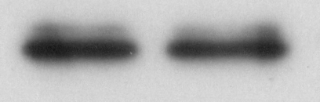

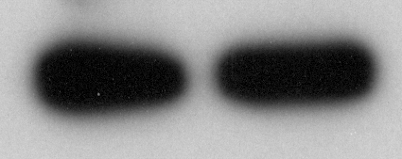
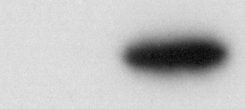
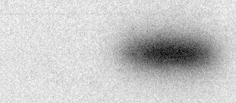
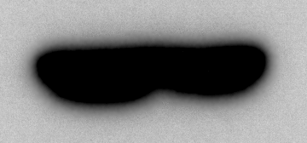

A
B
293T
293T
input
IP(HA)
input
IP(HA)
pcDNA3.1
+ | -
- | +
+ | +
+ | +
+ | -
- | +
+ | +
+ | +
pcDNA3.1
+ | -
- | +
+ | +
+ | +
+ | -
- | +
+ | +
+ | +
pcdna3.1-RHOGDIA-FLAG
pcdna3.1-RHOGDIA-FLAG
pcDNA3.1-HHEX-HA
pcDNA3.1-HHEX-HA
pcDNA3.1-CDC42-MYC
pcDNA3.1-RHOA-MYC
MYC
21 KD
MYC
21 KD
HA
34 KD
HA
34 KD
FLAG
30 KD
FLAG
30 KD
ACTB
43 KD
ACTB
43 KD

