Slide 1
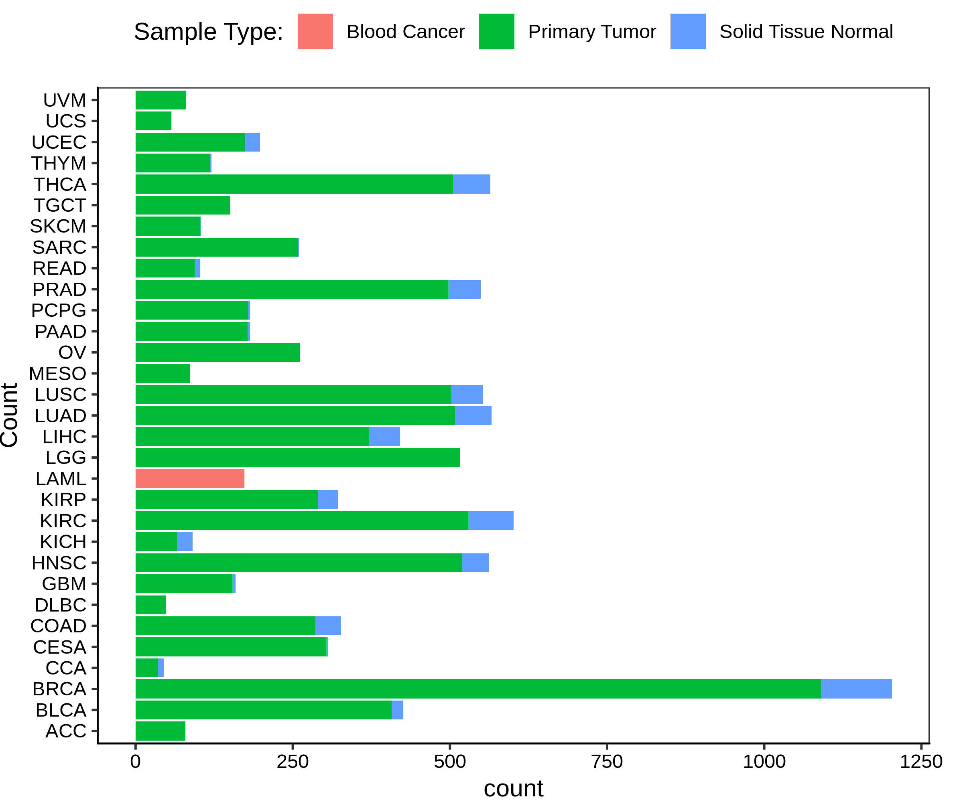
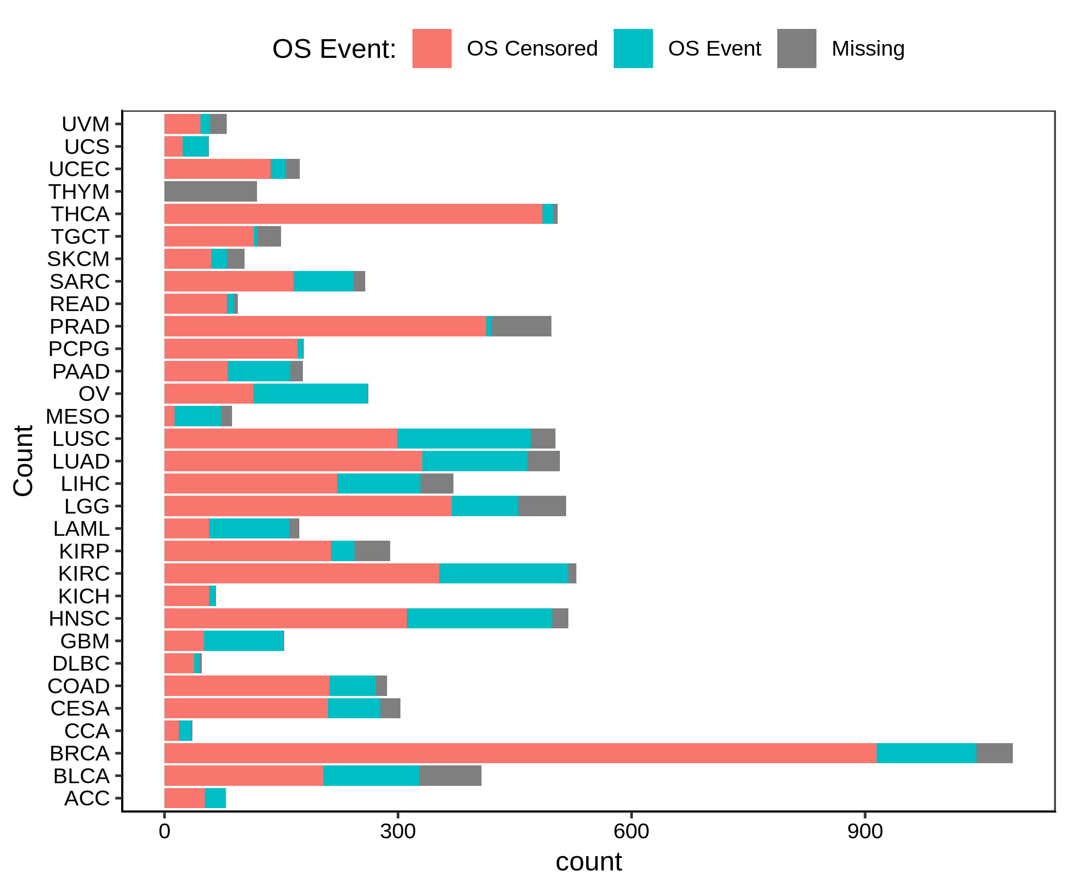
Figure S1
A
B
Notes:
Supplemental Figure1. Frequency of sample type and overall survival event in pan-cancer data. A. Frequency bar chart of number of primary tumors and number of adjacent normal. B. Frequency bar chart of number of ovarall survival event (OS_event), number of censored (OS_censored), and number of pateints without survival information (NA).
1

Slide 2
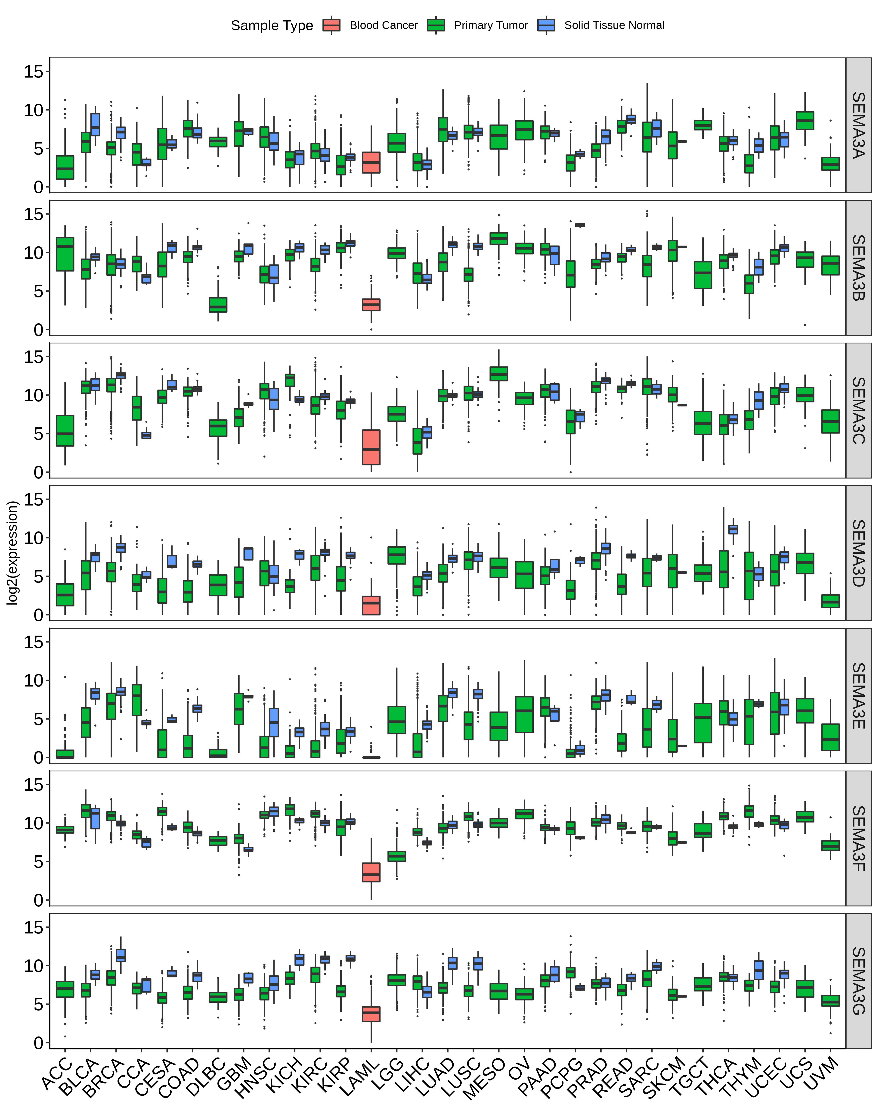
Figure S2
Notes:
Figure S2. Pan-cancer SEMA3 expression. A. Boxplot to show the expression distribution of SEMA3 members across pan-cancer. B. Heatmap for SEMA expression comparing tumor to adjacent normal based on log2foldchange. C. Corr matrix between SEMA3 family members across all 31 cancer types.
2

Slide 3
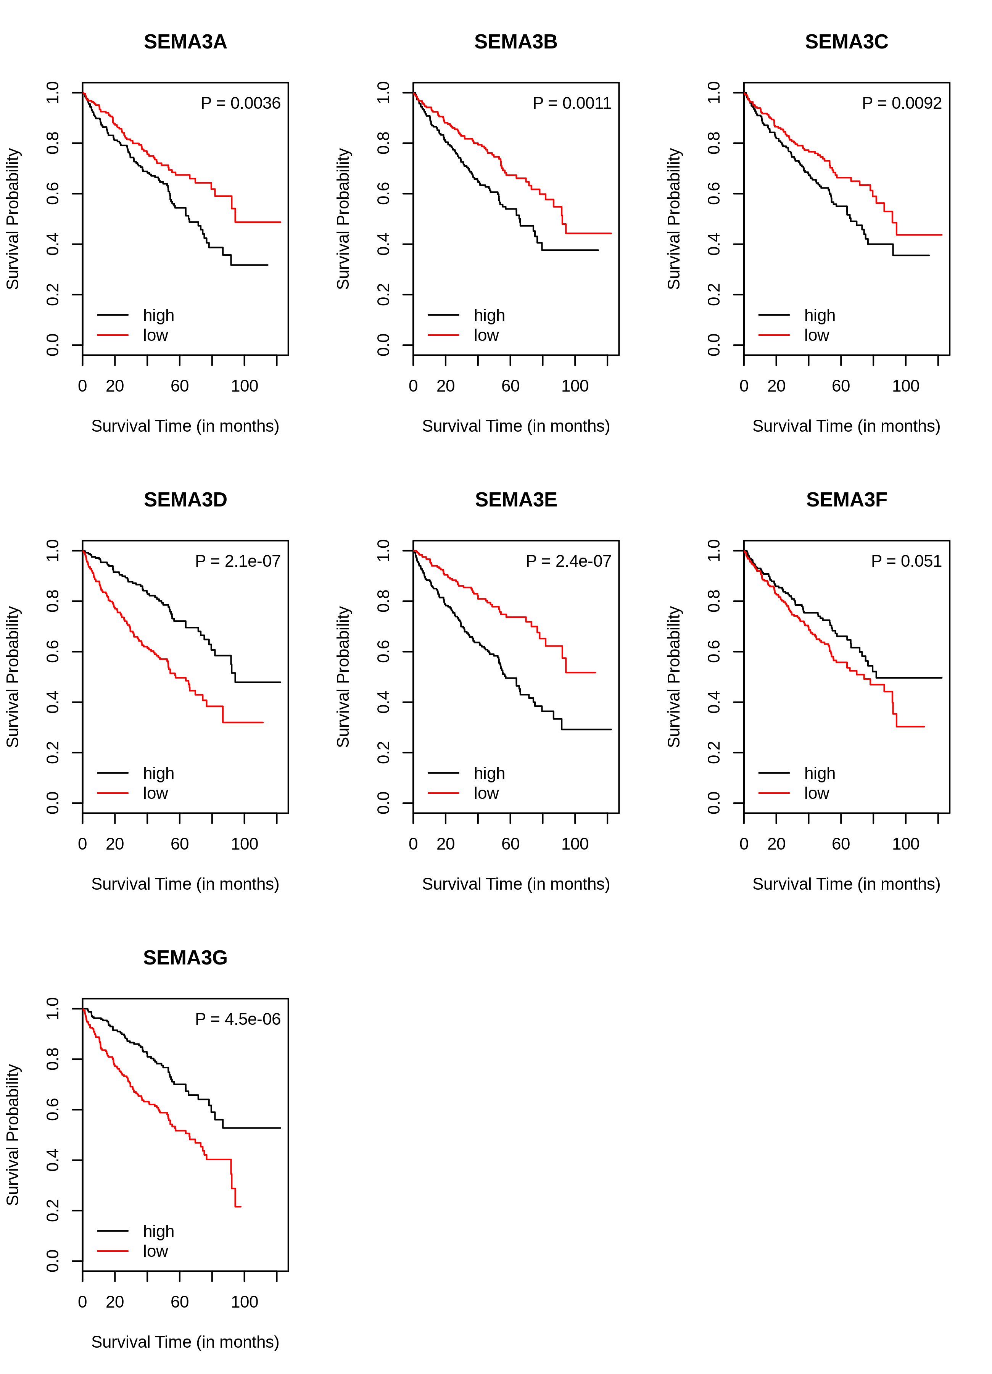
Figure S3
Notes:
Figure S3. SEMA3 expression and KIRC patient overall survival. High: expression above median. Low: expression below median.
3

Slide 4
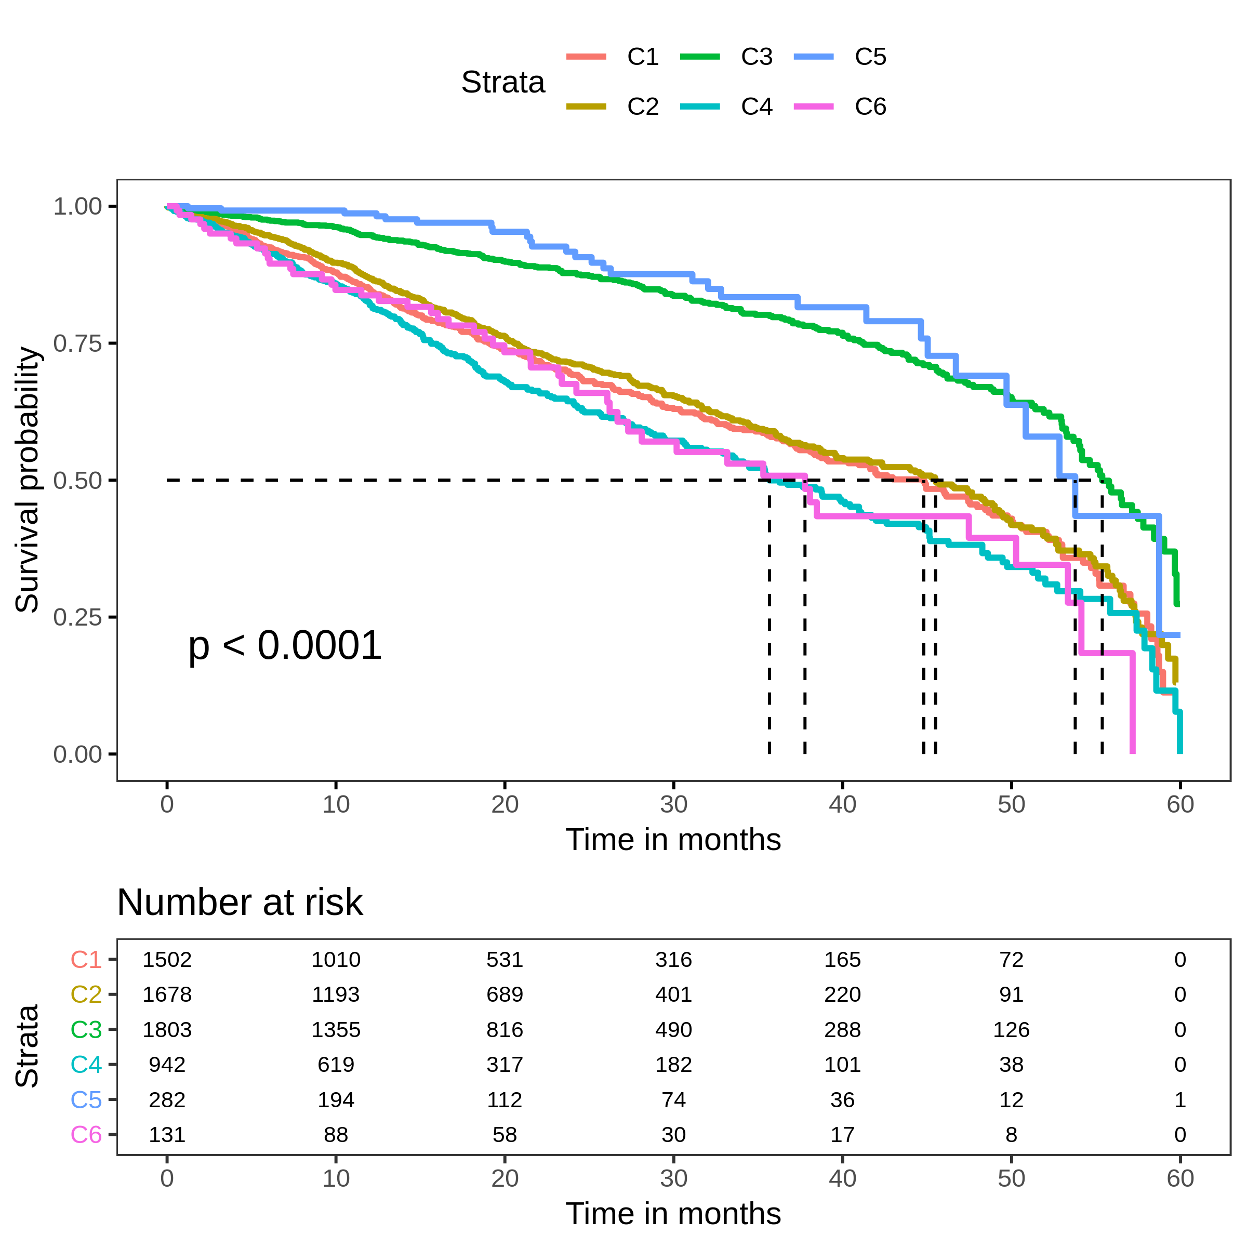
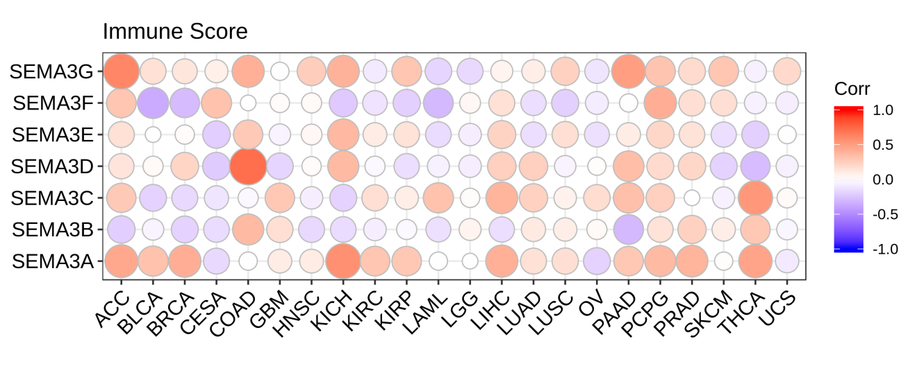
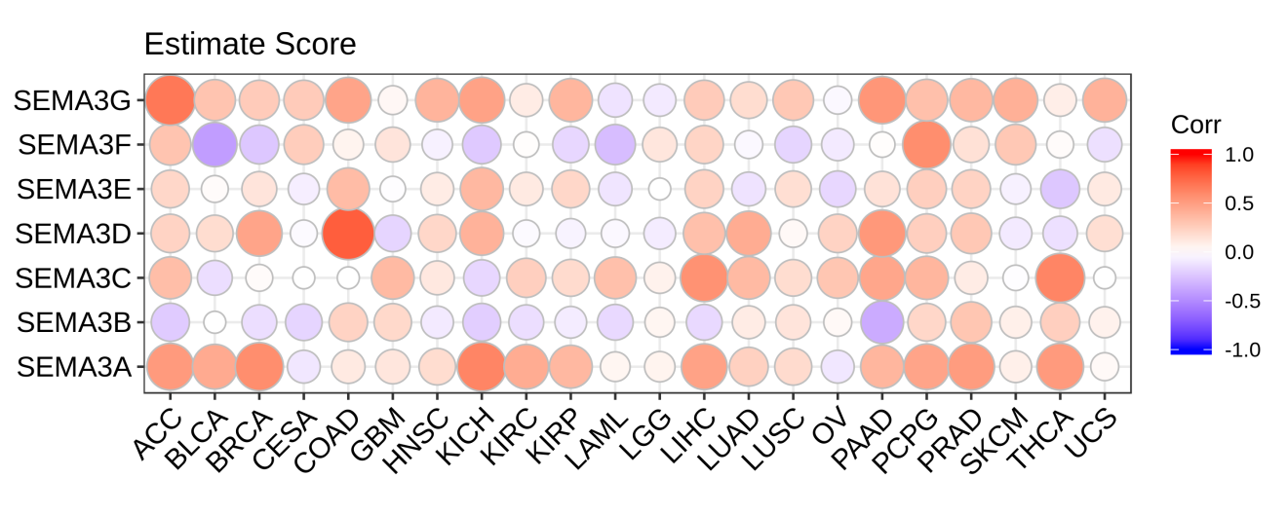
Figure S4
A
B
C
Notes:
Figure S4. A. Survival plot of patients belonging to different immune subtypes. B. Correlation matrix between expression of SEMA3 and level of immune cell infiltrates. C. Correlation matrix between expression of SEMA3 and level of tumor cell purity.
4

Slide 5
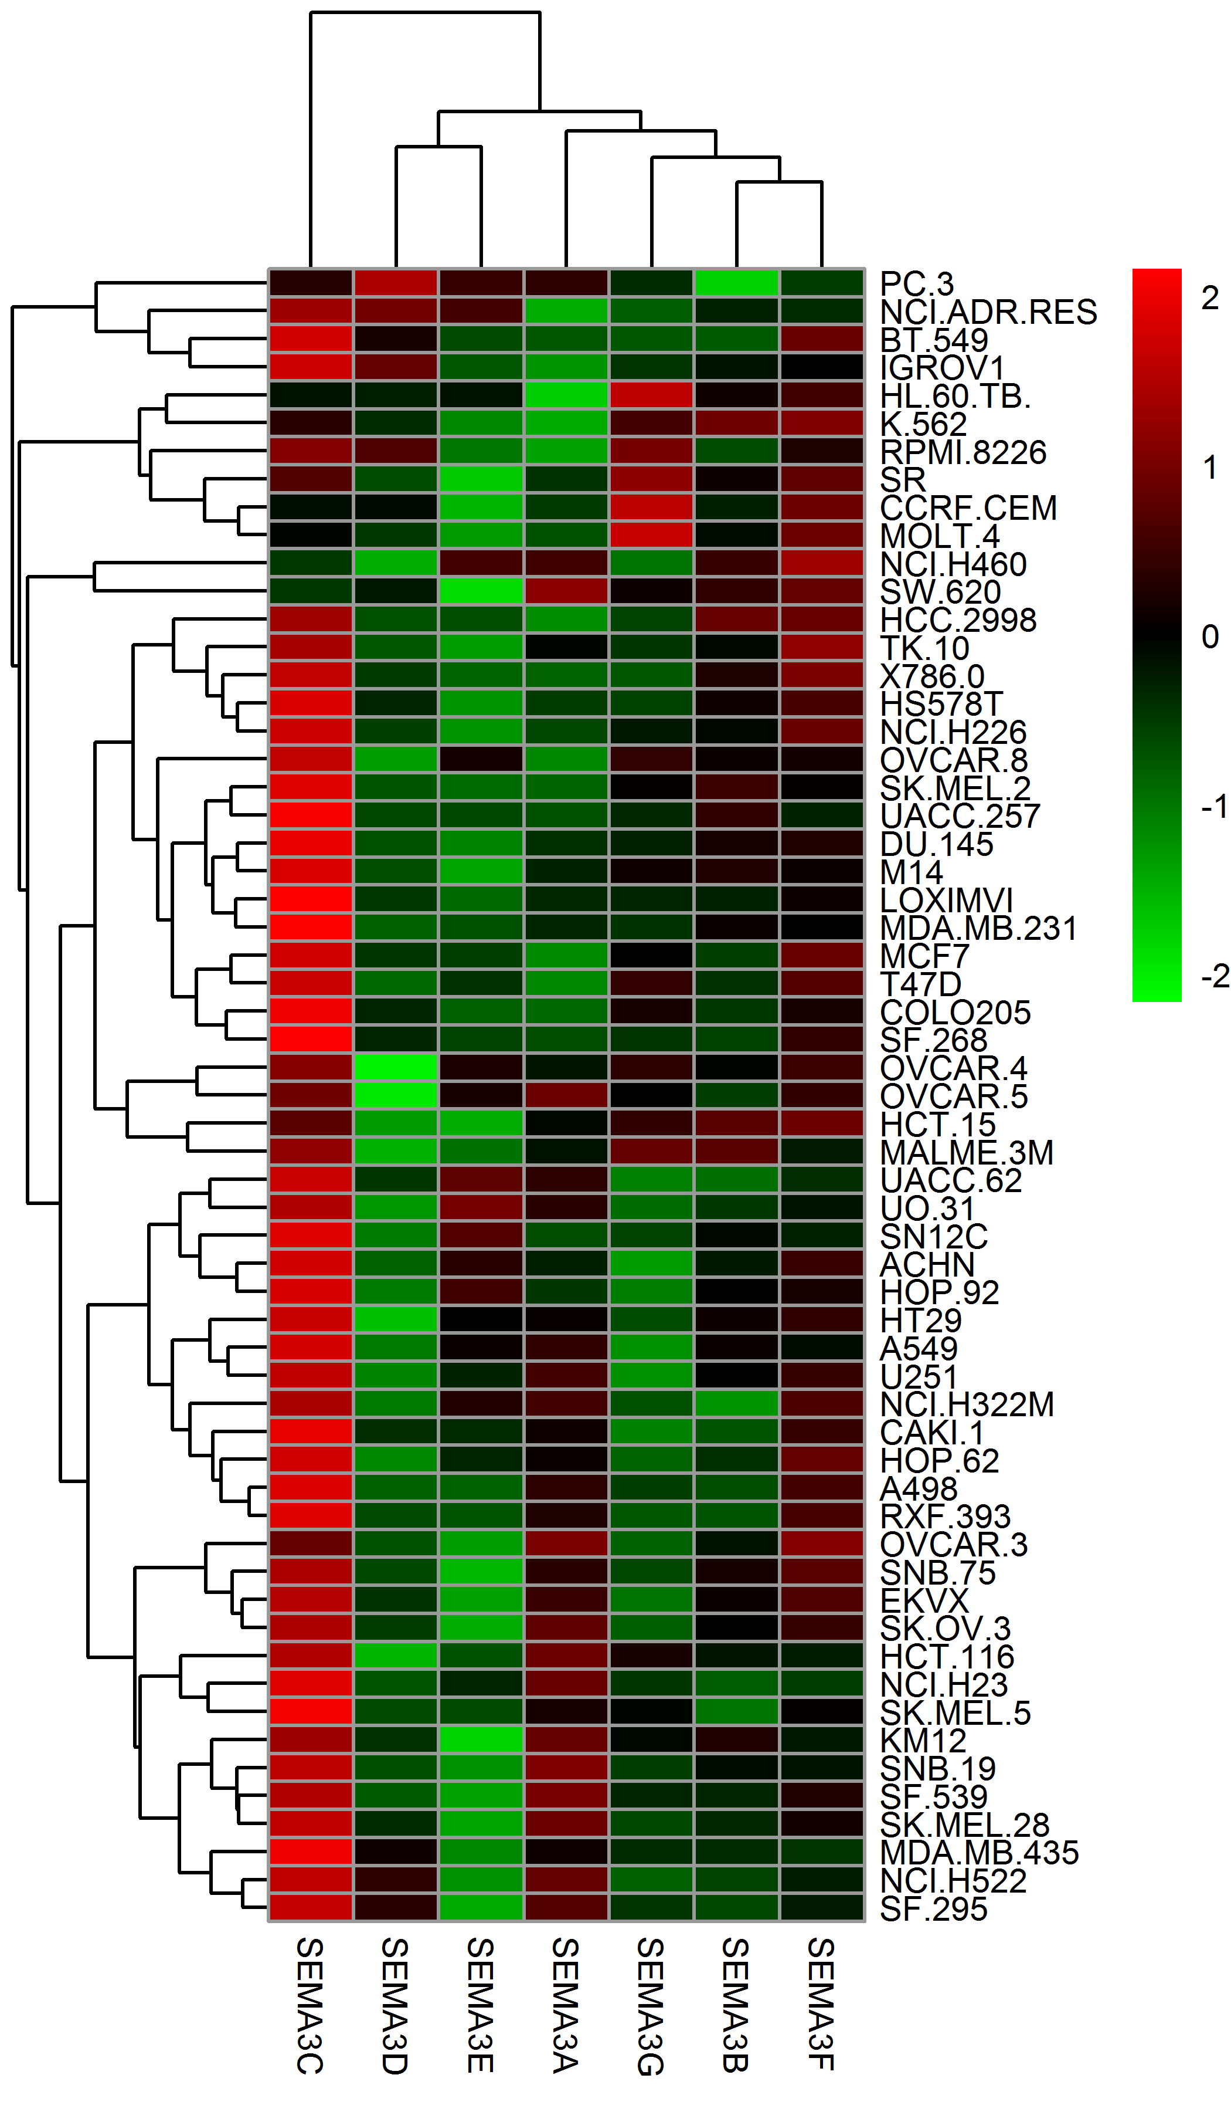
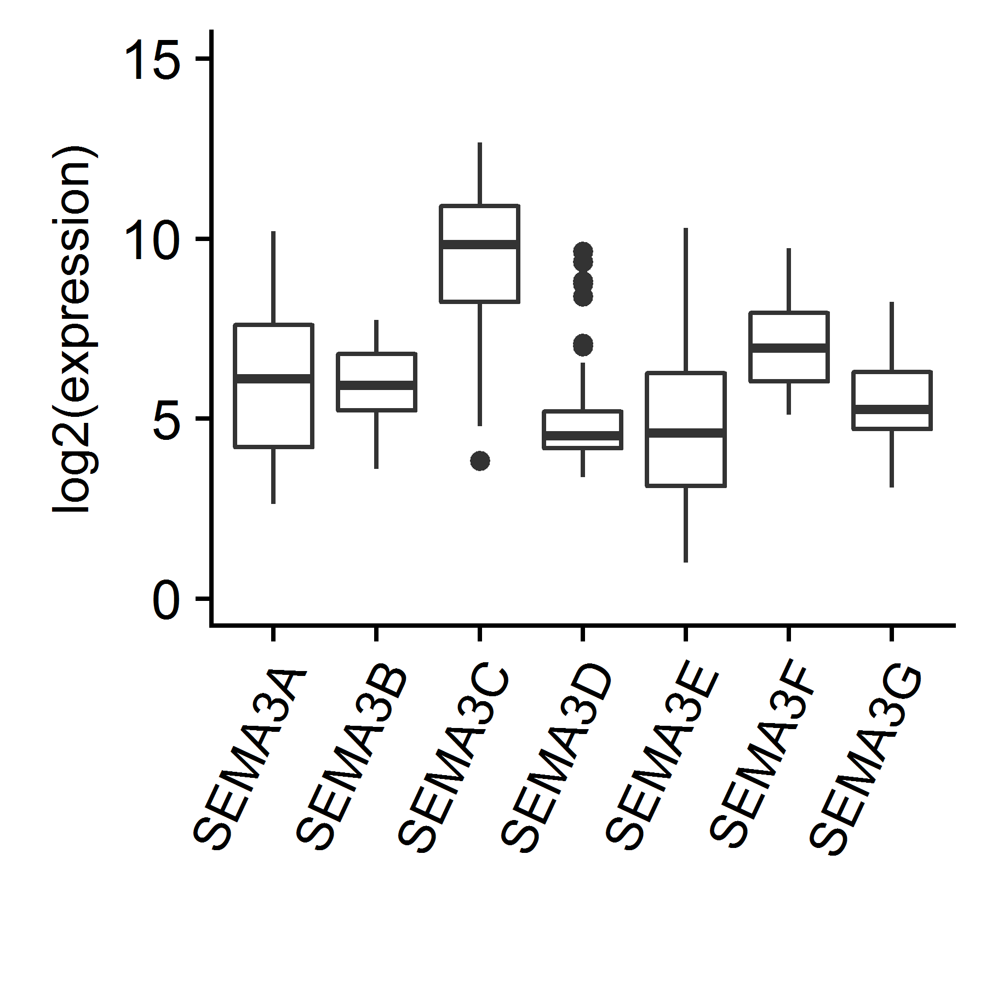
Figure S5
A
B
C
Afatinib
Bafetinib
Dabrafenib
Vemurafenib
Aminoflavone
Homoharringtonine
E−7820
Ibrutinib
Palbociclib
Nelarabine
Abiraterone
Imexon
PX−316
XK−469
Irofulven
7−Hydroxystaurosporine
Simvastatin
Carmustine
Oxaliplatin
Ifosfamide
Chelerythrine
Cyclophosphamide
Pipobroman
−4
−2
0
2
4
drug sensitivity z-score
Notes:
Figure S5. SEMA3 expression and cancer cell sensitivity to drug treatment using NCI-60 cell lines. A. boxplot to show SEMA3 exprssion across different cell lines. B. Heatmap to show SEMA3 expression in individual cell lines. C. The Z-score distritution of the drugs that associate with SEMA3 expression.
5

Slide 6
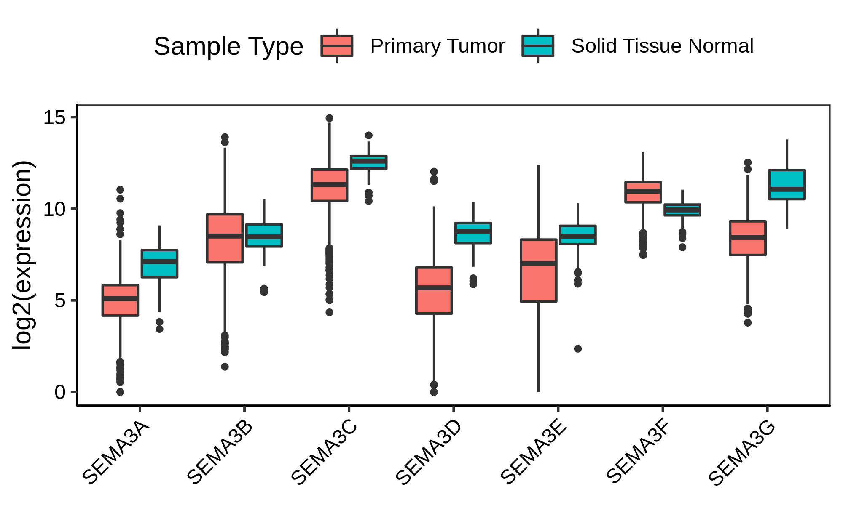
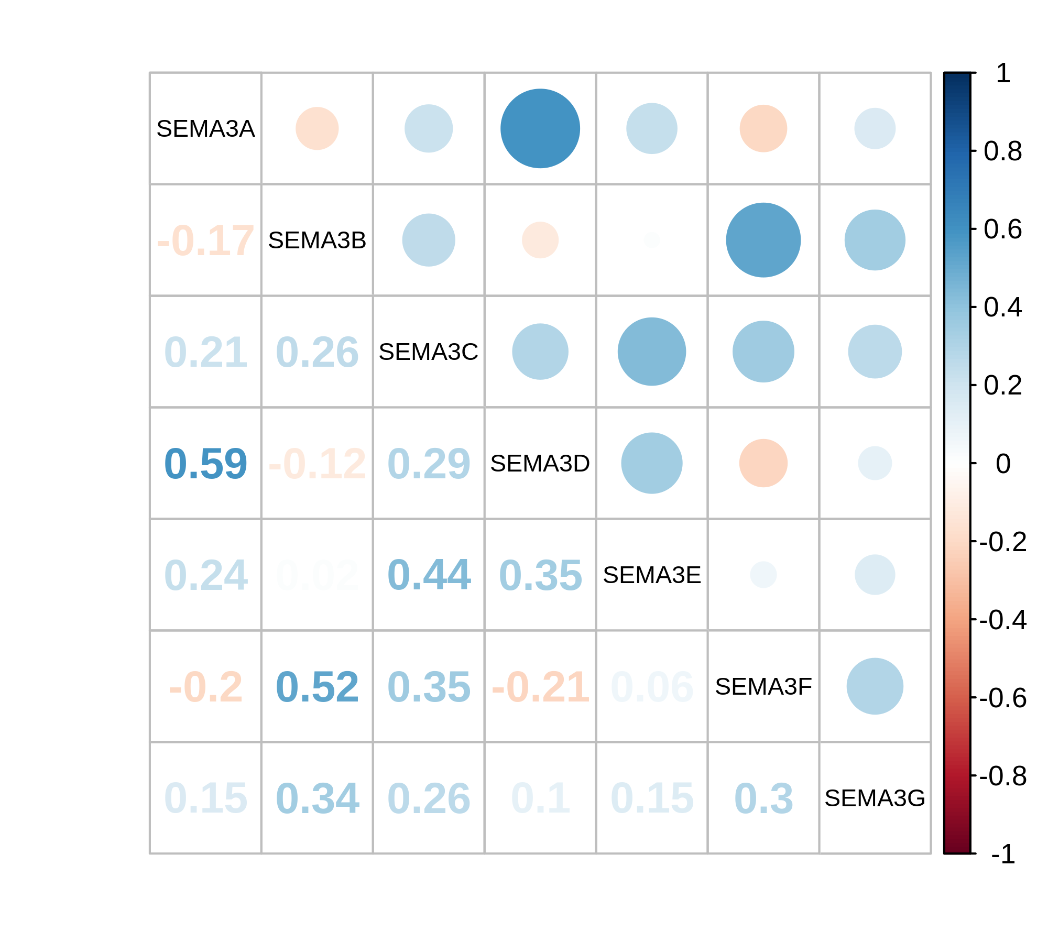
Figure S6
A
B
Notes:
Figure S6. SEMA3 expression in breast cancer. A. boxplot of SEMA3 expression between tumor and adjacent normal. B. Correlation matrix to show the correlation between members of SEMA3 family
6

Slide 7
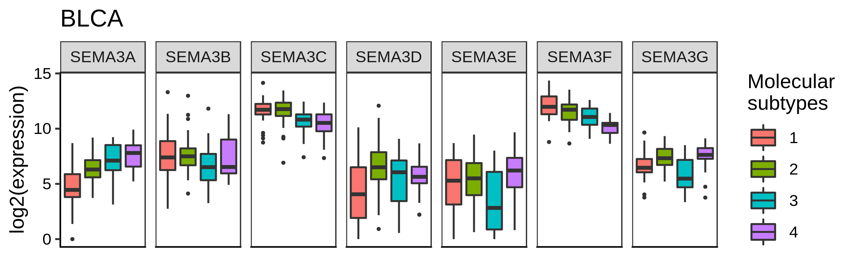
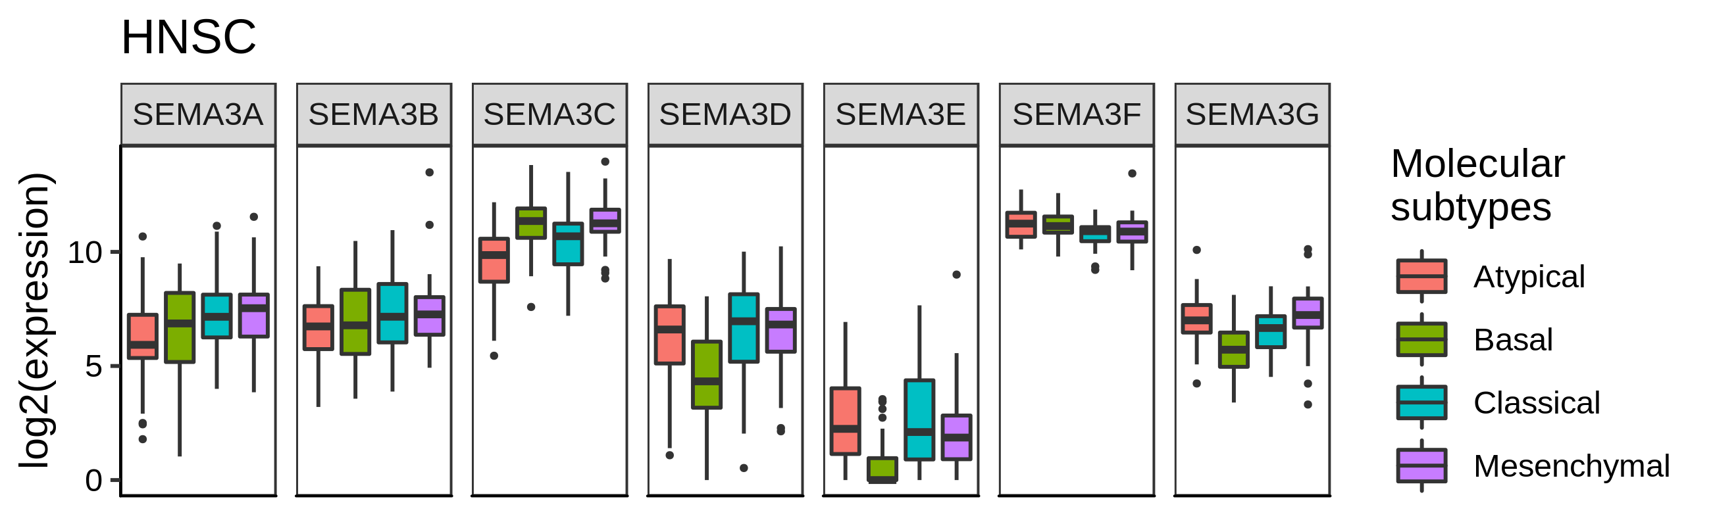
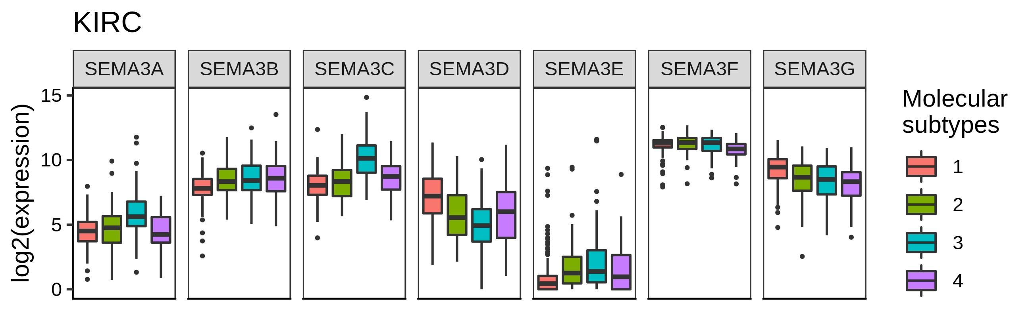
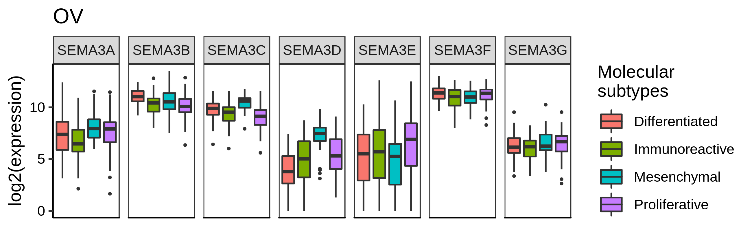
Figure S7

