Slide 1
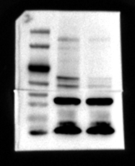
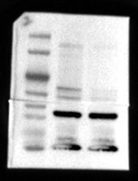
CAF
CAF
shNC
shCD36
shNC
shCD36
70
70
CD36
50
50
40
GAPDH
40
30
30

Slide 3
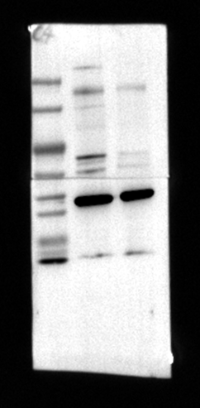
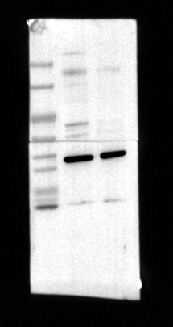
CAF
CAF
shNC
shCD36
shNC
shCD36
CD36
70
70
50
50
40
GAPDH
40
30
30

Slide 5
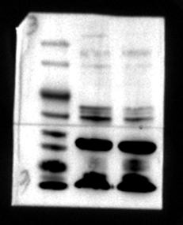
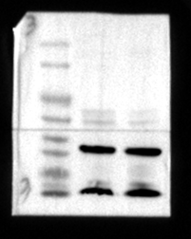
CAF
CAF
shNC
shCD36
shNC
shCD36
70
70
CD36
50
50
40
GAPDH
40
30
30

