Slide 1
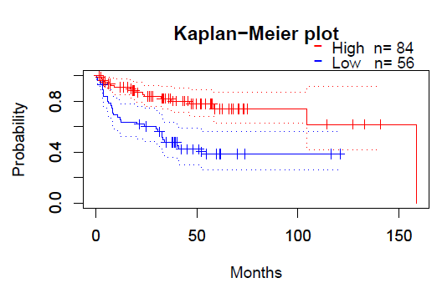
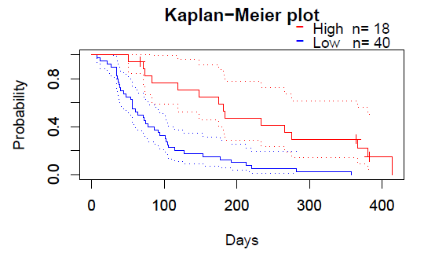
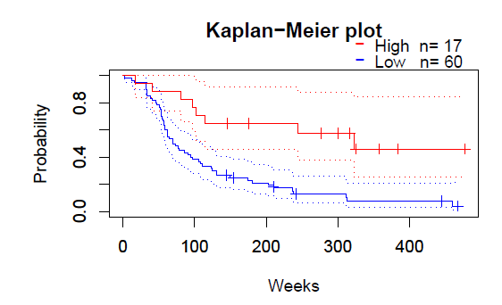
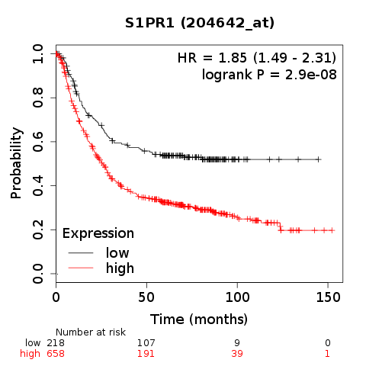
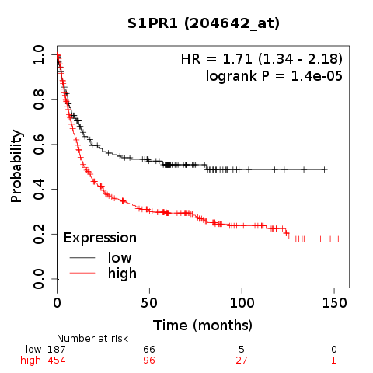
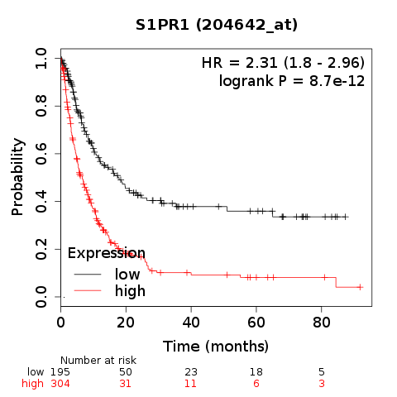
a
Soft tissue cancer, GSE30929, ID:204642_at, RFS,
HR=0.27, Cox P=0.000255
b
Blood cancer, GSE5122, ID:204642_at, OS,
HR=0.64, Cox P=0.000508
c
Brain cancer, GSE1456-GPL96, ID:204642_at, OS,
HR=0.68, Cox P=0.048802
d
e
f
Gastric cancer OS
Gastric cancer FP
Gastric cancer PPS
Figure S1

